Slide 1
Return to Play
Fall Update as of 6/18/21

Slide 2
Goals of webinar
Inform participants of all steps they must take before hosting any in person activities
Educate participants about on-site screening procedures
Discuss necessary changes to practices as well as provide recommendations and resources for social distant drills
Answer all questions related to return to play

Slide 3
Part 1: Required Trainings and Forms

Slide 4
Participant code of conduct and risk assessment form
Must be completed by EVERYONE participating in in-person activities
    i.e. coaches, volunteers, athletes, unified partners, family members (if they are present at events)
The code of conduct states that you understand you could get coronavirus through sports, training, competition, or any group activity at Special Olympics, and that you are choosing to participate at your own risk.
By signing the code of conduct you are also agreeing to take steps to help keep yourself and others safe, including staying at home if you have any symptoms, participating in temperature screenings and symptom questionnaires at every practice, and practicing proper handwashing.
Notes:
The Covid-19 Participant code of conduct and risk assessment form must be signed by all athletes, coaches, and volunteers present at any in person activities.
This form simply states that you understand you could get coronavirus through sports, training, competition, or any group activity at Special Olympics, and that you are choosing to participate at your own risk. By signing the code of conduct you are also agreeing to take steps to help keep yourself and others safe, including staying at home if you have any symptoms, participating in temperature screenings and symptom questionnaires at every practice, and practicing proper handwashing.

Slide 5
Participant code of conduct and risk assessment form cont.
Anyone who does not sign the code of conduct will not be allowed to participate in any Special Olympics activities
Violating the code of conduct can result in suspension from Special Olympics
The code of conduct can be found and submitted online at somi.org/resources
Notes:
If an individual does not sign the code of conduct, they will not be allowed to participate in any Special Olympics activities, and violating it could result in suspension from Special Olympics

Slide 6
“Coronavirus Outbreak: What you need to know” & “Return to Activities trainings”
Training must be completed by all coaches and volunteers participating in in-person events
To access trainings:
    Visit learn.specialolympics.org
    Register or log in
    Click the search icon at the top of your screen
Once you complete the two trainings email your completion certificates to your regional office
    Northern/UP areas: somiforms@somi.org
    Southwest areas: sw.forms@somi.org
    Southeast areas: se.forms@somi.org
Notes:
Next up we have the Coronavirus Outbreak: What you need to know & Return to Activities trainings. These two trainings must be completed by all coaches and volunteers participating in in person activities. These trainings can be done online by going to learn.specialolympics.org. Once you are at that sight you will need to register for an account or sign in if you already have an account. Once signed in click on the search bar at the top of the site and type in the training name.
Once you complete the training email copies of your certificate to your regional office.

Slide 7
Finding the forms and trainings
Go to www.somi.org
Click on Sports → coaches corner
Scroll down under the picture and click on “Step 2”
All of the trainings will be listed here
Notes:
Open browser and show

Slide 8
Part 2: Practice Protocols

Slide 9
Conducting practices
Beginning July 12th:
  Each coach may coach a maximum of 16th athletes
  The coach and chaperone ratio will be enforced
    For every 4 athletes you must have 1 chaperone
  There may be no more than 50 people at a location at a time
  Any events, tournaments, or games must be approved by SOMI before they are held
  Athletes are required to attend 8 weeks of training prior to a State Events
Notes:
Beginning on July 12th each coach may coach up to 16 athletes. Keep in mind that the coach and chaperone ratios will still be enforced, so for every 4 athletes you will need to have 1 chaperone.
There may be no more that 50 people at a location at a time and any events or tournaments must be approved by SOMI before they are held. Also, remember athletes must be training for a minimum of 8 weeks prior to a state event.

Slide 10
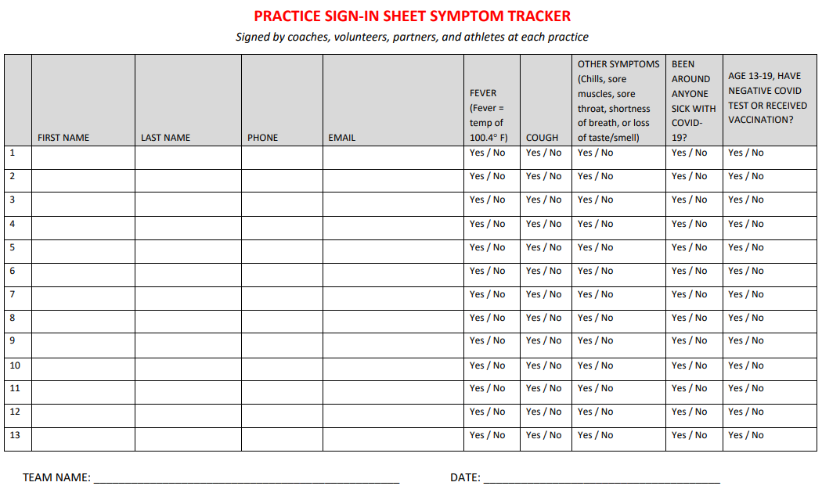
Submitting your initial roster
Before beginning practice you must submit a roster to your regional office for approval
Roster includes all coaches, volunteers, unified partners, athletes, and anyone else attending practices
SOMI will check to ensure all participants have completed the necessary forms and that athletes are up to date on the physicals before giving approval for teams to practice
Teams may not begin practicing until they receive approval from SOMI
Notes:
Before beginning practice you must submit a roster to your regional office for approval
Roster includes all coaches, volunteers, unified partners, athletes, and anyone else attending practices
SOMI will check to ensure all participants have completed the necessary forms and that athletes are up to date on the physicals before giving approval for teams to practice
Teams may not begin practicing until they receive approval from SOMI

Slide 11

Preparing your venue

Slide 12
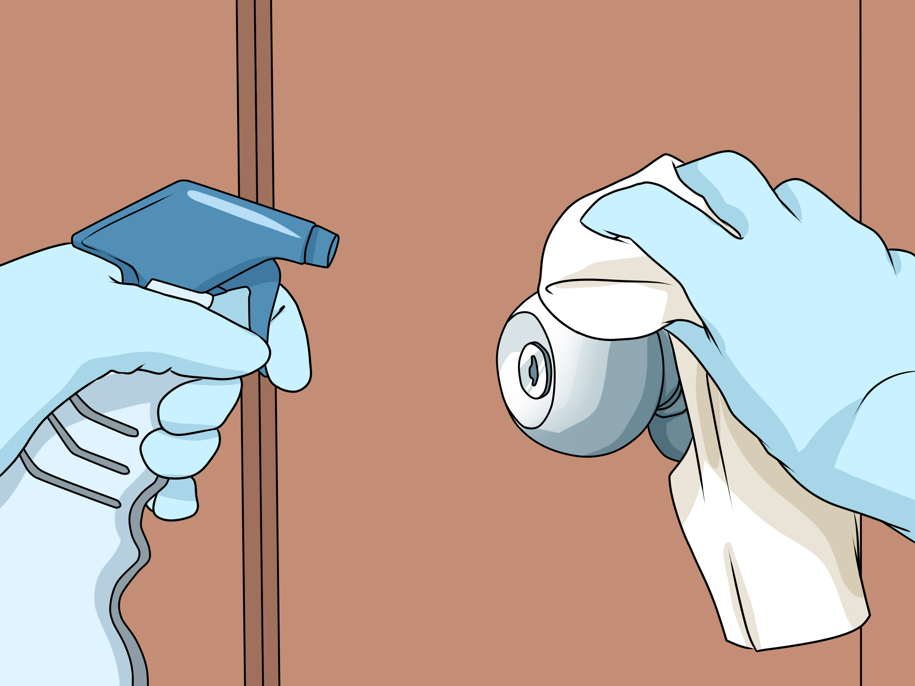
Clean & disinfect high touch areas such as bathrooms, door handles, and tables
Make sure to always wear gloves when cleaning or handling trash!
Notes:
Preparing the venue to safely welcome participants is vital. Arrive early to prepare the space. Start by ensuring the venue is disinfected, especially the bathrooms and other high touch areas. Wear gloves for all tasks in the cleaning process, including disinfecting areas and handling trash.

Slide 13

Hang signs around the venue to help everyone remember the new rules
These signs can be printed from https://resources.specialolympics.org
Notes:
After disinfecting your venue, we recommend hanging signs reminding athletes and volunteers to follow social distancing rules, and to wash their hands often.
Signs like the one shown here can be printed from the Special Olympics website.

Slide 14
Arriving to practice
Participants should wear a facemask in vehicles if taking public transportation or carpooling
Stagger arrival times to avoid crowds in the entrance area
    Athletes arrive at 5-minute intervals
    Athletes wait in the vehicle or parking lot until coach signals to enter
Make sure athletes bring a full water bottle
    Drinking fountains should not be used
Notes:
If individuals are taking public transportation or carpooling to practices, we strongly recommend they wear a facemask while doing so.
Coaches should try to stagger arrival times to avoid crowds or congestion in the entrance area. This could mean that athletes arrive at 5-minute intervals or that athletes are instructed to wait in their vehicles until the coach signals them to enter.
As athletes arrive check to make sure they have a full water bottle as they are not able to share and drinking fountains should not be used

Slide 15
Onsite screening
All participants (including coaches and volunteers) must complete onsite screening upon arrival
Create a safe screening area:
    Single point of entry
    Mark 6 feet for physical distancing
    Hand sanitizer stations at entrance
Notes:
Prior to entering any activity, practice, event, or gathering all participants, including the coach and volunteers, must participate in an onsite screening. It is important to create a safe screening area. Here are a few tips on how you can create a safe space:
Create a single point of entry. One entryway helps ensure that all participants are screened before interacting with each other.
Use chalk, tape, cones, or other markers to indicate 6 feet for physical distancing
Set up a hand sanitizer station at the entry way and require all participants to use it as they enter

Slide 16
Onsite screening: Roster
Roster must be completed at the start of every practice or event
Names may be pre-entered to save time
Recommend having one volunteer sign everyone in
    If each individual signs themselves in, you must provide one pen per person
Rosters must be submitted to your regional office weekly by Monday at 8am. Coaches should keep copies of their rosters
Notes:
Upon arrival a volunteer should fill out a roster which will include the participants name, contact information, temperature, answers to the screening questions, and the outcome of the screening – for instance, can they participate or have they been isolated and sent home. If you choose to have participants sign themselves in, then be sure to bring enough pens so each person has their own. Make sure to keep all of the sign in sheets incase a participant is later found to have COVID-19 and contact tracing is necessary. Coaches must also submit copies of their sign in sheets to their regional office after every practice.

Slide 17
Onsite Screening Cont.
Screening questions include:
  In the last 14 days have you had contact with someone who has been sick with COVID-19?
  Have you had a fever in the last week (100.4 or higher)?
  Do you have a cough and/or difficulty breathing?
  Do you have any other signs or symptoms of COVID-19 (such as loss of taste or smell, fatigue, or headaches)?
Following screening questions temperature checks will be done
  If higher than 100.4 wait and retest after 5 minutes
Notes:
The screening questions include:
In the last 14 days have you had contact with someone who has been sick with COVID-19?
Have you had a fever in the last week (100.4 or higher)?
Do you have a cough and/or difficulty breathing?
Do you have any other signs or symptoms of COVID-19 (such as loss of taste or smell, fatigue, or headaches)?
After answering the screening questions, you will conduct temperature checks using a thermometer. If the participant has a fever of 100.4 or higher you should retest the participant after 5 minutes.

Slide 18
What if someone fails the screening?
If anyone answers yes to the screening questions or has a fever of 100.4+ they will be sent home or isolated from other participants
Parents/caregivers should wait 10 minutes before they leave incase their athlete fails the screening
Athletes who carpool, take public transportation, or have their ride leave may wait in an isolation area.
Coach may provide drills and exercises for isolated athletes
Recommend they see a healthcare provider
Must be symptom free for 7 days or have a written doctors note in order to return to practice
Notes:
If a participant answers yes to any questions or have a temperature of 100.4 or higher they must be isolated from the group and sent home if possible. Participants should advise their transportation to wait 10 minutes after they get dropped off just in case they do not pass the onsite screening tests. If they took public transportation or have to wait for a ride to return, they should wait in a designated isolation area. The coach may provide individual drills and exercises for the athlete to do in the isolation area
Participants that show symptoms of COVID-19 must be symptom free for 7 days before returning to activity or must provide a note from a physician stating they may return to Special Olympics activities. If a participant tests positive for COVID-19 they must provide a doctor’s clearance note before returning to activities

Slide 19
Part 3: Practice Adjustments

Slide 20
Practice adjustments
Enforce 6 ft. of distance in all space utilized
    Use cones or markers to visually show
    Includes team area where athletes keep belongings, warm-up area, and drill space
Enforcing new team rules
    No high-fives, fist bumps, team huddles or hugging
No sharing supplies or personal equipment
    All athletes should bring their own water bottles & may not share
    Cannot share uniforms (including practice pennies) or towels
Any shared sports equipment must be disinfected between athletes and at the end of practice
Notes:
Coaches need to be prepared to adjust some of their coaching strategies to lead safe practices.
During practice it is important to maintain physical distancing of at least 6 feet between all participants. To do this the coach should place makers on the ground in all spaces you will be utilizing. This includes markers for your team area where your athletes will keep their belongings and water bottles, stretching and warm up spots, and markers for any drills you do.
We know it is difficult, but coaches must also communicate and enforce new practice rules such as no fist bumps, high-fives, hugs, or huddles. Instead challenge your athletes to come up with a new celebration technique such as a team cheer, expression, or air fives!
All participants should come with their own supplies, such as water bottles, and cannot share masks, water bottles, towels, or uniforms. Sharing of equipment should be limited or avoided. Any equipment that is shared must be disinfected between uses as well as at the end of practice.

Slide 21
Practice adjustments cont.
Stagger water breaks
Bathroom breaks one at a time
Injury assessment:
    Use gloves
    Wear a mask
    Wash hands for 20 seconds
Make sure to cool down! COVID-19 is easily spread from heavy breathing so breathing should be slowed to normal before getting in a vehicle
Notes:
Coaches should stagger water breaks as to avoid crowding. Bathroom breaks should be given one person at a time
When assessing injury or providing care coaches should make sure to wear a mask and gloves and practice universal precautions. After any injury assessment or treatment make sure to wash your hands.
Make sure to leave time in your practice for a cool down. Heavy breathing and sweat can pass particles containing COVID-19, so athletes should have their breathing slowed and heartrate back to normal before entering an enclosed space like a car or bus.

Slide 22
Leaving practice
Stagger departure
Wash/sanitize hands
Sanitize all equipment
Notes:
Coaches should stagger practice departure to avoid congestion in the parking lot. Instruct parents/caregivers to wait in their cars. Participants should also sanitize their hands as they leave practice. Finally, the coach or volunteer should sanitize all equipment used.

Slide 23
Section 1 Summary
Before you begin | During Practice | After Practice
Attend return to play webinar – coaches | Complete roster sign in sheet | Submit your roster sign in sheet to your regional office
Complete Coronavirus Outbreak: What you need to know online training – Coaches & Volunteers | Answer screening questions | Notify SOMI if anyone does test positive for covid-19
Complete Return to Activities online training – Coaches & Volunteers | Social distancing whenever possible
Complete COVID-19 Participation waiver and risk assessment form – Everyone attending practice!
Submit your roster to your regional office
Receive approval from SOMI to begin practice
Notes:
Finally, here is just a quick summary of the requirements before you start your season, during practice, and then after practice.
(Read slide)

Slide 24
Questions?

