Slide 1
Weightlifting Official Rules

Slide 2
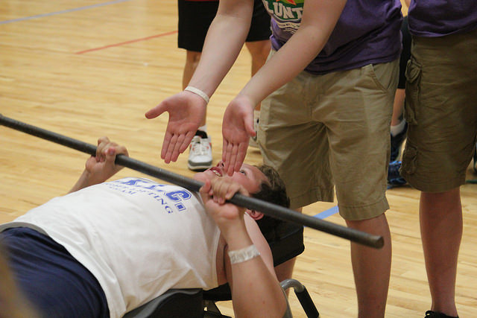
“Let me win, but if I cannot win, let me be brave in the attempt.”

Slide 3
The Basics
Sport season:
  February - June
Culminating State Events:
  State Summer Games

Slide 4
Events Offered
Sit-Ups
Exercycle
Modified Push-Ups
Modified Bench Press

Slide 5
Weightlifting Uniform
Uniform is a one-piece singlet that is close-fitting, collarless, and does not cover the knees, or a T-shirt and shorts.
  A T-shirt may be worn under one-piece.
The uniform can be any color.

Slide 6
General Rules
The correct bar weight for the modified bench press is 12 lbs.
Athletes entered in weightlifting events may not enter powerlifting events at State Summer Games.
  Weightlifting and Powerlifting are considered separate and unique sports.

Slide 7
Sit Ups
The event can be conducted on level ground or on gym mats laid on the floor.
Athlete will start in supine position with knees bent and feet flat on the floor.
  Athlete’s feet are held to the floor by competition assistants.
  Athlete keeps arms folded across his/her chest with hands grasping opposite shoulders during this event.
  Athlete begins sit ups when the whistle blows and has 60 seconds
  To perform a complete sit-up, and athlete must touch one of his/her elbows to the thighs or knees.
  One point is awarded per sit up conducted over a 60 second period.

Slide 8
Exercycle
Place the exercise bike on level ground and keep the wheel tension the same for all athletes grouped in a division.
  Athlete starts this event sitting on the bike with feet on the pedals in any position. Athlete may receive assistance to stay on the bike, but not pedaling
  If the athlete's feet fall off the pedal, he/she may put them back on to the pedals and resume pedaling. The athlete has the option of strapping his/her feet to the pedals in order to prevent them from slipping.
  Athlete begins pedaling at the whistle for 60 seconds.
  Total score will be the number of revolutions made over the 60 second period.

Slide 9
Modified Push Ups
Athlete performs push ups form the kneeling position.
  During the modified push-ups, the athlete’s chest must touch the floor for a legal push-up to be counted.
  Athlete attempts to perform as many legal push-ups as possible during a 60 second time period.
  In order to perform a legal push-up, the athlete must lower his/her head and upper body to the floor, touch the chest to the floor, and return to the starting position. The athlete’s back must remain straight.
  The push ups do not have to be performed continuously.
  No assistance may be given to the athlete.
  One point is awarded per push up over the 60 second period.

Slide 10
Modified Bench Press
Set the bench on level ground or on gym mats.
  Correct bar weight for modified bench press is 12 lbs.
  Athlete starts with the bar resting across his/her chest.
  One press is designated as starting and finishing with the bar touching the athlete's chest, in between which the athlete presses the bar straight up above his/her chest until the arms are straight.
  Athlete will begin at the whistle and press for 30 seconds.
  One point is awarded for each bench press over the 30 second period.

