Slide 1
Weightlifting

Slide 2
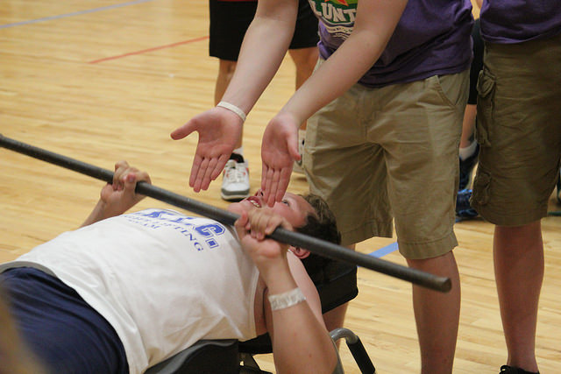
“Let me win, but if I cannot win, let me be brave in the attempt.”

Slide 3
The Basics
Sport season:
  February - June
Culminating State Events:
  State Summer Games

Slide 4
Events Offered
Sit-Ups
Exercycle
Modified Push-Ups
Modified Bench Press

Slide 5
Uniform

Slide 6
Weightlifting Uniform
One piece that is close-fitting, collarless, and does not cover the knees, or a T-shirt and shorts.
The uniform can be any color. A T-shirt may be worn under one-piece.

Slide 7
General Rules

Slide 8
General Rules – Modified Push Ups
During the modified push-ups, the athlete’s chest must touch the floor for a legal push-up to be counted.
Athlete attempts to perform as many legal push-ups as possible during a 60- second time period.
In order to perform a legal push-up, the athlete must lower his/her head and upper body to the floor, touch the chest to the floor, and return to the starting position. The athlete’s back must remain straight.

Slide 9
General Rules Sit Ups
  Athlete’s feet are held to the floor by competition assistants.
  Athlete keeps arms folded across his/her chest with hands grasping opposite shoulders during this event.
  To perform a complete sit-up, an athlete must touch one of his/her elbows to the thighs or knees.

Slide 10
General Rules – Modified Bench Press
Athlete starts with the bar resting across his/her chest.
One press is designated as starting and finishing with the bar touching the athlete's chest, in between which the athlete presses the bar straight up above his/her chest until the arms are straight.

Slide 11
General Rules - Exercycle
Equipment: Exercise bike (stationary and with odometer), stopwatch, and whistle.
Athlete starts this event sitting on the bike with feet on the pedals in any position
Athlete may receive assistance to stay on the bike, but not pedaling
If the athlete's feet fall off the pedal, he/she may put them back on to the pedals and resume pedaling. The athlete has the option of strapping his/her feet to the pedals in order to prevent them from slipping.

Slide 12
Thank you.

