Slide 1
Volleyball Official Rules

Slide 2
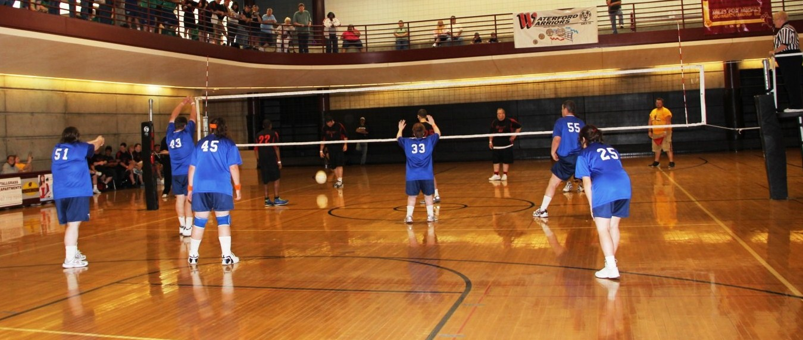
Events Offered
Team Competition
Unified Team Competition
Modified Team Competition
Individual Skills Competition

Slide 3
Uniforms
Team uniforms consist of a jersey, shorts, socks and athletic shoes.
Knee pads are recommended, but not required.
Numbers should be on the front and back center of the uniform and be of a contrasting color of the uniform color.
  Legal uniform numbers should range from 1-99.
All athletes on a team wearing undergarments including t-shirs, tights or compression shorts must have like colored undergarments.
Jewelry, hats, visors and bandanas are prohibited.
Denim is not allowed to be worn during competition.

Slide 4
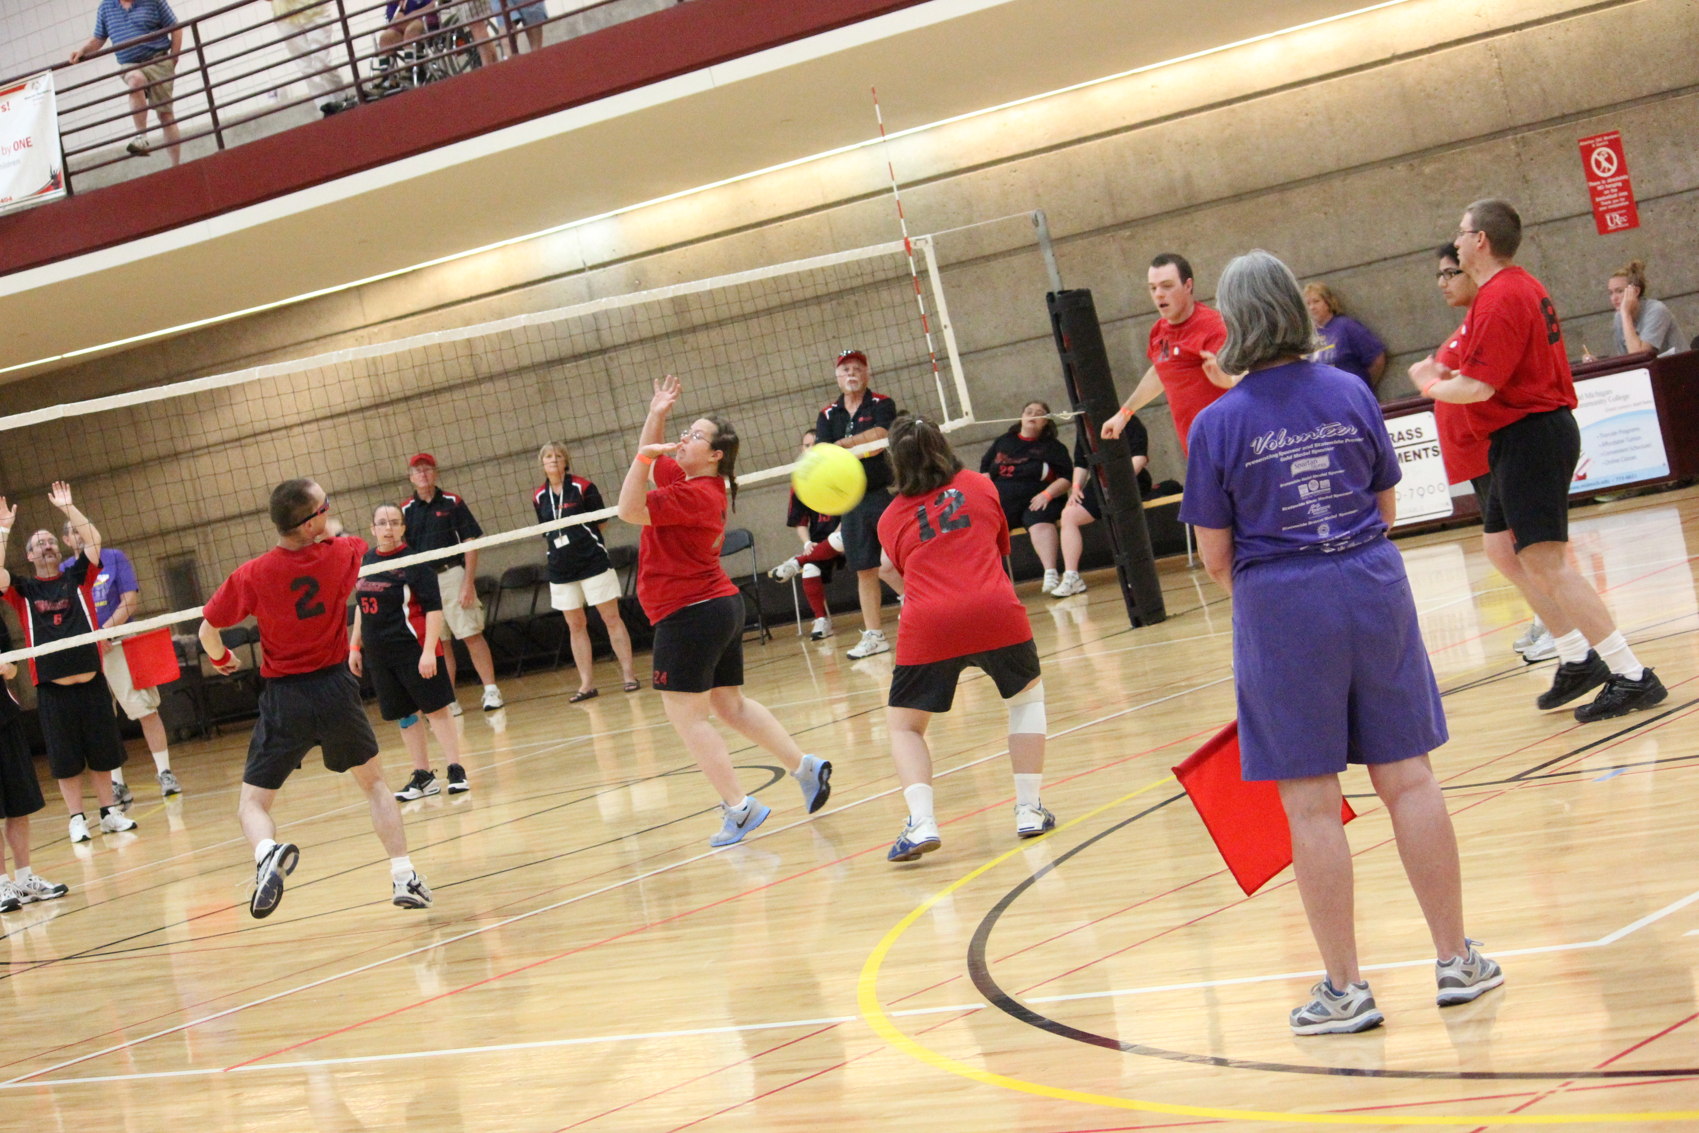
Uniforms
All team uniforms must have the Special Olympics Logo adorned somewhere on the jersey.
  Logos may be placed on the front, back or sleeve and may be located on the top or bottom of the uniform and should be visible.
  Logos may be screen printed or embroidered or may be part of a patch or sticker.

Slide 5
Team Size
Volleyball rosters must have a minimum of 7 players and a maximum of 12 players.
  A game must start with 6 players present but can continue with fewer due to injury or ejection.
There are six players on the court for each team during match play.

Slide 6
Substitutions
A team is allowed a total of 12 substitutions per set; each player may substitute in a max of 3 times per set.
  Starting a set constitutes one of the entries.
  Players who re-enter the set must assume their original position in the serving order in relation to their teammates.
  Substitutes may take place at the start of each set, or when the ball is out of play after a point has been scored.

Slide 7
Volleyball Court
Court size: 59 feet long by 29 feet 6 inches wide.
Net Height:
  Traditional Male, Co-ed & Unfied: 7 feet 11 5/8 inches.
  Traditional Female & Modified: 7 feet 4 1/8 inches.
Service line:
  Traditional Male, Traditional Female & Unified: 29 feet 6 inches from the net (back of court line).
  Modified: 14 feet 9 inches from the net.
A regulation size volleyball is used for Traditional and Unified divisions.

Slide 8
Scoring
All matches, including modified matches, will utilize Rally Scoring. You need not to be serving to score a point.
Traditional and Unified division matches will play the best 3 out of 5 sets, with the winner being the team who wins three sets.
Modified division matches will play the best 2 out of 3 sets, with the winner being the team who wins two sets.
A playoff set is considered a match, and only one game will be played.

Slide 9
Scoring
In Traditional and Unified division matches a set is won by the team that scores 25 or more points with a two-point advantage. In the case of a 24-24 tie, play is continued until a 2-point lead is achieved.
In Modified division matches a set is won by the team that scores 21 or more points with a two-point advantage. In the case of a 20-20 tie, play is continued until a 2-point lead is achieved.
In the case of a 1-1 (modified) or 2-2 (traditional and Unified) set tie, the deciding set (3rd or 5th) is played as a tiebreaker with rally point scoring procedures to 15 points and no point cap.

Slide 10
Scoring
If a team fails to serve properly, return the ball, or commits any other fault, the opponent wins the rally and scores the point.
When the serving team wins a rally, it scores a point and continues to serve. If the receiving team wins the rally, it scores a point and gains the right to serve.
Teams change sides when one team has scored eight points.

Slide 11
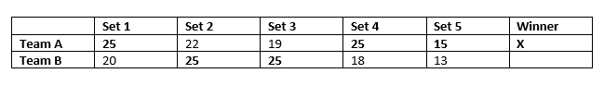
Scoring
3 match scores are due to the State Office in order to participate at State Summer Games.

Slide 12
Game Rules
The winner of the coin toss may choose to serve, receive or select a specific side of the court. If a deciding third or fifth set is necessary, a coin toss shall again be conducted with the same options.
The first server of each set is the right back player. Thereafter, the right front player rotates to the right back position. The team receiving first service shall rotate upon the first side out and receiving their serve.

Slide 13
Game Rules
Once a server has scored three consecutive points, his/her team shall rotate to the next server and continue to serve.
Serve shall be from the serving area. Stepping on or over the end line or outside the service area as defined by the sidelines upon contacting the ball or jumping to serve shall constitute a violation.
A served ball touching the net shall remain in play, and the receiving team has three plays to return the ball to the opponents.

Slide 14
Game Rules
Any ball hitting the ceiling will be considered playable by the team causing such contact, as long as the ball stays on their side of the court and does not cross the plane of the net.
A player may not play the ball twice in succession except when the first touch is while blocking.
The ball may be hit with any part of the body.
  Carries and lifts will be called illegal hits.
Any ball landing on the line is considered “in”
For safety reasons, the ‘Pursuit Rule’ will not be in effect. Once a ball has crossed the net between or outside the antennas, it is no longer playable.

Slide 15
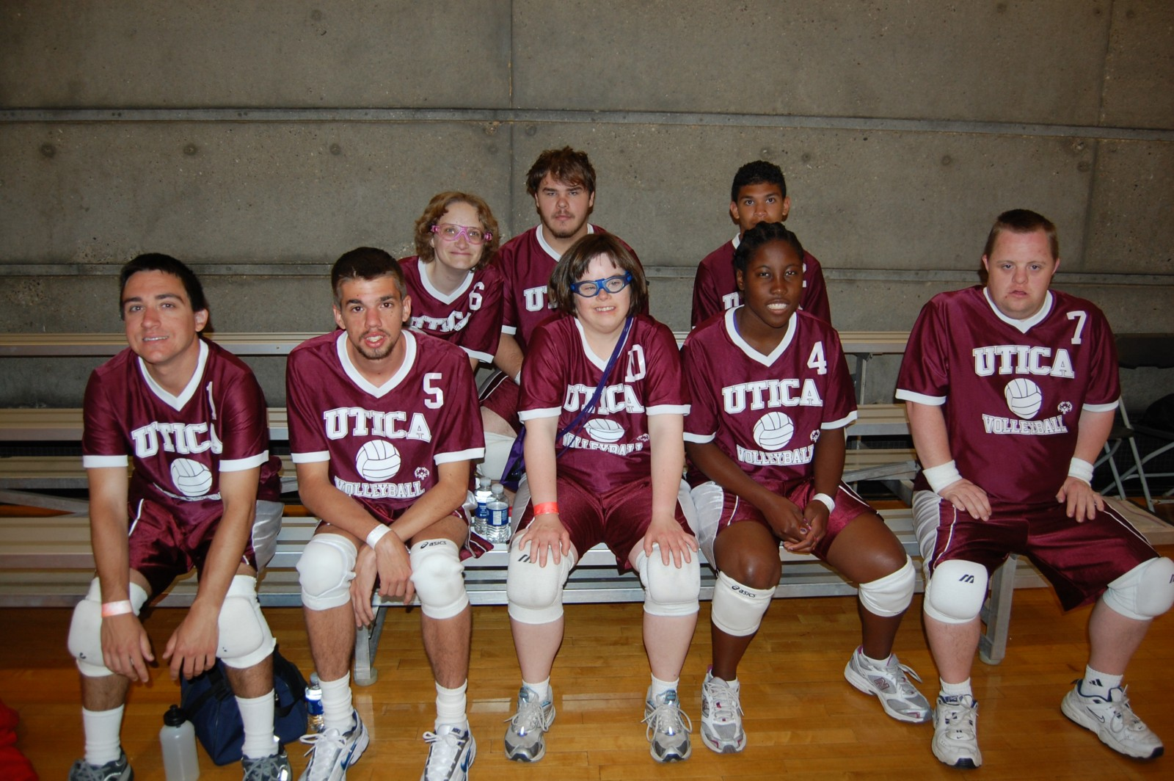
Game Rules
Touching any part of the net while playing the ball is a fault. Crossing completely over the centerline with any part of the body except the feet will not constitute a violation unless there is interference. It is a fault to cross completely over the centerline with the foot or feet.
Each team will get two timeouts per set

Slide 16
Modified Volleyball
Additional modifications for Modified Volleyball:
  Modified matches are played with a slightly larger, lighter, and softer ball making it easier and softer to hit.
    Size: 32 inches in diameter and 8 ounces in weight.
  One assist per serve is allowed to help the ball over the net.
  A 3-point service role will be used. Once a player has scored 3 points in a row on their serve, there will be an automatic side out, and the serve will go to the opposing team.
    If the ball, after having been tossed or released by the server, is caught or falls to the floor, it is considered a service tossing error. One re-serve is permitted.
  A time limit of 30 minutes per set is used.

Slide 17
Unified Volleyball
The roster should contain a proportionate number of Athletes and Unified Partners
During competition, the lineup shall never exceed three athletes and three partners at any time.
  Failure to adhere to the required ratio results in a forfeit.
Each team shall have an adult, non-playing coach responsible for the lineup and conduct of the team during competition.

Slide 18
Unified Volleyball
The serving order and positions on the court, at service, shall be an alternation of Athletes and Unified Partners.
Once a server has scored three consecutive points, their team shall rotate to the next server and continue to keep the serve.
  This ensures no Unified Partner can dominate the game by keeping their service.

Slide 19
Libero
Libero players are players that play defensive positions only. Any team has the option to designate two Libero players on its roster for each match. There are special rules if the Libero player is injured and cannot continue.
The Libero jersey number(s) must be placed on the lineup sheet for the first set of the match, in addition to the numbers for the starting six players.
The Libero player must wear a uniform of a different and contrasting color and/or design than that of the rest of the team in order to be easily recognized on the court.

Slide 20
Libero
Libero playing actions:
  The Libero is allowed to replace any player in a back-row position, except in Unified Sports competition when an athlete may only replace an athlete and a partner replace a partner.
  He/she is restricted to perform as a back-row player and is not allowed to complete an attack hit from anywhere (including playing court and free zone) if at the moment of the contact, the ball is entirely higher than the top of the net.
  A player may not complete an attack hit from higher than the top of the net if the ball is coming from an overhead finger pass by a Libero in his/her front zone.
  The ball may be freely attacked if the Libero makes the same action from behind the front zone.

Slide 21
Libero
Libero Replacements:
  When the Libero replaces a player in the back zone, it is not counted as a substitution.
  Libero replacements are unlimited.
  Only the players whom he/she replaced may replace the Libero.
  Replacements may take place at the start of the set after the second referee has checked the lineup or while the ball is out of play, before the first referee blows the whistle for service.

Slide 22
Individual Skills Contest
The individual Skills Contest is designed for lower ability, or new, athletes who have not yet developed the skills necessary to participate meaningfully in team competitions, and atheltes who use a wheelchair. Athlete may not be assisted by coaches and modifications may be made for athletes who have visual or hearing impairments.
Events Include:
    Overhead Passing
    Serving
    Forearm Passing

Slide 23
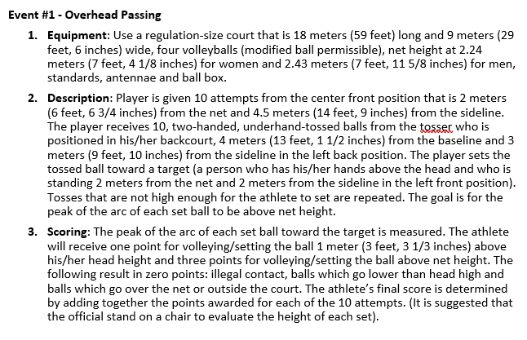
Individual Skills Contest
Overhead Pass

Slide 24
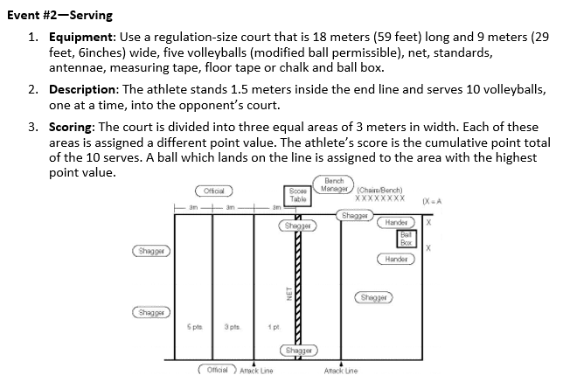
Individual Skills Contest
Serving

Slide 25
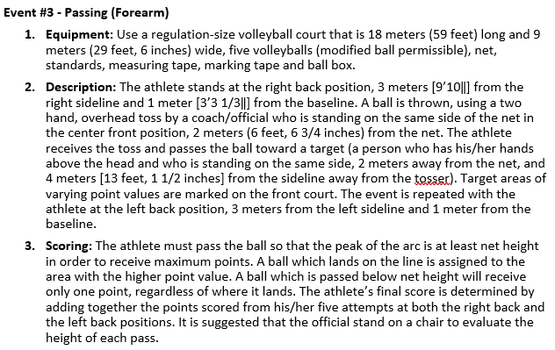
Individual Skills Contest
Forearm Passing

Slide 26
Terms
Pancake- A play where a defensive player will put his/her hand down on the floor to prevent the ball from hitting the floor
Pass- Usually the first contact by a teammate to the setter
Points to win- 15, 21 or 25 points is required to win a set; in order to win, a team must be at least 2 points ahead (Competition management may determine other limits in certain situations)
Rally- The act of playing the ball back and forth over the net
Rally Scoring- Each play results in a point unless a replay is directed

Slide 27
Terms
Replay- When an official instructs the team to play over the previous point due to an error or other reasons
Serve- The technique of putting the ball into play
Setter- A player (usually the second team contact) who delivers the ball to a hitter
Side Out/Rotate- When the team wins the serve from the opposing team, the team will rotate one position clockwise, often referred to as a Side Out

