Slide 1
Speed Skating Official Rules

Slide 2
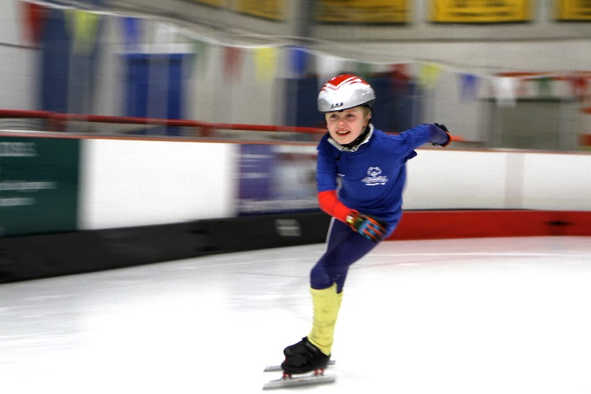
A picture paints a thousand words
“Let me win, but if I cannot win, let me be brave in the attempt.”
“Let me win, but if I cannot win, let me be brave in the attempt.”
Use the Picture and Caption format to create strong compelling slide like this. Don’t’t forget to caption where possible. For best effect crop the image to fill the placeholder.

Slide 3
The Basics
Sport season:
December – February
Culminating State Events:
State Winter Games

Slide 4
Events Offered
100-meter
300-meter
500-meter
800-meter
3000-meter Unified Relay

Slide 5
Uniform Guidelines and Equipment
All speed skaters will wear long-sleeved uniforms, knee pads, shin guards, and cut resistant throat protectors, cut resistant and no protrusions (which might get caught on a blade) gloves/mittens of a protective nature, and an approved safety helmet with a hard shell and chin strap.
All helmets must be an ISU approved helmet and be free of protrusions
Skates: Speed skaters should wear speed skates. In the event speed skates are not available to the athlete, hockey skates may be used. Figure skates and Klap style speed skate blades are not permitted.

Slide 6
Uniform Guideline and Equipment Cont.
All competitors must wear competition numbers for both time trial and final races.
Competition equipment, such as skates, must pass all appropriate safety guidelines.
Jewelry, and denim may not be worn during competition or practice. Headwear for religious or medical reasons are acceptable but must be brought to the attention of the Games Director prior to competition.

Slide 7
Course Layout

Slide 8
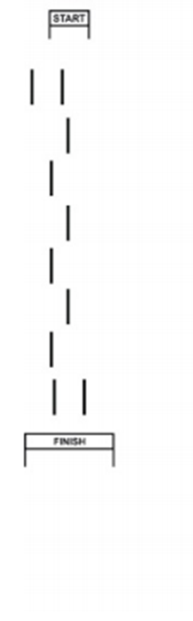
Rink Layout
The track shall be set on an ice rink with a minimum length of 56.38 m and a minimum width of 25.90 m.
If a 111-meter track is used the distance and laps are:
1 lap = 111 m
3 laps = 333 m
4.5 laps = 500 m
7 laps = 777 m

Slide 9
Rink Layout Cont.
Nothing shall be placed in or above the competitors' paths, or on or above the ice
Safety mats must be present during all training and competition periods
Rink barriers shall be covered by mats from the curve apex block to the centerline of the rink. The mats shall be of double thickness along the rink barrier on the far side of the curve. Mats shall be attached to the rink barrier with their weight on the ice. Mat height must be adequate to cover the height of the wall of the ice rink.

Slide 10
Rink Layout Cont.

Slide 11
General Rules

Slide 12
General Rules
Speed Skaters must go to the middle of the rink to stop. A skater who uses the wall to maintain balance or to assist in propelling oneself forward is considered assistance and will be disqualified.

Slide 13
Start Equipment
  A start pistol or whistle shall be used to begin each race. False starts will require a restart.
  For hearing impaired skaters, dropping a hand or flag shall accompany the sound of the gun.

Slide 14
Track Markers
Moveable markers of rubber or other suitable material shall be used to mark the track
No track markers shall be of such size and width, or be fixed to the ice, so that they will not move freely if they are struck by a skater.

Slide 15
Race Start
  All skaters shall start a race with both skates behind the start line. A speed skater shall finish the race when the blade of one of his/her skates first crosses the finish line after completing the appropriate number of laps in the race.
  If a skater is interfered with and falls before the first apex block after the starting line, the skaters may be called back to make a new start.

Slide 16
Race Start Cont.
  The starter shall position himself/herself in front of the start line in such a way that he/she is clearly visible and distinguishable as the starter to all skaters starting the race.
  Races shall not start until the gun is fired or the whistle is blown. Skaters making two false starts shall be disqualified.

Slide 17
Start Command
"Go to the start" (skaters step to start line and place skaters behind the start line),
"Ready" (skaters get down into start position),
Signal the start of the race with the firing of a start pistol or blowing a whistle.

Slide 18
Unified Speed Skating Rules

Slide 19
Unified Speed Skating Rules
Each team shall consist of two Special Olympics Athletes and two Unified Sports® Partners.
Each team member must skate a minimum of three laps. The last two laps must be skated by a single skater that will be an Athlete member of the team.
Each team shall be clearly identified by wearing the same uniform or by wearing the same color pinnie vest or helmet bib.

Slide 20
Unified Speed Skating Rules Cont.
The relay zone will be between the blue hockey zone
The relay may be by either push start or tag of hand.
No other personnel, other than the referees, will be on the ice to allow the infield of the track to be used for marshaling and pacing for relay exchanges

Slide 21
Thank you!

