Slide 1
Snowshoe Official Rules

Slide 2
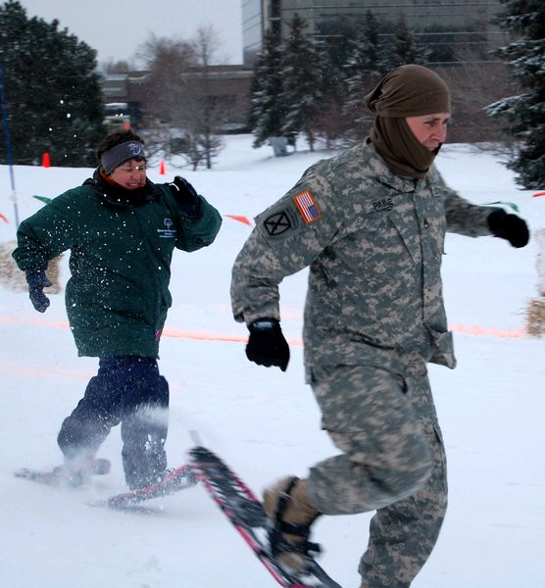
Events Offered
25-Meter
50-Meter
100-Meter
200-Meter
400-Meter
4X100-Meter Relay
4x400-Meter Relay
4x100-Meter Unified Relay
4x400-Meter Unified Relay

Slide 3
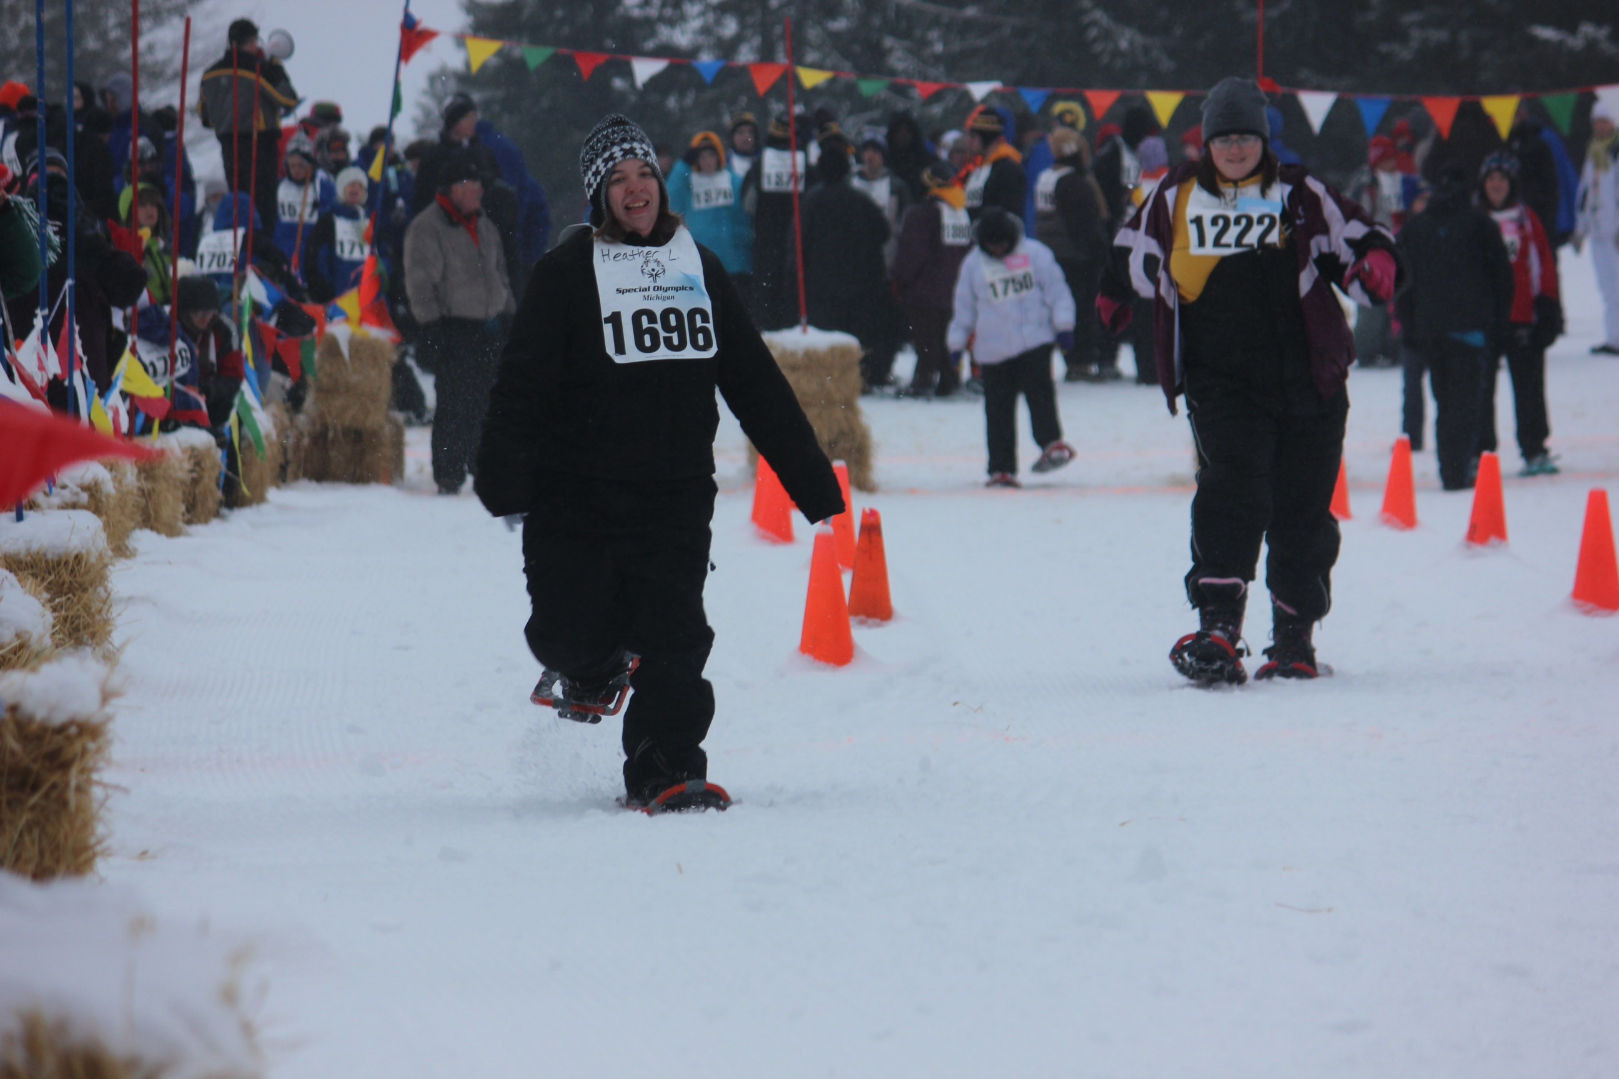
Event Suggestions
Beginner Athletes:
  25-meter and 50-meter races
Intermediate Athletes:
  50-meter and 100-meter races
Advanced Athletes:
  200-meter and 400-meter races
Athletes may enter up to 2 snowshoe races

Slide 4
Uniforms
Athletes should wear appropriate winter sports attire including warm ski gloves or mittens, a hat, snow pants or bibs, scarf, headband or ski mask.
  Sunglasses, goggles, wrist guards and kneepads are optional recommended pieces of equipment.
Clothing should be conducive to freedom of movement.
Athletes will receive an entry number to wear during competition in the form of a numbered bib. The bib should always be worn when at the competition site and on the racecourse.

Slide 5
Equipment
All participants must provide their own snowshoes.
SOMI recommends a Michigan or Alaskan-style snowshoe
Snowshoes should measure at least 7 inches by 20 inches.
  It is not necessary for snowshoes to have a “tail” provided that the snowshoe meets these minimum size standards. Snowshoes may not be altered in any way.
Athletes must use the same snowshoes during time trials and finals competition. If an athlete is found to be wearing different snowshoes during finals competition, the athlete will be disqualified and given a participation ribbon only.
  Snowshoes may not be altered in any way.

Slide 6
Competition
Only the officials and the athletes competing in the race are allowed on the course.
Athletes begin with feet behind the start line. All snowshoe races will use the starting command, “5-4-3-2-1-Go!” At the same time as the verbal start command, a flag will be dropped to alert timers to the start and to accommodate hearing-impaired athletes.

Slide 7
Competition
Any competitor starting before the start signal is given will be charged with a false start.
  A false start occurs when a competitor significantly moves any body part before the start signal after coming to a still set position after the “Racers ready” command and before the starting signal.
  An official should identify and notify the athlete that is charged with a false start.
  Any competitor making two false starts in the same race will be disqualified from that race.

Slide 8
Competition
Athletes must stay within their assigned lanes. Athletes continue on snowshoes until crossing the finish line. Athletes must complete the entire distance of this course with both snowshoes on.
  If one, or both, snowshoes come off, the athlete must stop, put the snowshoe back on (at the point where it came off), and then complete the course.
A competitor must have both snowshoes on his/her feet when crossing the finish line to be official.
Time is taken from the point that the competitor’s torso crosses the finish line. The finish referee is responsible for all such decisions.

Slide 9
Competition
Pacing of competitors is not allowed.
A competitor may not progress forward unless they have both snowshoes attached to their feet.
Any competing athlete who jostles or obstructs another athlete, so as to impede his or her progress, shall be liable to disqualification from that event.
  The action must be judged to be intentional and beyond incidental to result in disqualification.
  The Referee shall have the authority to order the race to be re-held excluding any disqualified athlete.

Slide 10
25-, 50-, 100-Meter Courses
Racecourse Layout for 25-meter, 50-meter and 100-meter races should be as flat as possible and on a straight course.
The start line should stay the same for all three distances.
The finish line should be marked at 25-meter, 50-meter, and 100-meter distances from and parallel to the start line.
Six lanes should be designated, and each lane should be at least 1-meter wide.

Slide 11
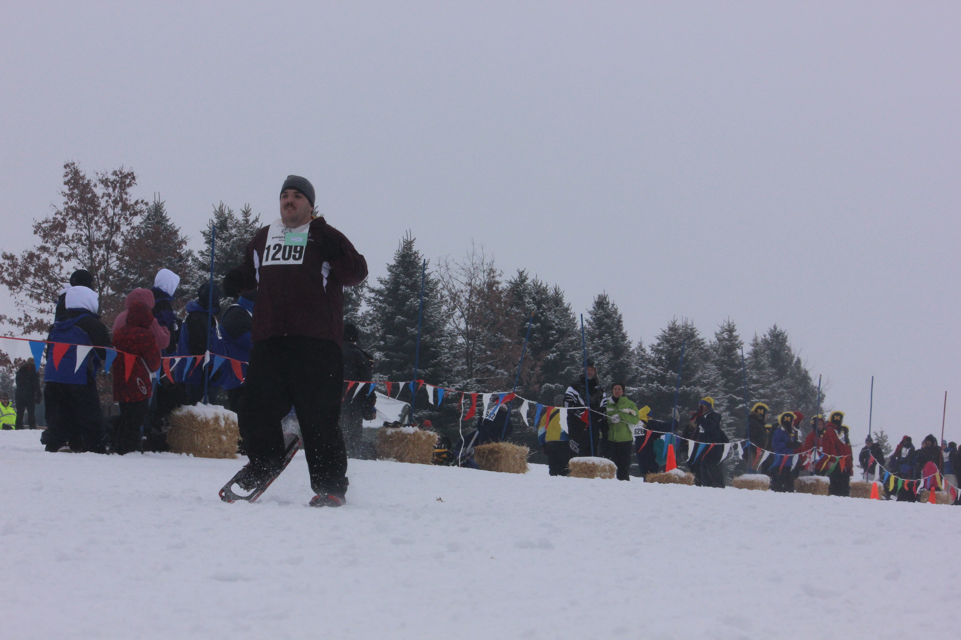
200-, 400-Meter Courses
The minimum size of the course layout should be 400 meters in length and can be run on a straight course a continuous loop over varied terrain.
  For the 200-meter race, the racers will run over a portion of the 400-meter course. For the 400-meter race, racers will run one lap of the 400-meter course.

Slide 12
200-, 400-Meter Courses
Oval or Waterfall starting lines may be used for all races not run on a straight course.
The waterfall starting line will ensure all racers run the same equal distance from the starting point.

Slide 13
Relay Races
A team of four racers will complete a relay race with each member of the team running one-fourth, or one leg, of the race.
Unified Relay races include 2 Special Olympics Athletes and 2 Unified Partners racing on the same team.
  Unified Partners are athletes who do not have intellectual disabilities.
  Athletes and Unified Partners can race in any order during a relay race.

Slide 14
Relay Races
Relay Races will all be run over the 400-meter course with three exchange zones built in.
  Each exchange zone will be 20-meters in length and clearly marked for the racers.
  The start of the zone is the line closest to the starting line.
  A proper exchange of the relay baton must take place within the exchange zone between the incoming, and outgoing racer.

Slide 15
Relay Races
Racers awaiting the baton will be positioned by officials on the course prior to the start of the race for the 4x100-meter races, or as the runner crosse the 200-meter mark in the 4x400-meter races.
If dropped, the baton must be recovered by the racer who dropped it.
  They may leave their lane to retrieve it if they do not make any progress towards the finish line or impede another racer.
  The passing of the baton outside the exchange zone is illegal and results in a disqualification.

Slide 16
Relay Races
The baton should be a smooth, hallow tube made of wood, metal, or other rigid one-piece material; caution should be used if handling them with bare skin in cold weather.
They should be between 280-300 millimeters long, 40 millimeters in diameter and not weigh more than 50 grams.
Batons should be colored so they are easily visible during a race and always carried by hand while racing.

Slide 17
Disqualification
Racers can be disqualified if they:
  Make two false starts in any race
  Fail to follow the course or take short cuts
  Receive unauthorized assistance
  Leave their lane and impede another competitor
  Fail to give way to a passing racer
  Do not finish with both snowshoes attached to their feet
  Make progress towards the finish line without their snowshoes on or while dropping the baton during relay races
  Receive assistance from team members during a relay race
  Run outside of the exchange zone during a relay without the baton.

Slide 18
Terms
Binding- The part of a snowshoe that attaches the footwear to the snowshoe
Carrying Surface- Surface area of a snowshoe; the larger the surface area, the more flotation and support for the snowshoer
Crampon- The sharp pointed traction device that may be attached to a snowshoe’s pivot hinge to prevent slippage. Generally made from heat-treated aluminum or tempered carbon steel
Fall line- Shortest distance down a slope. The direction perpendicular to the ground that an object ( you, rock, snow) would fall.
Flotation- Ability of a snowshoe to limit sinking down into soft or deep snow
Frame- The rigid outer structural component of a snowshoe, usually made of wood, plastic or metal

Slide 19
Terms
Claw- Like a crampon but with comparatively short serrations. Claws are an angle traction device attached to snowshoes. They give a “grip” comparable to that provided by the webbing of traditional snowshoes and are used in conditions where ice or steep surfaces are not encountered.
Decking- Solid or webbed pieces of nylon, rawhide or rubber-like material attached to the snowshoe frame that provides flotation for the snowshoer
Heel Strap- Part of the snowshoe binding that secures the heel. It is a strap that wraps around the back of the snowshoer’s footwear
Lamp Wick- A 1 ½ inch cotton woven cord (oil lamp cord) used for binding snowshoes.
Pivot Rod- Attaches to the frame and allows the foot and binding to rotate as the snowshoer moves
Tail- The rear area of a snowshoe frame

Slide 20
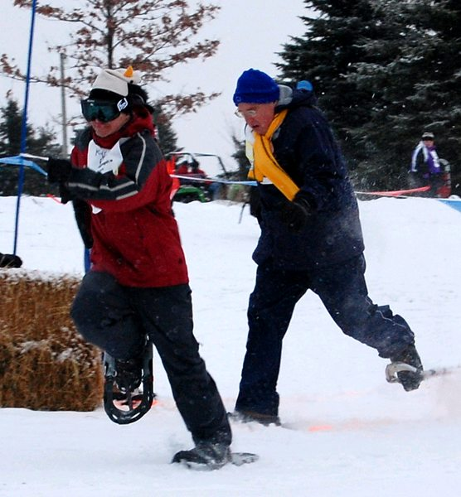
Terms
Tip or Toe- The front area of a snowshoe frame
Toe Hole- The opening in the front decking that allows the forefront to pivot through a complete range of motion
Tuque- A knitted hat adorned with a tassel on the top, the traditional headgear for snowshoers

