Slide 1
Snowboarding Official Rules

Slide 2
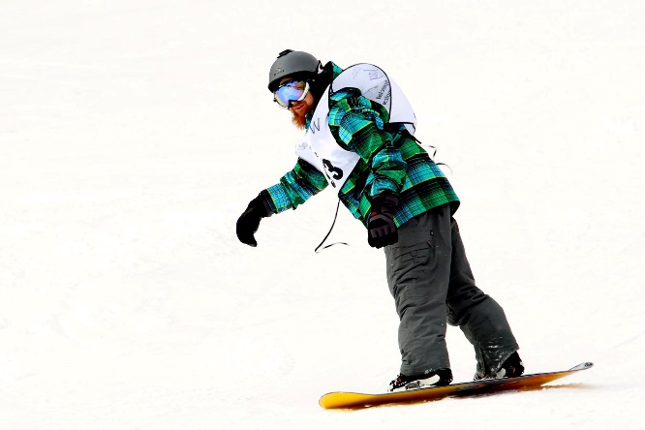
A picture paints a thousand words
“Let me win, but if I cannot win, let me be brave in the attempt.”
“Let me win, but if I cannot win, let me be brave in the attempt.”
Use the Picture and Caption format to create strong compelling slide like this. Don’t’t forget to caption where possible. For best effect crop the image to fill the placeholder.

Slide 3
The Basics
Sport season:
December - February
Culminating State Events:
State Winter Games

Slide 4
Events Offered
Slalom: Novice, Intermediate, Advanced
Giant Slalom: Novice, Intermediate, Advanced
Super-G: Novice, Intermediate, Advanced
Unified Giant Slalom: Intermediate
Unified Slalom: Intermediate

Slide 5
Recommended Events for Appropriate Ability levels
• Novice (level 1) : Snowboarders may enter the Giant Slalom or Super-G. Please register in event specific for novice. Novice snowboarders will use a tow rope and are not allowed on the chairlift.
• Intermediate (Level II) and Advanced (Level III) Snowboarders may enter the Slalom, Giant Slalom or Super-G events. Athletes should be able to do beginner requirements, plus be able to do carving turns at moderate speeds. They must be trained using a chairlift.

Slide 6
Recommended Events for Appropriate Ability levels Cont.
Note: if an athlete has never been on a snowboard, he/she should not be entered in snowboarding. If they do not display the skills required for the level registered they will be moved up or down to the next level. If athletes create a safety hazard on the slopes the games officials have the authority to disqualify them.

Slide 7
Uniform Guidelines and Equipment
Athletes should wear appropriate winter sports attire. Warm gloves or mittens, hat, scarf, headband or ski mask, and sunglasses or goggles are recommended. Optional items include wrist guards and kneepads.
All competitors must wear competition bibs for all time trials and finals races. Bibs must be worn on the hill at all times throughout the games, even if the athlete is not competing at that time.

Slide 8
Uniform Guideline and Equipment Cont.
Competition equipment such as boards, boots and bindings must pass all appropriate safety guidelines.
All athletes competing snowboarding events must wear a ski racing helmet. Helmets from other sports including, but not limited to, cycling, hockey or football will not be allowed.

Slide 9
Uniform Guideline and Equipment Cont.
Jewelry, and denim may not be worn during competition or practice. Headwear for religious or medical reasons are acceptable but must be brought to the attention of the Games Director prior to competition.

Slide 10
Course Layout

Slide 11
Slalom , Giant Slalom, and Super-G
Slalom, Giant Slalom and Super-G gates consist of two poles: one outside pole and one stubby turning pole.
The first gate after the start should always be red.

Slide 12
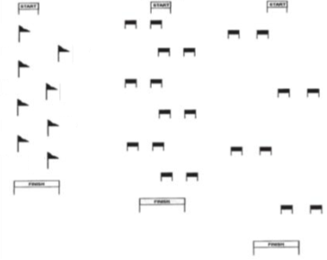
Slalom, Giant Slalom and Super-G
Slalom Giant Slalom Super-G

Slide 13
Course Layout Cont.
An auger or crow bar shall be made available for the course setter to set poles into the snow.
Adequate protection for the start and finish areas shall be provided. Fencing and/or pop fencing may be used.
Whenever possible, for safety reasons, the courses should be fenced off to be perceived by the Snowboarding public as a self- contained racing venue. Additional fencing, snow fencing, and protective bagging are the responsibility of the Snowboarding area.

Slide 14
Course Layout Cont.
Whenever possible, electric timing equipment, with back- up system, shall be used. When this is not possible, hand held timing may be used. Gate judges shall be responsible for timing the two minutes for the “Two Minute Rule”. Start and finish banners shall be used.

Slide 15
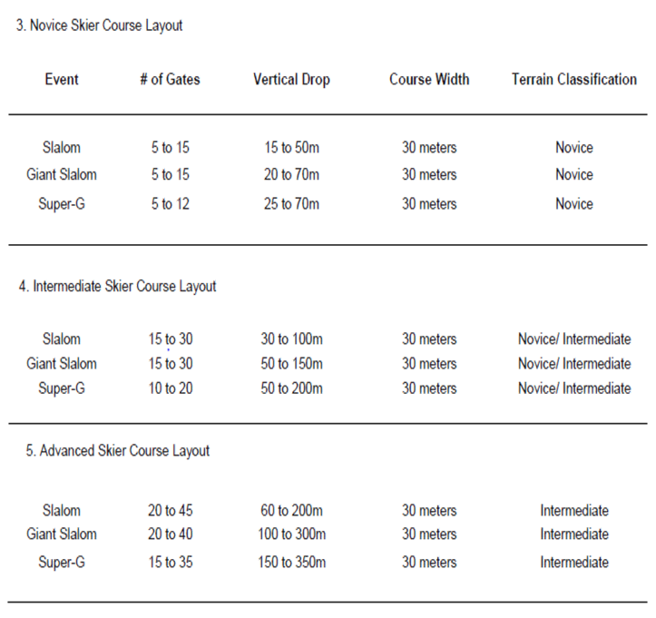
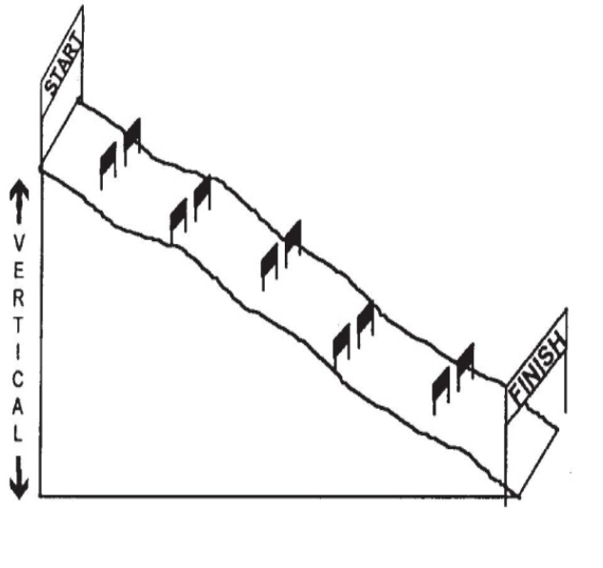
Course Layout Cont.
Vertical Drop Diagram

Slide 16
General Rules

Slide 17
General Rules
It is mandatory for all athletes to be on snow regardless of snow conditions prior to attending Winter Games.
Each athlete participating at the Games may only compete in one sport. Each athlete may participate in two events within the chosen sport. Special attention should be directed to recommended events for the athlete’s ability level. An athlete can be registered only within one level. For example, an athlete cannot be in Novice Slalom and Intermediate Super-G.

Slide 18
General Rule Cont.
3. All athletes must be accompanied by a Level II snowboard coach for safety reasons. If athletes are found on the hill unsupervised or if they are a safety hazard to others, they will be escorted off the hill.
Coaches MAY NOT coach on the hill.

Slide 19
Start Areas
I. All start areas shall be flat, enabling the skiers to stand in the start in either a relaxed or ready position. Care should be given to provide easy access to this area as well as securing the area from the flow of general public snowbaording traffic.

Slide 20
One Minute Rule
During competition, if the competitor moves out of the general direction of the line of the course (fall, miss a gate, lose a ski, etc.) he/she shall have 1 minute from the time of the deviation to re-enter the course.
A competitor who fails to adhere to this 1-minute time limit, or receives assistance of any kind, shall be disqualified. Disqualification shall be determined on the gate card by the Gate Judge assigned to the gate closest to where the infraction occurred.
The Gate Judge is responsible for timing the 1 minute.

Slide 21
Start Command
For all Special Olympics alpine events at each ability level, the start command shall be as follows: "5.4.3.2.1. GO!" The timer begins when the skier’s front boot crosses the start line, or when the electric timing wand is activated.

Slide 22
Gate Line
.The gate line is determined by the turning pole

Slide 23
Correct Passage
  A gate has been passed correctly when the competitor’s snowboard tip and both feet have passed by the gate. The start and finish lines are the same as a gate line. In the event that a competitor removes a pole from its vertical position before the competitor’s snowboard tip and both feet have passed the gate line, the snowboard tip and feet must pass the original gate.
  A competitor who receives assistance of any kind shall be disqualified

Slide 24
Event Modifications

Slide 25
Event Modifications: Slalom/Giant Slalom
Slalom and Giant Slalom races will consist of two timed runs. The combined times for each discipline will determine the results for awards.
A course reset for the second run will be determined by the Jury.
In Slalom and Giant Slalom events, the competitor’s first run times shall determine his/her second run start order within the division. Slowest first run time will start first, fastest last. Disqualified racers may have a second run, but they will run at the end of their division.

Slide 26
Event Modifications: Super-G
Competition organizers may vary the degree of difficulty of the Super-G courses dependent upon the ability levels of the competing racers.
One training run prior to the race run on the same course is required of all competitors.
Race organizers may elect to have the training run timed. This will have no bearing on start orders for the race.
The Super-G race will consist of one timed run.

Slide 27
Unified Snowboarding Rules

Slide 28
Unified Alpine Skiing Rules
Teams shall be made of one Unified Partner and one Athlete
A coach may not serve as the Unified Partner.
The Unified Partner shall make his/her timed run first with the athlete making his/her timed run immediately after in order.
The Unified Partner shall wait for the athlete outside the end of the finish chute area.

Slide 29
Unified Alpine Skiing Rules Cont.
For divisioning, each competitor shall make two runs on the specified course with the best of the two runs used to create divisions.
The final score for the team shall be the combined total of both runs for the Unified Partner and the Athlete following the competition.
The Unified Partner must complete the Application for Participation for Unified Partners.

Slide 30
Thank you!

