Slide 1
Horseshoes Official Rules

Slide 2
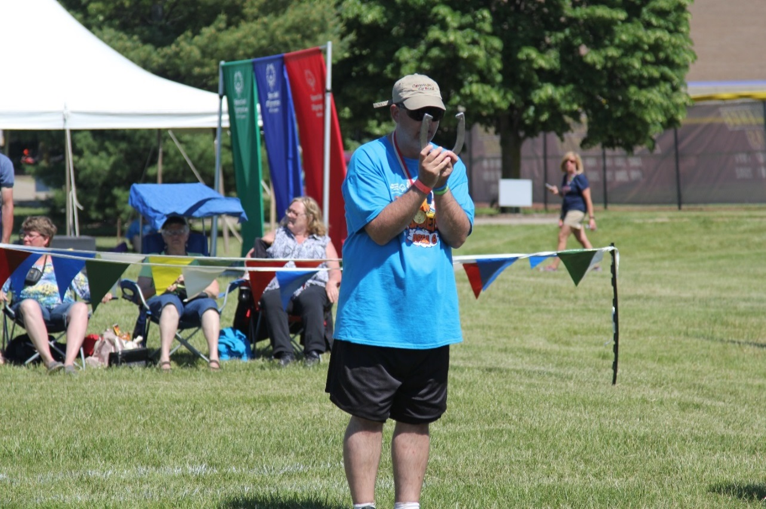
A picture paints a thousand words
“Let me win, but if I cannot win, let me be brave in the attempt.”
Special Olympics Oath
Use the Picture and Caption format to create strong compelling slide like this. Don’t’t forget to caption where possible. For best effect crop the image to fill the placeholder.

Slide 3
General
Sport season:
  April -June
Culminating State Event:
  State Summer Games

Slide 4
Events Offered
Singles
Doubles
Modified Singles
Modified Doubles

Slide 5
Uniform
Preferred Uniform:
  White short-sleeve shirt or T-shirt and dress shorts/pants.
Uniforms of all team members should be identical in color and style.
Shoes: Tennis shoes or smooth-soled shoes are recommended
Denim may not be worn during competition or practice
Hats, visors and religious headwear are allowed

Slide 6
Equipment
There are no minimum size standards, but a shoe shall not exceed 7 ½” in width, 7 5/8” in length, and shall not weigh more than two pounds and ten ounces.
The open end of the shoe should not exceed 3 ½ inches in size.
A straight edge or caliper will be used to measure the distance of pitched shoes.

Slide 7
Court Set Up
The court will occupy a level area of at least 50’ in length at least 10’ in width and consist of two pitcher's boxes.
  Each pitcher’s box will be a 6’ square with a stake in its exact center.
  Stakes shall be 1 inch in diameter and made of cold-rolled steel, mild iron, soft metal, or synthetic material.
  The top of each stake shall extend not less than 14 inches or more than 15 inches above the ground.

Slide 8
Court Set Up
Each pitcher's box shall consist of an area of clay, synthetic substance, dirt, or sand into which the players throw their shoes and flanked by two pitching areas from which the players throw their shoes.
Foul lines shall be clearly defined three feet in front of the entire edge of the pitcher's box.
The pitching distance for modified will be from the 20’ line with a 17' foul line.
The distance for traditional will be from the 30’ line with a 27' foul line.

Slide 9
Court Set Up
At State Summer Games there will be only one pitcher’s box set up with play set up to always pitch in the same direction.

Slide 10
General Rules
It is the discretion of the tournament director to place athletes in traditional or modified divisions at tournaments if the athlete consistently hits the box from the modified pitching distance.
In pitching the shoe, the pitcher shall stand on the pitcher's platform at one side or the other of the stake.
  All pitches from an athlete or pair in the same inning must be thrown from the same side of the stake. Failure to do so will result in the second pitch being called foul.

Slide 11
General Rules
In delivering the shoe, the pitcher must remain behind the foul line until the shoe has left his/her hand. The shoe must be pitched in underhand motion.
Any released horseshoe that has crossed the foul line shall be ruled a pitched shoe and cannot be re-pitched.
In order to count points, horseshoes must land in box. If the horseshoe rolls or bounces in the box, it must be removed before the next shoe is pitched.

Slide 12
General Rules
No contestant shall move his/her own or opponent's shoe or shoes until the winner of point or points has been agreed upon by contestants or a decision has been rendered by the referee.

Slide 13
Doubles Specific Rules
At State Summer Games, with doubles horseshoes, both athletes will pitch toward the pit in one direction behind the foul line. Partners' points are added together, but the individual records of ringers and shoes pitched should be kept. In all other respects, the game is the same as the conventional singles or walking game.
Athletes in a doubles pair may pitch in any order

Slide 14
Scoring
Measurements to determine points shall be made with calipers and/or a straight edge
A shoe must be within 6 inches of the stake to score.
A ringer is declared when a shoe encircles the stake far enough to allow the touching of both heel caulks simultaneously with a straight edge.
  Ringers: 3 Points
  Shoes within 6 Inches of the Stake: 1 Point
    This includes leaners – No extra points are awarded for a leaner.

Slide 15
Scoring
There are two official methods of scoring: the ‘Cancellation’ method and the ‘Count-All’ method. The ‘Count-All’ method is used at the State Summer Games.
  In this method an athlete, or doubles pair, will receive credit for all points according to the position of their shoes at the end of each inning, regardless of what their opponents score.
  It is possible for each athlete, or doubles pair, to score up to six points each inning.

