Slide 1
Rhythmic Gymnastics

Slide 2
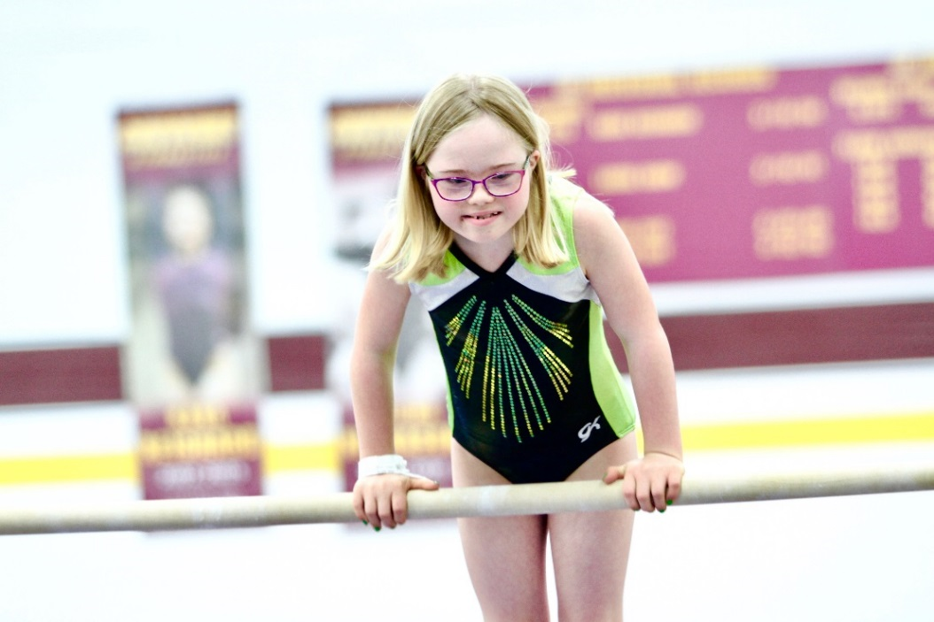
A picture paints a thousand words
“Let me win, but if I cannot win, let me be brave in the attempt.”
Special Olympics Oath
Use the Picture and Caption format to create strong compelling slide like this. Don’t’t forget to caption where possible. For best effect crop the image to fill the placeholder.

Slide 3
General
Sport season:
  March-June
Culminating State Event:
  State Summer Games

Slide 4
Women’s Events Offered

Slide 5
Uniform Guidelines

Slide 6
Uniform
1. Female rhythmic gymnasts should wear a leotard, have bare legs, bare feet, wear gymnastics slippers or Rhythmic half slippers. Unitards with legs may be worn. No decorations or trim may be added to the leotard. See rules for specifics.
2. Level A athletes may wear shirt and shorts with socks on their feet.
3. All athletes participating in group competition must wear like uniforms and use identical equipment.
4. Denim may not be worn during competition or practice

Slide 7
Equipment & Specifications

Slide 8
Equipment & Specifications
1. The size of the equipment can range from child size to senior equipment based on gymnast's size and skill.
2. Equipment should color coordinate with the athlete's leotard.
3. Equipment will be checked prior to competition. If the apparatus does not meet specs, a deduction of .5 each time for individual and 1.0 each time for group will occur.
4. In group routines, all equipment must be identical.

Slide 9
Rope Specifications
I. Rope may be made of hemp or a synthetic material with identical qualities of lightness and suppleness as a rope made of hemp.
II. The rope's length is proportionate to the size of gymnast.
III. Handles of any kind are not allowed at the ends of the rope, but one or two knots are permitted at each end.
IV. At the ends, only a maximum of 10 cm may be covered by an anti-slip material either colored or neutral or may be colored (all or partially) apart from the colors gold, silver, or bronze.
V. The rope may be of uniform diameter or be progressively thicker in the center provided that this thickness is of the same material as the rope.
VI. The rope may be of a neutral color or may be colored (all or partially) apart from the colors gold, silver, or bronze.

Slide 10
Hoop Specifications
I. The hoop may be made of wood or plastic, provided that the latter retains its shape during the movement.
II. The interior diameter of the hoop is from 60-90 centimeters.
III. The hoop should have a minimum weight of 150-300 grams.
IV. A section of the hoop may be in several different shapes: circular, square, rectangular, oval, etc.
V. The hoop may be smooth or ridged, and it may be all or partially covered with adhesive tape either of the same color as the hoop or a different color.
VI. The hoop may be a natural color or may be all or partially covered by one or several colors except gold, silver, or bronze.

Slide 11
Club Specifications
I. Clubs may be made of wood or synthetic material and must be between 25-50 centimeters (recommended size 40-50 cm) from one end to the other.
II. A club must be in a similar shape to that of a bottle. The wider part is called the body, the narrow part, the neck and the ends in a small sphere.
III. Clubs may be of a neutral color or may be colored (all or partially) with one or several colors except gold, silver or bronze

Slide 12
Floor Specifications
I. The floor should be 12 meters by 12 meters with a security zone of 1 meter around.
II. A carpeted area may be used or a floor that is neither too tacky nor slippery.
III. A fairly high ceiling is needed.

Slide 13
Ribbon Specifications
I. The stick must be made of wood, bamboo, plastic or fiberglass.
II. The diameter should be a maximum of 1 cm at its widest part.
III. The shape should be cylindrical or conical or a combination of the two shapes
IV. The length of the stick should be 45-60 cm including the ring, which fastens the ribbon to the stick.
V. The bottom end of the stick may be covered by an adhesive, anti-slip tape or have a rubber handle. The tape or handle should not exceed 10 cm at level of the grip. The top of the stick where the ribbon attaches may consist of a supple strap or metal ring (See Sports Rules for further details).

Slide 14
Ribbon Specifications Cont.
VI. Stick may be any color except gold, silver, or bronze.
VII. The ribbon material should be satin or a similar non-starched material.
VIII. The ribbon may be a single color or multi-colored but may not be gold, silver, or bronze.
IX. The weight of the ribbon only should be at least 20-35 grams.
X. The width of the ribbon should be 4 to 6 cm. From one end to the other, the finished length of the ribbon should be 2-6 meters (for Levels A, B) and 3-6 meters (for levels 1-4) and this part must be one piece.
XI. The ribbon is fixed to the stick by means of an attachment such as thread, nylon cord, or a series of articulated rings. The length of this attachment is a maximum of 7 cm.

Slide 15
General Rules

Slide 16
General Rules
1. Rhythmic gymnastics athletes may not enter artistic events.
2. Athletes may not mix levels.
3. Athletes may enter four events and compete for an all-around award, within the same level. Athletes may also register for group events of Group Ball or Floor Exercise (4 to 6 participants) in addition to the 1 to 4 other events.
4. Level A routines have been written for athletes who are unable to stand on their own. They may sit in a wheelchair or sturdy chair to compete.
5. You must register your athletes in GMS for the all-around event to be eligible for the special medal.
6. A score and levels must be listed at registration time.

Slide 17
General Rules Cont.
7. The text for all the routines is usually written for right dominant athletes. Left dominant athletes can reverse the whole routine to accommodate their dominant side. Once the routine is started on the dominant side, all aspects of the routine are executed on that same side. It is not recommended that the athlete change from the dominant side to the non-dominant side during any routine. Doing so will add extra steps/movements to the routine which will result in the athlete being deducted for extra steps/movements.
8. Only female athletes may participate in rhythmic gymnastics except for Level A, which is co-ed.
9. Athletes must compete on the same level in all chosen individual events

Slide 18
General Rules Cont.
10. Level A routines have been written for athletes who are unable to stand on their own. They may sit in a wheelchair or sturdy chair to compete. Level A routines are compulsory that are preformed seated. Level B routines have been written for athletes of lower ability level who can stand on their own.
I. Only female athletes compete in levels 1-4. Levels A & B are mixed gender.
II. Athletes must compete on the same level in all chosen individual events
III. Athletes may specialize by competing in one or more events at their chosen level. Gymnasts who do all four events at a level are considered All-Around.
IV. A gymnast may perform in one group routine in addition to individual routines.
11. The video of the compulsory routines is the official version. If a difference exists between the video and the written text, the video must be followed.
12. Olympic order for rhythmic gymnastics competition is rope, hoop, ball, clubs and ribbon.
13. Atlantoaxial Instability Rule: Athletes with Down Syndrome must have an x-ray indicating that he/she does not have atlantoaxial instability prior to participation in any gymnastics event.

Slide 19
Event Specific Rules & Modifications

Slide 20
. Event Specific Rules & Modifications
1. Athletes with hearing or visual impairments are allowed cues and signals from the coach. Coaches must notify the meet director and judges of the athlete’s impairment before the event begins.
2. Modifications for athletes using canes or walkers: In the floor exercise, coaches may walk onto the floor and remove (and replace) walkers and other aids as needed without any deduction.

Slide 21
Disqualifications

Slide 22
Disqualifications
A competitor may be disqualified if he/she:
1. Is wearing improper attire.
2. Undisciplined or unsportsmanlike behavior.
3. Improper equipment and use of aids.
4. Has assistance from a coach during a competition

Slide 23
Thank you!

