Slide 1
Artistic Gymnastics

Slide 2
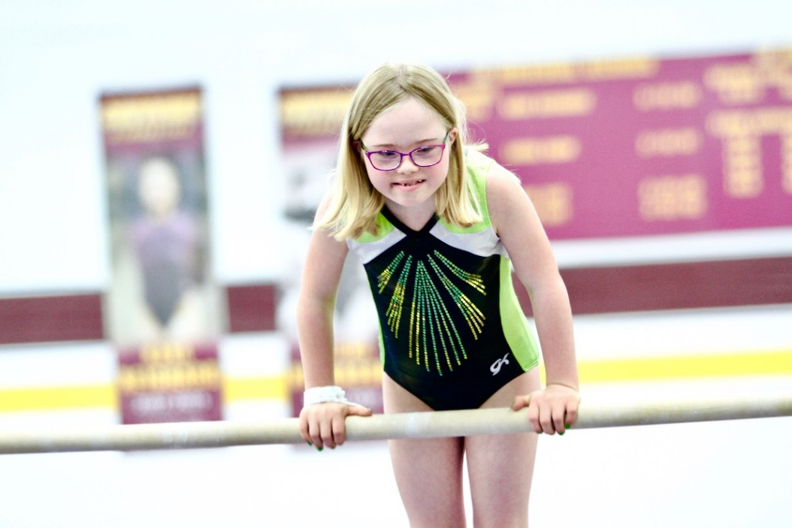
A picture paints a thousand words
“Let me win, but if I cannot win, let me be brave in the attempt.”
Special Olympics Oath
Use the Picture and Caption format to create strong compelling slide like this. Don’t’t forget to caption where possible. For best effect crop the image to fill the placeholder.

Slide 3
General
Sport season:
March-June
Culminating State Event:
State Summer Games

Slide 4
Women’s Events Offered
1. Vaulting
2. Uneven Bars
3. Balance Beam
4. Floor Exercise
5. All Around (total of all four event scores)

Slide 5
Men’s Events Offered
1. Floor Exercise
2. Pommel Horse
3. Vault
4. Parallel Bars
5. Horizontal Bar
6. All Around (total of all five event scores)

Slide 6
Mixed gender Events Offered
1. Vaulting
2. Single Bar
3. Wide Beam
4. Floor Exercise
5. All Around (total of all four event scores)

Slide 7
Uniform and Equipment Guidelines

Slide 8
Uniform
For male gymnasts, the preferred uniform is a tank top (leotard) and long manufactured gymnastics pants or shorts. A T-shirt that is tucked in may replace the tank top.

Slide 9
Uniform Cont.
For female gymnasts, the preferred uniform is a long-sleeved manufactured gymnastics leotard with bare legs. Flesh-colored tights with bare feet are permitted, but not recommended. Sleeveless leotards may be worn if temperature or body type warrants it.

Slide 10
Uniform Cont.
Gymnasts may compete in bare feet or gymnastics slippers.
Bandages may be worn as long as they are securely fastened.
Hip padding is not permitted.
The only jewelry allowed is stud earrings.

Slide 11
Uniform Cont.
Gymnastic leotards can be purchased from www.gkelite.com
Starting numbers may be required for technical and organizational purposes.
Denim may not be worn during competition or practice

Slide 12
General Rules

Slide 13
General Rules
All athletes can register for 1 to 4 events.
Athletes who register for Artistic Gymnastics may not enter Rhythmic events.
An athlete who enters a Level A event (developmental) may not enter other gymnastics events in levels I thru IV.

Slide 14
General Rules Cont.
Athletes may enter all 4 events and compete for an All-Around award, (which will be a special medal) or be a specialist, competing in one, two, or three events (or four events for males). All-Around athletes must compete in the same level for all events; specialists may be one level apart for their events. You must register your athletes in GMS for the all-around event to be eligible for the special medal. Only All-Around athletes will be eligible to advance to USA or World Games competitions.

Slide 15
General Rules Cont.
A score and levels must be entered at registration.
Gymnasts will now rotate by assigned group or area to specific principal (event).

Slide 16
General Rules Cont.
There are six levels of competition:
Level A – Compulsory routines for gymnasts who have ambulatory problems, etc., but are too advanced for the MATP (Mixed Gender)
Level I - Beginner Compulsory
Level II - Intermediate Compulsory
Level III - Advanced Compulsory
Level IV – Advanced Optional
Level B- Compulsory routines for gymnasts who are unable to perform level I routines

Slide 17
General Rules Cont.
Level IV gymnasts perform an optional routine.
Athletes with Down Syndrome must have an x-ray indicating that he/she does not have atlantoaxial instability prior to participation in any gymnastics event.
Age group divisions will be as follows: 8-11, 12-15, 16-21, 22-29, and 30+. Schedules are sometimes presented as junior (8-15) and senior (16+).
Age groups may be combined if there are not a sufficient number of athletes to have a competitive division.

Slide 18
General Rules Cont.
The text for all the routines is usually written for right dominant athletes. Left dominant athletes can reverse the whole routine to accommodate their dominant side.
Once the routine is started on the dominant side, all aspects of the routine are executed on that same side. It is not recommended that the athlete change from the dominant side to the non-dominant side during any routine. Doing so will add extra steps/movements to the routine which will result in the athlete being deducted for extra steps/movements.

Slide 19
Event-Specific Rules and Modifications

Slide 20
Event-Specific Rules and Modifications
Athletes with hearing or visual impairments are allowed cues and signals from the coach. Coaches must notify the meet director and judges of the athlete’s impairment before the event begins.
Modifications for athletes using canes or walkers: In the floor exercise, coaches may walk onto the floor and remove (and replace) walkers and other aids as needed without any deduction.

Slide 21
Disqualifications
A competitor may be disqualified if he/she:
Is wearing improper attire.
Undisciplined or unsportsmanlike behavior.
Improper equipment and use of aids.
Has assistance from a coach during a competition

Slide 22
Routines
To view videos of the artistic routines please click here.

Slide 23
Thank you!

