Slide 1
Golf Official Rules

Slide 2
A picture paints a thousand words
“Let me win, but if I cannot win, let me be brave in the attempt.”
Use the Picture and Caption format to create strong compelling slide like this. Don’t’t forget to caption where possible. For best effect crop the image to fill the placeholder.

Slide 3
The Basics
Sport season:
June-September
Culminating State Events:
State Fall Games

Slide 4
Events Offered
Golf Level 1 Individual Skills Contest
Golf Level 2 Unified 9-Hole Sports Team Play
Golf Level 4 Individual Stroke Play 9-Hole

Slide 5
Uniform Guidelines and Equipment
Athletes must wear shirts with collars and dress shorts or pants. Golf gloves are allowed. Shoes: Golf, tennis or athletic shoes are acceptable, but are subject to inspection by an event official. No heeled shoes are allowed. No metal spikes.
Jewelry and denim may not be worn during games or practice. Headwear for religious or medical reasons are acceptable but must be brought to the attention of the Games Director prior to competition.

Slide 6
Uniform Guideline and Equipment Cont.
A set of clubs shall include at least one wood, one iron and one putter. These clubs should be in an appropriate golf bag and should include golf balls.

Slide 7
General Rules

Slide 8
General Rules
All whiffs and duffs are considered 1 stroke.
If a tenth stroke is played without holing the shot, the player shall record a score of 10x and proceed to the next hole.
Each player shall register by submitting a verified score or the average of the most recent six scores over nine holes.
It two players tie for first place, the player with the fewest number of 10x scores shall be declared the winner.

Slide 9
Level 4 – Individual Stroke Play (9-hole)
Average of 70 or lower
This level is designed to meet the needs of those Special Olympics golfers who wish to play individually in a tournament where the stipulated round is nine holes.

Slide 10
Level 2 – Unified Sports Team Play
Team Average of 120 or lower (18 holes).
This level is designed to give the Special Olympics athlete an opportunity to play in a team format with a partner in the traditional Unified Sports® model where the teammates are of similar ability. A team shall include one Special Olympics athlete and a peer athlete without intellectual disabilities (unified partner).

Slide 11
Level 2 – Unified Sports Team Play Cont.
The players play alternately from the teeing grounds and then alternate strokes until the ball is holed.
In cases where a team registers and the difference in handicaps is greater than 10, the team shall be divisioned according to a standard differential of 10 applied to the lower of the two handicaps.

Slide 12
Individual Skills Contest

Slide 13
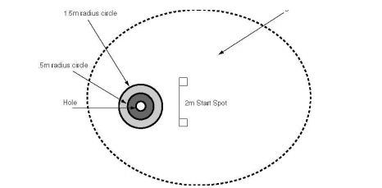
Event 1 – Short Putt
Purpose: To measure the athlete's ability to putt focusing on the short putt.
Description: A target hole is selected, and two circles are placed around the hole. The circles are 1.5 and .5 meters in radius. The athlete will strike five putts toward the hole. The putts will be made from a distance of 2 meters.

Slide 14
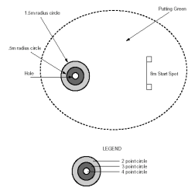
Event 2 – Long Putt
Purpose: To measure the athlete's ability to putt focusing on the long putt.
Description: A target hole is selected and two circles are placed around the hole. The circles are 1.5 and 5 meters in radius. The athlete will strike five putts toward the hole. The putts will be made from a distance of 8 meters.

Slide 15
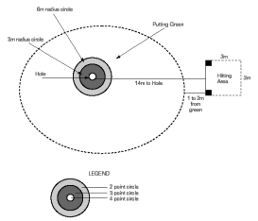
Event – 3 Chip Shot
Purpose: To measure the athlete's ability in hitting chip shots at 14 meters
Description: A chipping area is set up which includes a 3 m by 3 m square hitting area 14 meters from the hole. The hitting area should be between 3 and 4 meters from the edge of the green. A 3 meter and a 6 meter radius circle will be placed around the hole. The athlete is instructed to hit the ball at a designated hole—getting it as close to the hole as possible.

Slide 16
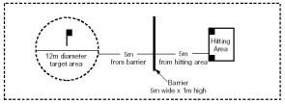
Event 4 – Pitch Shot
Purpose: To measure the athlete's ability in hitting controlled pitch shots in the air and in the proper direction.
Description: The athlete is instructed to hit the ball from the teeing area over the net, between the poles, at a designated flag in the target area, trying to get the ball to land within the target area.

Slide 17
Event 5 – Iron Shot
Purpose: To measure the athlete's ability to hit an iron shot for distance within a set hitting area.
Description: The athlete is instructed to hit the ball from the teeing area (it is acceptable to tee the ball), tee, or ground (player's choice) toward designated flag in the hitting area—trying to keep the ball within the boundary markers and achieving a distance of more than 90 meters.

Slide 18
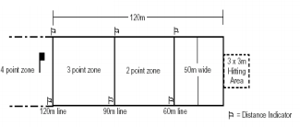
Event 6 – Wood Shot
Purpose: To measure the athlete's ability to hit a wood shot for distance within a set hitting area.
Description: The athlete is instructed to hit the ball from the teeing area or ground toward the designated flag in the hitting area trying to keep the ball within the boundary markers and achieving a distance of more than 120 meters.

Slide 19
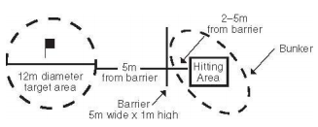
Event 7 – Bunker Shot (optional)
Purpose — to measure the athlete’s ability to hit controlled shots from a bunker in the air in the proper direction to a defined circular target area.
The athlete shall make five attempts. The athlete is instructed to pitch the ball out of the sand and toward the designated target area.

Slide 20
Thank you!

