Slide 1
Flag Football Official Rules

Slide 2
Events Offered
Traditional Team
Unified Team
Individual Skills Competitions

Slide 3
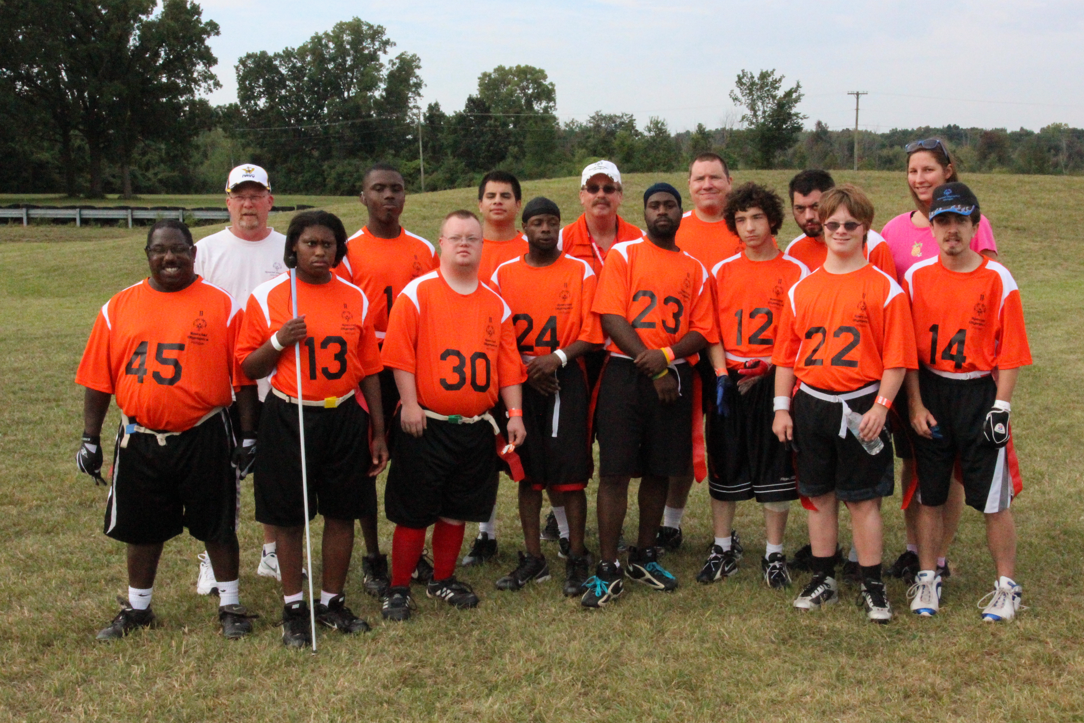
Rosters – Tradition Teams
Roster Minimum: 6
Roster Maximum: 10
Teams must have five (5) players to start the game. They may continue with a minimum of four (4) players, if necessary, due to disqualification or injury.

Slide 4
Rosters – Unified Sports Teams
Roster Minimum: 7
Roster Maximum: 10
The roster shall contain a proportionate number of athletes and partners.
Teams must have five (5) players to start the game. They may continue with a minimum of four (4) players, if necessary, due to disqualification or injury.
The line-up shall never exceed three (3) Athletes and two (2) Unified Partners at any time.
Failure to adhere to the required ratio results in forfeit

Slide 5
Rosters – Unified Sports Teams
Each team shall have an adult non-playing coach responsible for the line-up and conduct of the team during competition.
Unified Partners playing quarterback may NOT pass to another Unified Partner.
Unified Partners MAY handoff to another Unified Partner.
Unified Partners shall NOT dominate play.

Slide 6
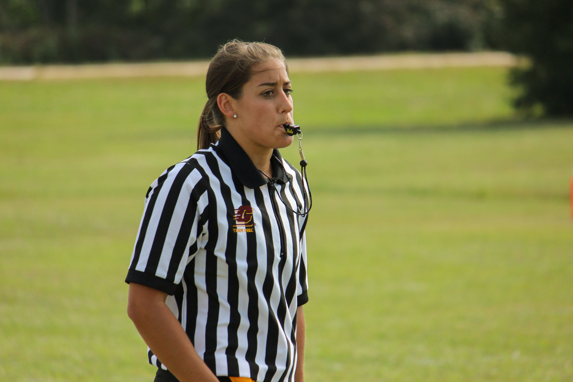
General Rules
Special Olympics Flag Football is non-contact
Teams will be grouped into divisions based on team type, game scores submitted and TEQs.

Slide 7
Points of Emphasis
No team shall repeatedly commit penalties/fouls which halve the distance to the goal line.
Neither team shall commit any act which, in the opinion of the referee, tends to make a travesty of the game. This includes intentionally committing penalties/fouls to gain an advantage
The referee will enforce any penalty he/she considers equitable, including the award of a score for an unfair act.

Slide 8
Uniforms
All participants must have a playing uniform consisting of matching shirts and shorts.
Numbers should be on both the front and back of the jersey.
Jerseys must be tucked in at the waist to avoid obstruction of Flag Pulling
All players must wear athletic shorts without pockets
Players must wear rubber-cleated or flat-soled athletic shoes. Metal spikes are illegal.

Slide 9
Uniforms
No jewelry may be worn (rings, bracelets, earrings, etc.).
No blue jeans or denim will be allowed.
Athletes should not wear hats, bandanas, or any other form of headwear.
Sports style headbands are permissible
Any athlete with a medical condition or religious head covering must notify Games Officials at registration.

Slide 10
Equipment
A regular or intermediate (youth) size football will be used in all divisions
Players will wear a one-piece flag belt with three flags.
Flags should be placed one on each hip and one on the backside.
A protective mouthpiece must be worn at all times

Slide 11
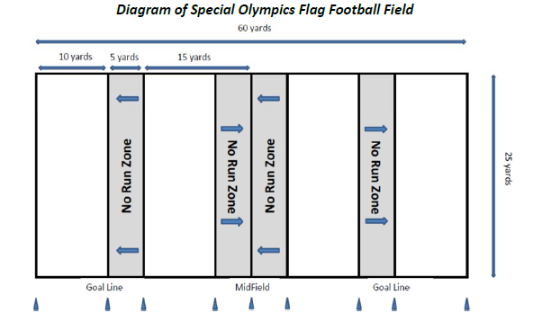
Playing Field
A flag football field is 60 yards long (including the end zones) and 25 yards wide. End Zones are 10 yards long each, meaning the playing field is 40 yards long with midfield being the 20-yard line.
Stepping on a boundary line is considered out of bounds.

Slide 12
Playing Field
No-Run Zones are in place to prevent teams from conducting power run plays. While in the No-Run Zones (a 5-yard zone before midfield and before the end zone), teams cannot run the ball in any fashion. All plays must be passing plays.
A space of at least 5 yards around the field must be free and clear of obstructions. The field can be marked with chalk, paint, and/or traffic cones.

Slide 13
Timing
The game consists of two (2) 20-minute halves with a running game clock. There is a 5-minute halftime break.
Officials can stop the clock at their own discretion (injuries, delays).
There is a 30-second play clock. This clock starts at the end of the previous play.
Each team receives one (1) 60-second time-out per half. An unused time-out in the first half does not carry over to the second half.
The clock will stop on all time-outs.

Slide 14
Timing
The ball must be put in play promptly and legally and any action or lack of action by either team that tends to prevent this is considered delay of game.
This includes
Interrupting the 30-second count for any reason except for a granted timeout.
Consuming more than 30-seconds to snap the ball after it is ready for play.
Failing to remove an inured player for whose benefit an excess timeout has been granted.
Deliberately advancing the ball after it had been declared dead.

Slide 15
Overtime
If the score is tied at the end of regulation play the game moves to overtime.
A coin toss is held to determine first possession.
Each team receives two (2) plays from midfield and the team gaining the most points or gaining a yardage advantage is awarded one (1) extra point and wins the game.

Slide 16
Overtime
Exceptions to this rule are as follows:
If the team with the first attempt in overtime scores on the first play, the opposing team must score on its first play also. If both teams score a touchdown, or gain the same yardage, the procedure is repeated until one (1) team wins.
Interception: the team that intercepts the pass automatically wins the game.

Slide 17
Scoring
Touchdown: six (6) points
Extra Point: one (1) point from the 6-yard line, two (2) points from the 12-yard line.
Safety: two (2) points

Slide 18
Coin Toss
A coin toss will be held to determine the games first possession
The officials and two (2) team captains will meet three (3) minutes prior to the start of the game at midfield to conduct the coin toss.
The winner of the coin toss will choose offense, defense, or end of field to defend. The team winning the coin toss may defer its choice to the second half.

Slide 19
Possessions
There are no kick-offs, all possessions start at the offensive team’s 5-yard line.
Exception: There are no interception returns. So, following an interception, the ball will be placed at the spot of the interception.
An interception in the end zone will result in a touchback with the intercepting team taking over possession at their own 5-yard line.
The offense has four (4) plays to cross mid-field
Once the offense crosses mid-field, they have four (4) additional plays to score a touchdown.

Slide 20
Possessions
If the offensive team fails to cross mid-field or score a touchdown in the prescribed number of plays, possession of the ball changes and the oppossing team starts at their 5-yard line.
The ball is marked at the spot where the position of the ball is when the player is declared down.
The ball carrier may not dive, hurdle, stiff arm or use either arm to shield a defender from grasping his/her flag

Slide 21
Formations
Line of Scrimmage
The line of scrimmage for each team is a vertical plane through the point of the ball nearest the team’s goal line.
Each player on a team must be on its side of the line of scrimmage when the ball is snapped.
Snap
A snap is the legal act of passing the ball through the Center's legs from the ground to the QB to start a play. This can either be a direct snap or a shotgun snap.

Slide 22
Formations
Motion
Only one player of the offensive team may be in motion, or moving laterally, at the snap.
This player must be behind the QB and not moving toward its goal line at the time the ball is snapped. This player may only move laterally along the line of scrimmage.
If the player comes to a stop, he/she must be set for one (1) second.

Slide 23
Formations
Shift
A shift is the action of one (1) or more offensive players who after taking set positions move to a new position prior to the snap.
A player who shifts must reset for one (1) second prior to the snap.

Slide 24
Substitutions
Any player on the roster may enter upon the completion of a play or a dead ball.
Each substitute must play at least one (1) down prior to being replaced
A replaced player must leave the field immediately
In Unified game play Athletes must sub for Athletes; Unified Partners must sub for Unified Partners

Slide 25
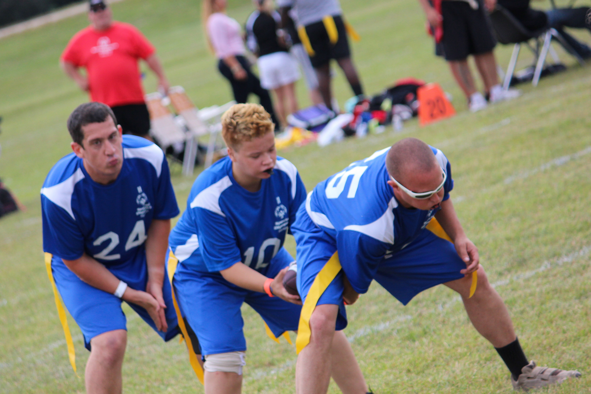
Live Ball/Dead Ball
Positions/Snap
The ball must be snapped between the Center’s legs to start each play.
If the snap is dropped and the ball hits the ground the play is over.
No minimum number of players is required to line-up on the line of scrimmage.

Slide 26
Live Ball/Dead Ball
A play is ruled dead when:
The ball carrier’s flag is pulled;
The ball carrier loses his/her flag;
The ball carrier steps out of bounds;
The ball carrier’s knee or hand touches the ground;
A touchdown, extra point, or safety is scored;
When during a try-for-point the defense obtains possession of the ball;
When a forward pass strikes the ground or is caught simultaneously by the opposing players (the offense retains possession);
A snapped ball touches the ground

Slide 27
Live Ball/Dead Ball
A play is ruled dead when: (cont.)
A pass is intercepted (no returns);
A receiver catches a ball without his/her flags attached;
False Start
No member of the offensive team may simulate the start of the play before the ball is snapped.
When there is an inadvertent whistle.
In case of an inadvertent whistle, the team in possession of the ball may choose to accept the result of the play at the point where the play was blown dead or choose to re-play the down.

Slide 28
Live Ball/Dead Ball
There are no fumbles
If the ball is fumbled the play is over and the offense retains possession of the ball at the spot of the fumble.
If fumbled forward, the ball is spotted where the ball carrier’s feet were at the time of the fumble. If ball falls backwards, it is marked where it hits the ground;

Slide 29
Flag Pulling
A legal flag pull takes place when the ball carrier is in full possession of the ball.
It is illegal to pull or strip the ball from the carrier’s possession at any time. Will result in a penalty.
If a player’s flag belt inadvertently falls off during the play, the player is down immediately upon possession of the ball and the play ends.
A defensive player may not intentionally pull the flags off a player who is not in possession of the ball. Will result in a penalty.

Slide 30
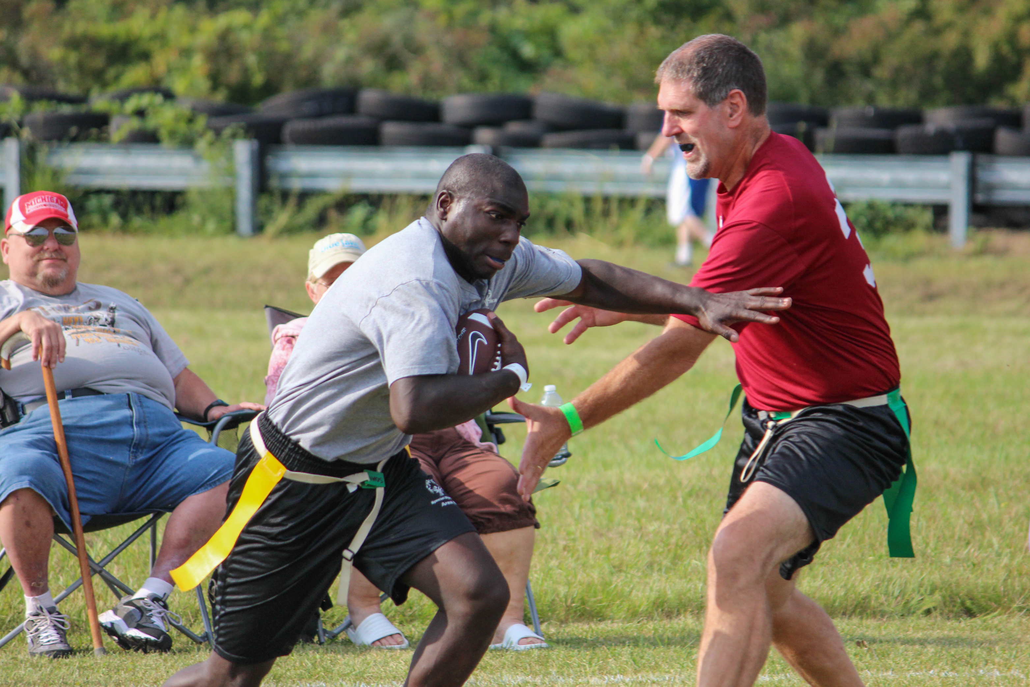
Flag Pulling
Flag Guarding/Shielding is an illegal attempt by the carrier to obstruct the defense’s access to the flags by stiff arming, dropping the head or shoulder, or intentionally covering the flags with the football jersey.

Slide 31
Running
Handoff
A handoff is transferring possession of the ball from one teammate to another without throwing or kicking it.
All handoffs must be direct handoffs
No forward hand-offs are allowed (illegal pass)
Laterals and pitches are illegal.

Slide 32
Running
In Unified divisions, a Unified Partner may handoff to a Unified Partner.
The player who takes a hand-off can pass the ball, as long as he/she does not pass the line of scrimmage.
The Quarterback (first player gaining possession of the snap) cannot advance the ball across the line of scrimmage.
The ball is marked at the spot where the position of the ball is when the player is declared down (carrier’s flag belt is pulled or hand/knee touches ground).

Slide 33
Running
The ball carrier may not dive, hurdle, stiff arm or use either arm to shield a defender from grasping their flag.
Shielding (Flag Guarding) – Runners shall not shield (flag guard) by using their hands, arms, or the ball to deny the opportunity for an opponent to pull or remove their flag belt.
This includes
Swinging the hand or arm over the flag belt
Stiff arms
Placing the ball in a possession over the flag belt
Lowering shoulders or arm over the flag belt
Hurdling

Slide 34
Passing/Receiving
All passes must be forward and received beyond the line of scrimmage.
Shovel passes are allowed but must be received beyond the line of scrimmage.
All players are eligible to receive a forward pass, including the Quarterback, if he/she has legally handed the ball off.
Exception in Unified Sports divisions, Unified Partners are not allowed to throw to other Unified Partners, their passes must be thrown to Athletes.

Slide 35
Passing/Receiving
A player must have at least one (1) foot in bounds when making a catch.
Interceptions change possession of the ball at the point of the interception; no returns are allowed
Exception: A ball intercepted in the end zone is spotted at the 5-yard line.

Slide 36
Passing/Receiving
Diving
A defensive or offensive player may dive to catch a pass.
Diving is illegal when used to down a player (pull their flag) or advance the ball.
A player cannot dive in an attempt to gain extra yardage.
The team will be penalized accordingly

Slide 37
Passing/Receiving
Eligible Receiver
All offensive players are eligible to receive a pass, including quarterbacks after they execute a handoff.
Exception: In Unified Sports divisions Unified Partners are ineligible when Unified Partners are throwing the pass.
Unified Sports teams are expected to comply with this rule without intervention by officials.
Failure to “self-patrol” will be considered unsportsmanlike and will be penalized accordingly.

Slide 38
Rushing the Passer
The player who rushes the QB must be a minimum of 7-yards from the line of scrimmage when the ball is snapped.
A special marker, placed by the official, will designate the spot 7-yards from the line of scrimmage
Players not rushing the QB may defend the line of scrimmage.
Once the QB hands off the ball, the 7-yard zone no longer exists, and all defenders are eligible to rush.

Slide 39
Screen Blocking
Screen Blocking – legally obstructing an opponent without contacting him/her with any part of the screen blocker’s body.
Screen blocking is the only form of legal blocking that can be used by any player at any time.
The screen blocker shall have his/her arms fully extended to the ground (below the waist) either at his/her side, in front, or behind his/her back. Arms may also be crossed at the chest with hands at the shoulders.
Any use of arms, elbows, legs, or shoulders to initiate contact during the screen block is illegal.

Slide 40
Screen Blocking
Screen blocker must give opponent at least one step
Screen blocker must not initiate contact with opponent
Screen blocker may not take a position so close to a moving opponent that this opponent cannot avoid contact by stopping or changing directions.
After the snap of the ball, a blocker may move laterally or backward (2) steps.
If any of the provisions listed are violated, and contact results, the screener has committed an illegal block

Slide 41
Penalties
Penalties are called at the sole discretion of the officials.
Coaches and/or captains have the option of accepting or declining all penalties.
All penalties are assessed from the line of scrimmage.
No penalty may take the ball more than half the distance to the offender’s goal line.

Slide 42
Penalties
Offense: Pre-Snap Penalties
5-yards from the line of scrimmage and replay down
Illegal Motion (more than one (1) player moving at snap, moving forward at snap).
Illegal Shift (more than one (1) player moving at the snap without resetting)
Offside (in neutral zone at snap, false start)
Delay of Game (failing to snap within 30 seconds of ready)

Slide 43
Penalties
Offense: Post-Snap Penalties
5-yards from the line of scrimmage and loss of down
Illegal forward/backward pass (pass not completed beyond line of scrimmage; illegal backward pass; Partner to Partner; QB pass beyond line of scrimmage)
Illegal Procedure (QB run)
Pass Interference (picking or pushing defender)
Illegal Contact (holding, blocking, bumping, stiff arming)
Flag Guarding (driving, spinning, warding off, hurdling)

Slide 44
Penalties
Defense: Pre-Snap Penalties
5-yards from the line of scrimmage and replay down
Offside (in or beyond neutral zone at snap)
Defense: Post-Snap Penalties
5-yards from the line of scrimmage and automatic first down
Pass interference
Illegal Contact (holding, blocking, bumping, stripping)
Illegal flag pull (before receiver has ball)
Illegal Rushing (rushing QB inside 7-yard marker)

Slide 45
Unsportsmanlike Conduct
Offensive Penalty
10-yard penalty and loss of down
Defensive Penalty
10-yard penalty and automatic first down
The officials will disqualify any player who participates in rough or unsportsmanlike play.
During player possession, it is illegal for a defensive player to strip or pull the ball from the ball carrier at any time.

Slide 46
Unsportsmanlike Conduct
Ball carriers MUST make an effort to avoid defenders with an established position.
Defenders are not allowed to run through the ball carrier when pulling flags.

Slide 47
Individual Skills Contest
The Individual Skills Contest is designed for lower ability, or new athletes, who have not yet developed the skills necessary to participate meaningfully in team competition and athletes who use a wheelchair. Athletes may not be assisted by coaches. Modifications will be made for athletes who have visual or hearing impairments.
The athlete's final score is determined by adding together the scores achieved in each of the events. For diagrams and rules for each event please visit somi.org/sports/sports/flag football.html

Slide 48
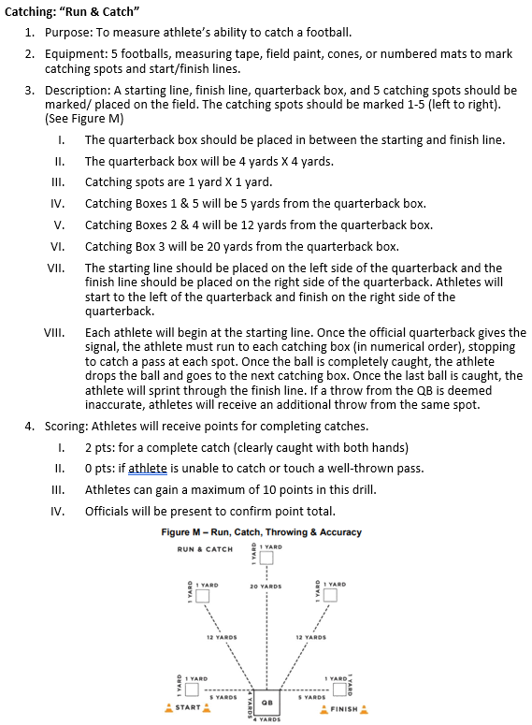
Individual Skills Contest Run & Catch

Slide 49
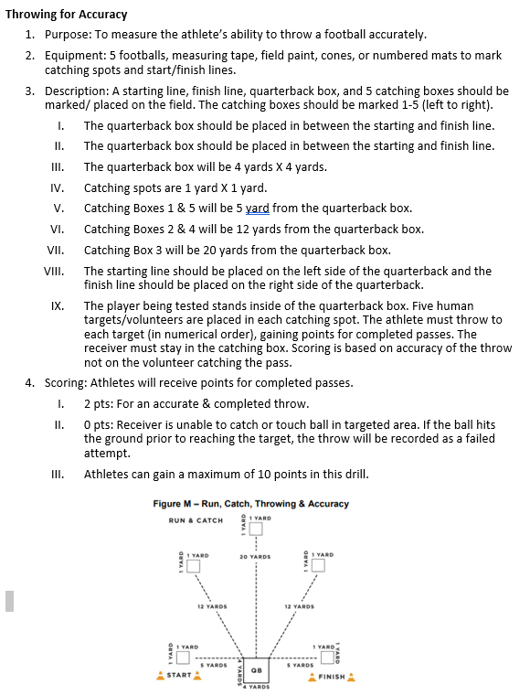
Individual Skills Contest Throw For Accuracy

Slide 50
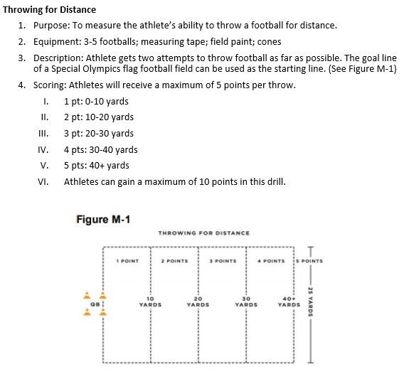
Individual Skills Contest Throw For Distance

Slide 51
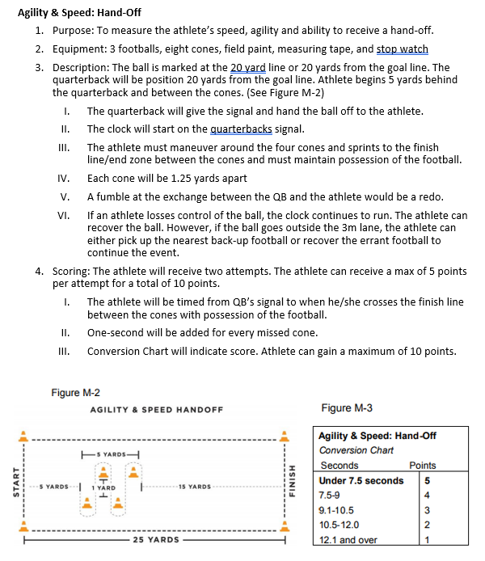
Individual Skills Contest Speed Hand Off

Slide 52
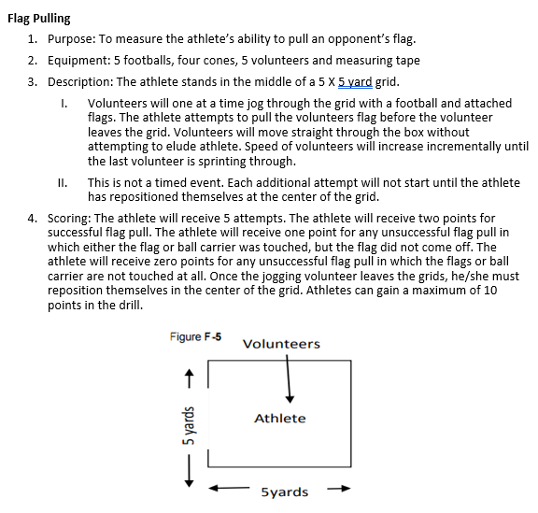
Individual Skills Contest Flag Pulling

Slide 53
Referee Signals

Slide 54
Terminology
Out of bounds | The outer perimeter line of the field. They include the sidelines and the back of the end.
Line of Scrimmage | (LOS) an imaginary line running through the point of the football and across the width of the field
Rush Line | An imaginary line running across the width of the field 7 yards (into the defensive side) from the line of scrimmage.
Offense | The team with possession of the ball
Defense | The team opposing the offense to prevent them from advancing the ball
Passer | The offensive player that throws the ball and may or may not be the quarterback
Quarterback | The offensive player first receiving possession of the ball. The quarterback may not run the ball.

Slide 55
Terminology
Rusher | The defensive player(s) assigned to rush the quarterback to prevent him/her from passing the ball by pulling his/her flags or by blocking the pass.
Downs (1,2,3,4) | The offensive squad has 4 attempts or “downs” to advance the ball. They must cross midfield to get another 4 “downs” to score.
Live Ball | Refers to the period of time that the play is in action. Generally used in regard to penalties, live ball penalties are considered part of the play and must be enforced before the down is considered complete.
Dead Ball | Refers to the period of time immediately before or after the play.
Whistle | Sound made by an official using the whistle that signals the start/end of play or a stop in the action for a timeout, half time, or the end of the game.

Slide 56
Terminology
Inadvertent Whistle | Official’s whistle that is performed in error
Screen Blocking | A legal obstruction of an opponent without contacting him/her with any part of the screen blocker’s body.
Shielding (Flag Guarding) | An act by the ball carrier to prevent a defender from pulling the ball carrier’s flags by stiff arm, lowering elbow or head, or by blocking access to the runner’s flags with a hand or arm
Shovel Pass | A legal pass attempted beyond the line of scrimmage by throwing the ball underhand or pushing it towards a receiver in a shot put type manner.
Later/Pitch | A BACKWARD PASS of the ball by the ball carrier.

Slide 57
Terminology
Unsportsmanlike Conduct | A rude, confrontational, or offensive behavior or language.
Shift | A shift is the action of one or more offensive players who after taking positions move to a new position prior to the snap.
Defer | Winner of Coin toss is giving the choice to the other team for the first half of the game. The winner of the coin toss gets choice in the second half.
No Run Zones | Areas of the field where teams can only pass the ball.
Center | Player that snaps ball through legs to begin play.

