Slide 1
Cycling Official Rules

Slide 2
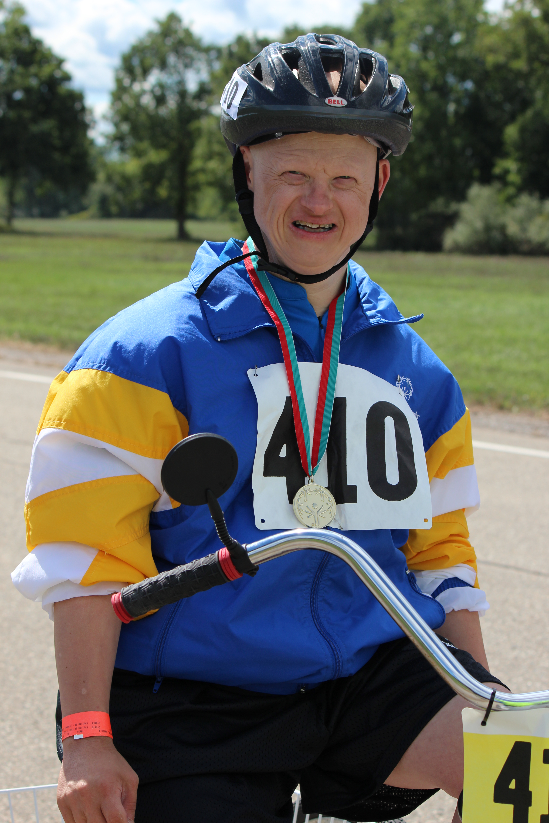
Events Offered
Three Wheel Bike
    250M Time Trial
    500M Time Trial
    1K Time Trial
    3K Time Trial
Two Wheel Bike
    500M Time Trial
    1K Time Trial
    3K Time Trial
    5K Time Trial
    5K Road Race
    10K Road Race
Unified
    3K Unified Time Trial
    5K Unified Time Trial
    10K Unified Time Trial
    3K Unified Tandem Time Trial
    5K Unified Tandem Time Trial

Slide 3
Uniforms
Uniform: The recommended cycling uniform is a jersey, cycling shorts, and cycling gloves although this uniform is not mandatory. Shorts should be mid-thigh in length. If wearing long pants, only form fitting pants may be worn (i.e. spandex). Clothing should not be too big or too loose as to get caught in the bike while riding.
Athletic shoes are recommended, ensure that laces are tied and not of excessive length. Bicycle “click-in” shoes are allowed
The tournament director will have the final say on what shorts and/or pants will not be allowed.

Slide 4
Uniforms
The SOMI logo must be on all jerseys worn during competition.
Hats, jewelry and demin may not be worn during competition.

Slide 5
Equipment
Equipment: All bicycles and helmets must pass a safety inspection on race day prior to competition. Inspections will be conducted on race morning by a qualified bicycle mechanic on site.
If a bicycle is deemed unsafe, the bicycle will not be allowed on the course. If adjustments need to be done, they must be done before the inspection period is over. Athletes whose bikes do not pass inspections will be disqualified.
Any standard bike that complies with the safety standards may be ridden.

Slide 6
Equipment
Adaptive bikes may be used in time trial events if they do not impede other riders or cause an advantage, the bikes must pass safety inspection.
Bicycles must have two working brakes to be used during competition.
Helmets are required and must meet ANSI or SNELL safety standards and must be fitted properly. Helmets must be bike helmets and not helmets from other sports.
Bicycles with handlebars with forearm supports or forward/upward extensions may only be used during time trial events.

Slide 7
Equipment
It is the coach and athlete’s responsibility to bring equipment that is in working order. Any repairs needed are the responsibility of the coach.

Slide 8
Races
SOMI offers the following races for Cycling State Competition
Three Wheel Bike
    250m Time Trial, 500m Time Trial, 1k Time Trial, 3k Time Trial
Individual
    500m Time Trial, 1k Time Trial, 3k Time Trial, 5k Time Trial, 5k Road Race, 10k Road Race
Unified
    3k Unified Time Trial, 5k Unified Time Trial, 3k Unified Tandem Time Trial, 5k Unified Tandem Time Trial, 5k Unified Team Road Race, 10k Unified Team Road Race

Slide 9
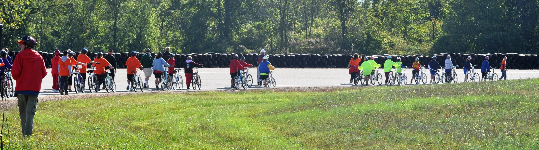
Races
    FOR ALL DIVISIONS
    To qualify to register for 3k events, the athlete must be able to complete the race in 15 minutes or less
    To qualify to register for 5k events, the athlete must be able to complete the race in 18 minutes or less
    To qualify to register for 10k events, the athlete must be able to complete the race in 26 minutes or less

Slide 10
Races
Time Trial: Consists of an individual racing against the clock. Racers will start individually at 20-second intervals. The race line-up will typically start with the racer with the slowest qualifying time first and the racer with the fastest qualifying time last. This is an official event, not a qualifying race for another event.
Road Race: Consists of racers all beginning together in a mass start. For multi-lap courses everyone will finish on the same lap as the leader.

Slide 11
Races
Each athlete may enter up to two events. Athletes competing in Unified events may not enter individual traditional events.
Qualifying Scores must be submitted for all races prior to attending State Cycling Finals. Scores should be submitted using minutes, seconds, milliseconds.
  Example: 12 minutes 29 seconds would be – 12:29.00
The finish line for all races should stay the same. Start lines will vary based on race distance.

Slide 12
General Rules
All riders must be in the staging area 30 minutes prior to their event. Start time is forfeit time. If not present at start time you will forfeit
Riders will start from a stationary position. The rider may be held with their feet on the pedals for the start but may not be pushed. Drafting and taking pace (side by side) is not allowed in time trials unless it is a team event. Partners can draft each other, but not other teams. Separation between two bikes should generally be at least 3 bike lengths, unless passing.

Slide 13
General Rules
The starter shall countdown to the starting time using both audible and visual countdowns for each rider. (15 seconds, 10 seconds, 5, 4, 3, 2, 1, Go!)
The start is by a starter gun, whistle or beeper system. Hearing impaired racers may be given a visual cue to indicate the start.
The race shall be declared finished when the front tire of the bike crosses the finish line.
The finish is determined by placing/order of crossing the finish line.
Coaches are not allowed on the track.

Slide 14
General Rules
No racer may use or carry radios for communications with other racers or coaches.
The use of headphones of any style is not allowed while racing or training. However, racers with certified hearing impairments may use hearing detection and amplifying devices.
Racers will wear entry number bibs during competition. Numbers will be placed on the front of the handlebars facing forward, on the racers back facing backwards and on the racers helmet on the right side facing out. The bib with the timing chip will be placed on the handlebars.

Slide 15
General Rules
Racers who experience mechanical problems may change any part of the bicycle, or the entire bicycle, to finish a race. Assistance is allowed in this circumstance.
A racer remounting their bike following a crash or mechanical problem may be pushed up to 10 meters but may not make any progress while not on their bicycle.
In the case of a mechanical problem the racer may push the bike to the finish line to finish the race.
  For Tandem Teams, both riders must be touching the bike at the finish line.

Slide 16
Unified Team Events
Unified Team events will include the 3K and the 5K Time Trial and the 5K and 10K Road Race. This will include a two-person Unified Sports Team. (1 Athlete and 1 Unified Partner). The team’s place will be determined when the last competitor’s front wheel (Partner or Athlete) crosses the finish line.
  Two-wheel bicycles must be used for Unified races.
Athletes and Unified Partner teammates must stay a maximum of 3 seconds apart during the race, or the team will be disqualified.
Unified tandem events will include the 3K and 5K Time Trial. The Athlete or Partner may assume the driver (front) or stoker (rear) position on the tandem.

Slide 17
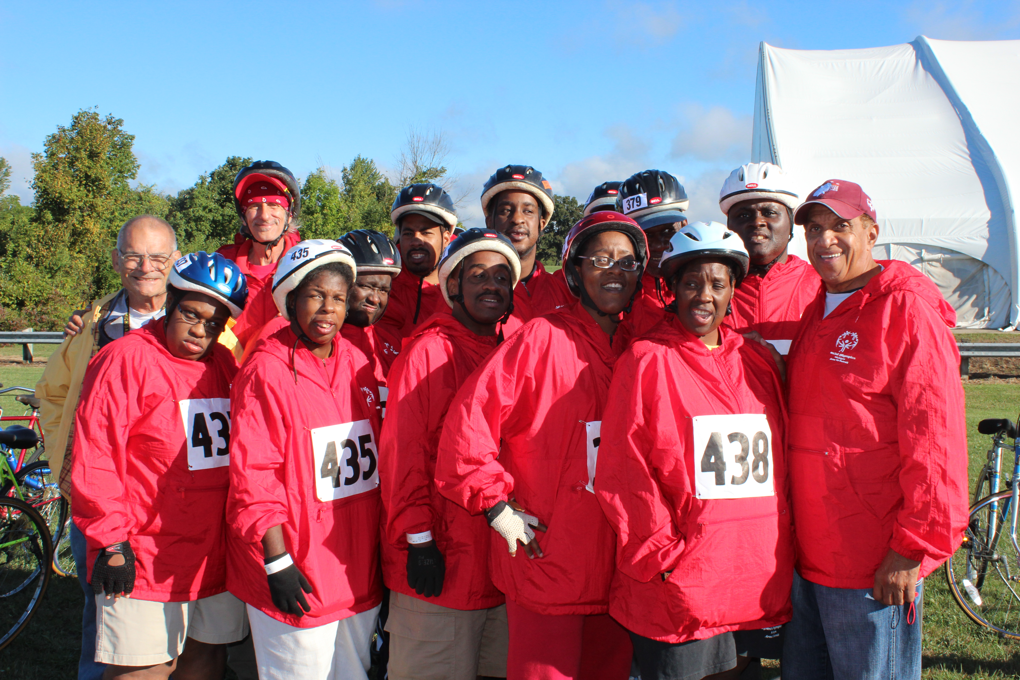
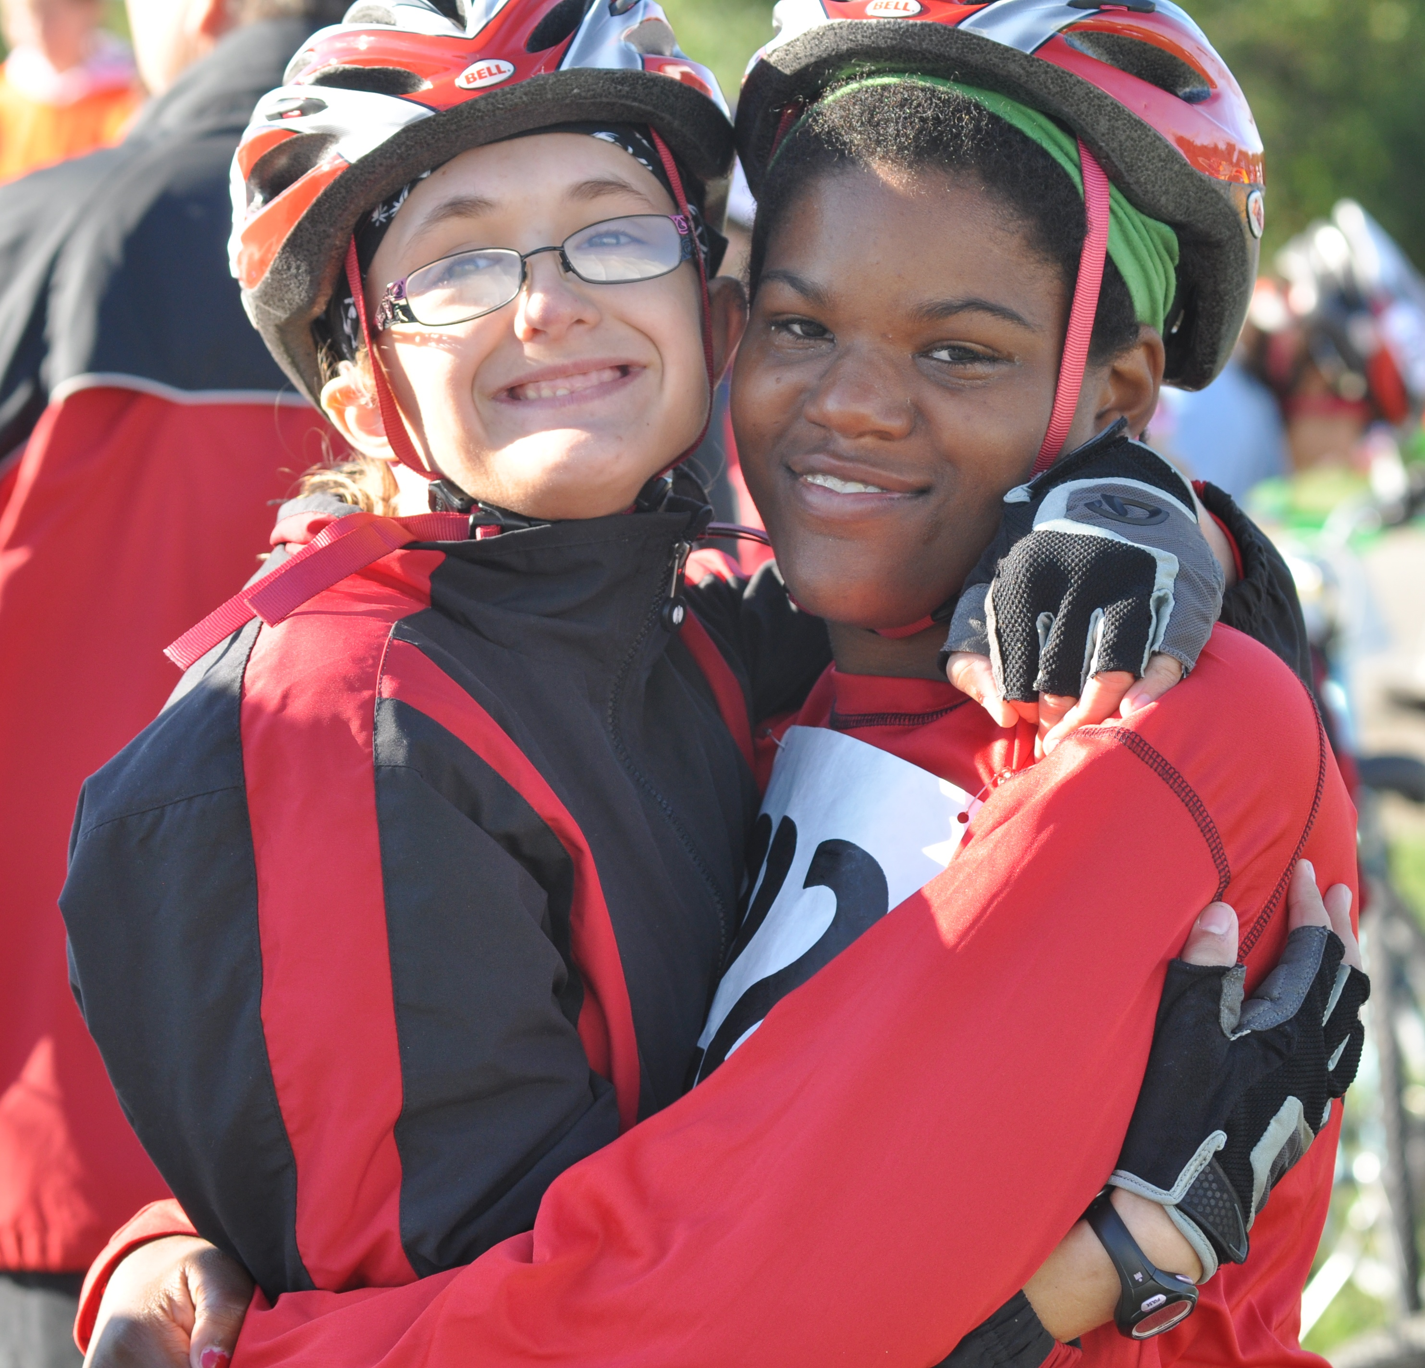
Divisioning
A time must be submitted for each event an athlete is registered for. Separate divisions will be made for 3-wheel bicycles. Any athlete using these bikes must be identified at registration time.

Slide 18
Practice
Athletes should begin practice 8-12 weeks before the state culminating event and should practice regularly
It is recommended to have coaches/chaperones available to ride with/alongside the athletes
Facilities – Trails, large parking areas (schools, churches, office complexes), cycling or racetracks, parks and rail trails
    It is important to cone off or make entrance and exit areas inaccessible to cars during practice sessions

Slide 19
Safety
It is important for athletes to have well-fitted equipment and bicycles
Athletes should understand how the bike works, brakes, shifting, etc.
Athletes should have a strong understanding of mounting and dismounting the bike.
Athletes should wear a helmet at ALL TIMES, practice, home practice and competition
When practicing it is important for all athletes to understand the importance of roadway safety
    Look both ways, pay attention to traffic signs, etc.

Slide 20
Bike Terms
Brake Levers: Mechanisms attached to the brake arms, which clamp the rim during braking.
Brake Pads: Rubber pads attached to the brake arms, which clamp the rim during braking.
Cassette: The set of gear cogs on the rear hub; also freewheel, cluster or block.
Chain: The flexible metal link between the rear wheel and the front chain ring. It transmits the power from the pedals to the rear wheel.
Chain Rings: The front gear wheels that drive the chain. One to three speed bicycles have one chain ring; ten to sixteen speed bicycles have two chain rings. Bicycles with more speeds than that have three.

Slide 21
Bike Terms
Chainstay: Small tube running from bottom bracket back to rear dropouts.
Cleat: A metal or plastic fitting on the sole of a cycling shoe that engages the pedal.
Clincher: Tire and tube separate, and the tire expands under pressure to grip the sides of the rim like a car tire.
Drivetrain: Components directly involved in making the wheel turn: chain, crank set and cassette.
Dropout: Open-ended fixtures at the fork ends and at the convergence of the seat and chain stays, which receive the axels of the wheels.

Slide 22
Bike Terms
Drops: Lower parts of a turned-down handlebar, also called the hooks.
Foot Brake: Mechanism that stops the rear wheel when pedals are pushed in reverse.
Freewheel: The cluster of gear wheels attached to the rear wheel, which provides a variety of gears.
Handlebars: The bicycle’s steering apparatus.
Mudguards: Fenders.
PSI: Abbreviation for pressure per square inch.
Rim: Outside section of the wheel, around which the tube is inflated. Usually steel or aluminum.

Slide 23
Bike Terms
Saddle: The bicycler’s seat.
Toe Clip: Toe piece attached to a pedal, which holds the foot on the pedal.

