Slide 1
Cross Country Ski Rules

Slide 2
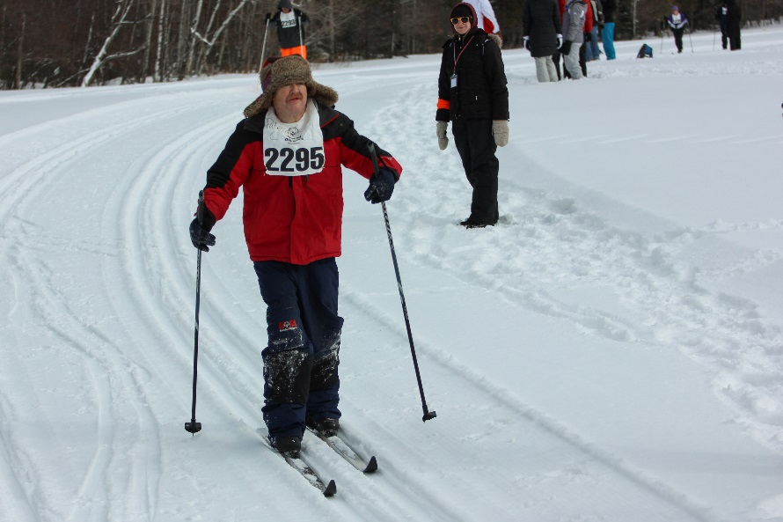
A picture paints a thousand words
“Let me win, but if I cannot win, let me be brave in the attempt.”
Use the Picture and Caption format to create strong compelling slide like this. Don’t’t forget to caption where possible. For best effect crop the image to fill the placeholder.

Slide 3
The Basics
Sport season:
December-February
Culminating State Event:
State Winter Games

Slide 4
Events Offered
50 Meter
100 Meter
250 Meter
500 Meter
1K
2.5K
5K
4x1K Relay
4x1K Unified Relay (local)

Slide 5
Uniform Guidelines and Equipment

Slide 6
Uniform Guidelines and Equipment
Athletes should wear appropriate winter sports attire. Warm ski gloves or mittens, a hat, scarf, headband or ski mask, and sun-glasses or goggles are recommended.
It is best to wear clothing that is layered to trap heat between layers. Layered clothing is especially important for 500 meter, 1K, and 2.5K skiers.

Slide 7
Uniform Guidelines and Equipment Cont.
Bibs: All competitors must wear competition bibs for both time trials and finals races.
Competition equipment, such as skis, boots, bindings, and poles, must pass all appropriate safety guidelines.
Jewelry and denim may not be worn during competition or practice. Headwear for religious or medical reasons are acceptable but must be brought to the attention of the Games Director prior to competition.

Slide 8
Course Layout/Facilities

Slide 9
Course Layout/Facilities
Markers, poles, and fencing shall be available to identify the course.
Poles and fencing shall be used to block off trails, which might lead the competitors off the race course. Banners shall mark the start and finish.

Slide 10
Course Layout/Facilities Cont.
Electric timing with a backup, hand held timing system shall be used for timing 1- 10 kilometers events. The 100 meter event should be timed with a number of stop watches equal at least to the number of athletes per division, plus two. A watch should be assigned to each lane while two extras serve as backup.

Slide 11
Course Layout/Facilities Cont.
Cross-country trails, suitable in length and terrain to accommodate skiers of beginning, intermediate, and advanced skill levels shall be available. At least one set of tracks should be set and the other lane, which is mandatory, shall be set as either a skating lane or second set of tracks.

Slide 12
Course Layout/Facilities Cont.
If more than one set of tracks are used, they should be 1 to 1.2 meters apart, measured from the middle of one track to the middle of the other. Individual ski tracks should be 20 - 24 centimeters apart, measured from the middle of one track to the other. Tracks should be at least 2-5 centimeters deep.
A warming facility should be accessible from the trails. It should be large enough to accommodate the Special Olympics crowd in case of extreme weather conditions.

Slide 13
General Rules

Slide 14
General Rules
Athletes may enter three (3) events if one is the 5K.
Events ranging from the 500 meter race to the 5 K race should follow the interval start format. That is, one or two racers should start at intervals of every 30 seconds.

Slide 15
General Rules Cont.
The start command for cross-country skiing events ranging from the 500 meter race through the 2.5 kilometer race shall be as follows: "Racer... 15 seconds... 10 seconds... 5, 4, 3, 2, 1, GO!" For individual events of distances 100 meters or less, there shall be no preliminary warning. The start command for relay events shall be the same as for individual events of distances 100 meters and less, except that there will be a 10 second warning: "10 seconds... racers... ready... Bang."

Slide 16
General Rules Cont.
Events ranging from the 500 meter race through the 5 kilometer race should be conducted on courses which include uphill, downhill, flat sections, and sections with turns. They should be conducted on courses, which are a loop configuration. In long distance events, multiple loop courses are permissible.

Slide 17
General Rules Cont.
Due to the possibility of very low registration numbers, the following events may be combined and run as open divisions: 2.5K & 5K, this means combining males and females and all age groups. Athletes will be awarded separately.

Slide 18
Event-Specific Rules and Modifications

Slide 19
50, 100 and 250 Meter Cross-Country Skiing Race
The start line is a straight line. There must be 8 lanes with tracks set in the center of each lane. These lanes must be a minimum of 2 meters wide.
The course for the 100 meter and 250 meter events should be as flat as possible.
In no event should a course slope more than 5%. In the event that the course is set on slopes, the start of the race shall be such that the competitors will ski uphill to finish the race.

Slide 20
Relays
4 x 1K Relay is each athlete competing in a 1K length.
Divisions for cross-country skiing relay races shall be established by computing Team Qualifying Times. A Team Qualifying Time is computed by combining the times of the members of a team in time preliminaries from the individual event of similar distance to one "leg" of the relay event (e.g. Times from the 1 Kilometer Cross-Country Skiing Relay).

Slide 21
Relays Cont.
Team members not entered in the individual event of similar distance to one "leg" of the relay event must enter and compete the preliminary event for that individual event.
Race officials may start a relay division once every minute.
In the event a team does not execute a proper exchange, an exchange zone referee shall notify the skiers involved in the exchange immediately. It is then the skier’s responsibility to decide whether or not to re-execute an exchange.

Slide 22
Disqualifications

Slide 23
A competitor may be disqualified if he/she:
Does not follow the marked course or does not pass all the control check points or takes a short cut.
Receives unauthorized assistance.
Fails to give way to an overtaking competitor when so requested or prevents another racer from passing.

Slide 24
A competitor may be disqualified if he/she:
Violates technique ruling regarding skating in classical races.
Does not finish with skis on his/her feet.
Falls or leaves the track: that individual has 2 minutes to resume racing, the competitor must also advance forward a minimum of 20 meters within that time. Failing to resume advancement on the track within 2 minutes, and/or receiving unauthorized assistance.

Slide 25
Thank you!

