Slide 1
Bocce Official Rules

Slide 2
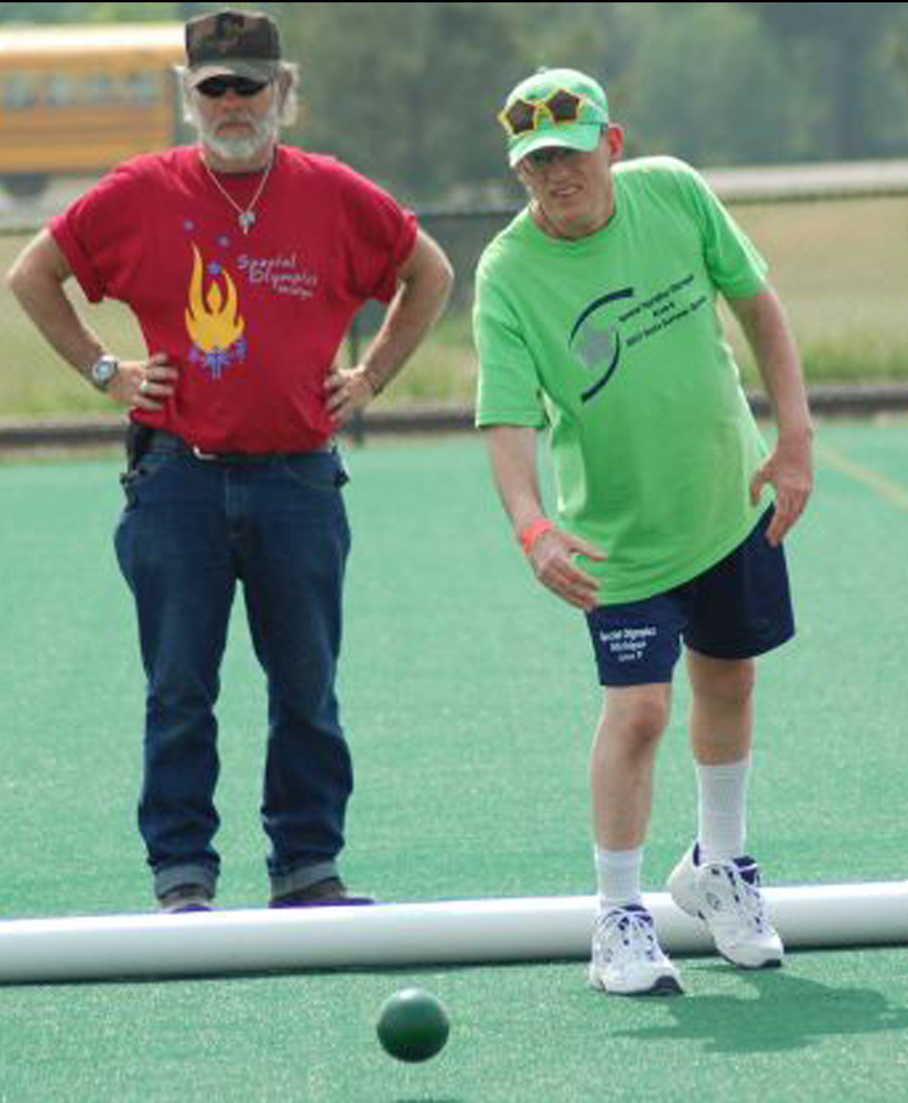
Events Offered
Singles
Doubles
Modified Singles
Modified Doubles
Unified Doubles
Unified Team

Slide 3
Uniforms
Preferred Uniform: White collared shirt or T-shirt and dress shorts/pants
    If not possible at State Summer Games, athletes should wear their area shirts.
    All team members must wear a uniform that is identical in color and style.
Both jewelry and demin are not allowed to be worn during competition.
    Medical or Religious jewelry may be worn if necessary. Please bring this to the attention of the Games Director prior to competition.

Slide 4
Uniforms
Hats and visors are allowed to be worn during competition.
Shoes:
    Closed toe shoes or smooth soled athletic shoes are recommended.
    Spikes are prohibited.

Slide 5
Court
A Bocce court measures 60’ long by 12’ wide.
The court surface may be comprised of stone-dust, dirt, clay, grass or artificial grass and should be free of obstructions.
Court walls may be composed of any rigid material and should be at least as tall as the bocce ball. All side and end walls may be used during play for bank shots.

Slide 6
Court
Each Court should have marked:
  Half Court (30 Foot Line): Which is the minimum distance the pallina must travel to begin play.
  Ten Foot Line (on each end): Which is the foul line for shooting.

Slide 7
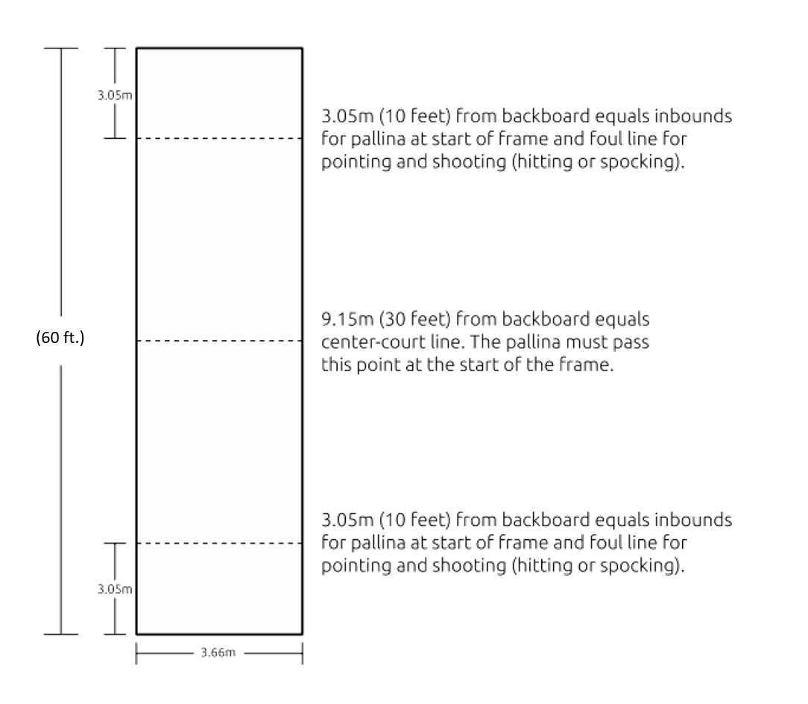
Court

Slide 8
Equipment
Bocce balls may be composed of wood or composition materials and should be of equal size.
  There should be 8 bocce balls total for game play, four per team.
  The bocce balls for each team should be different colors to differentiate between teams.
The color of balls is immaterial provided that the four balls of one team are clearly and visibly distinct from the four ball of the opposing team.
Traditional Bocce Balls should measure between 107mm to 110mm and weigh 2.0 to 2.25 pounds.

Slide 9
Equipment
Pallina: The target ball.
  Should be a color visibly distinct from both bocce ball colors – typically white but can be orange in some instance.
  Should measure between 48 – 63mm.
A tape measure, or other measuring device, is needed to accurately measure distances.
Visually impaired athletes may be allowed the use of a beeper near the pallina to identify the throwing direction.
Ramps may be used in modified divisions.

Slide 10
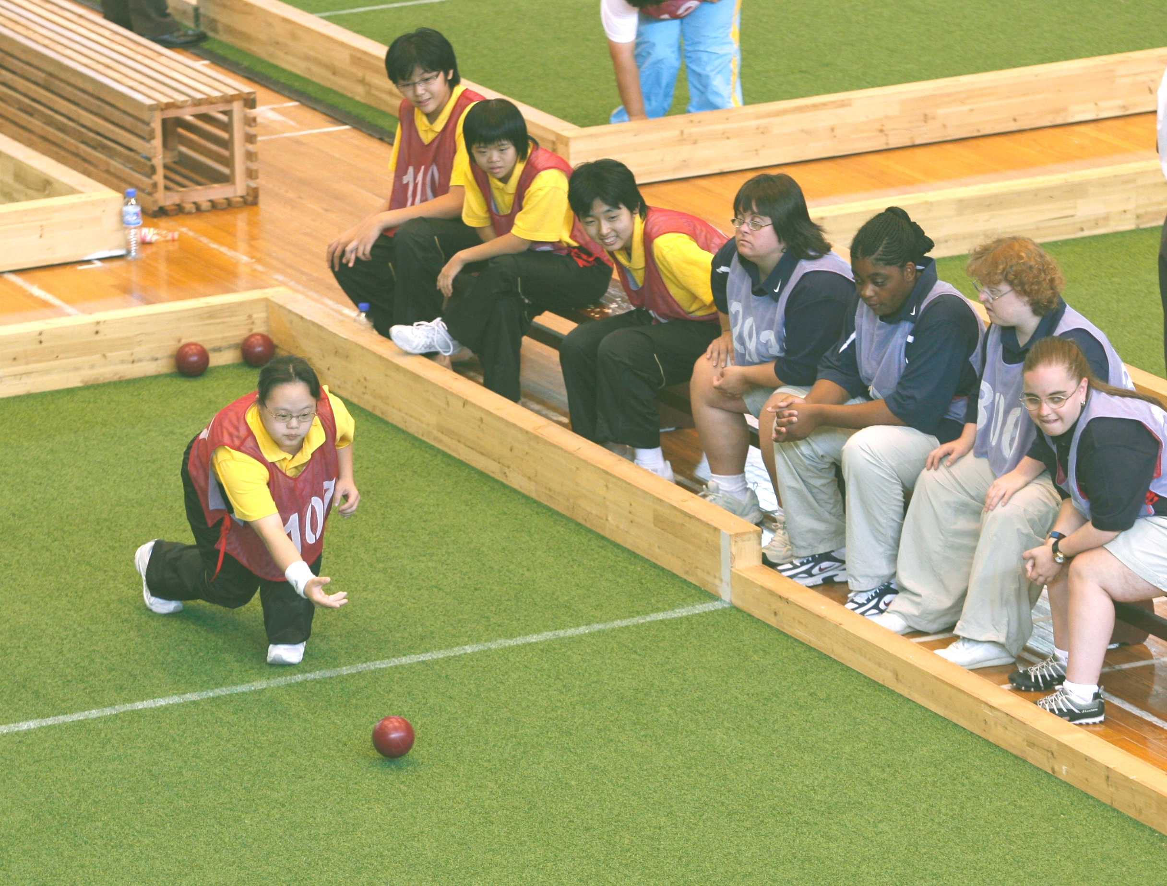
Number of Balls Played
Singles: Players roll 4 balls.
Doubles: Players roll 2 balls each.
Team: Players roll 1 ball each.

Slide 11
General Rules
A coin toss by referee determines which team has the pallina and choice of ball color.
Pallina is rolled or tossed by a member of team who won the coin toss.
  Team possessing the pallina will have 3 attempts at placing the pallina within the 30’ mark and before the 10’ mark on the opposite end.
  If 3 attempts are unsuccessful, the opposing team has one opportunity to place the pallina.
  If this is unsuccessful, the referee will place the pallina in the center of the court.

Slide 12
General Rules
Player who tossed the pallina delivers the first ball. The opposing team follows delivering their first bocce ball. This team continues until the point is taken or they have exhausted their four balls. This "nearest ball" rule governs the sequence of played balls.
The side whose ball is closest to the pallina is called the “in” ball and opposing side the “out” ball
Whenever a team gets “in,” it steps aside and allows the “out” team to deliver their bocce balls

Slide 13
General Rules
Initial Point
    It is always incumbent upon the team with the pallina advantage to establish the initial point.
    Example: Team A rolls the pallina and delivers the first ball. Team B elects to hit Team A's ball out of position. In doing so, both balls, Team A and Team B fly out of court, leaving only the pallina in the court. It is incumbent upon Team A to re-establish the initial point.

Slide 14
General Rules
Ball Delivery:
    A team has the option of rolling its ball down the court provided it does not go out of bounds or the player does not violate the foul markers.
    A player also has the option of “spocking” or hitting out any ball in lay trying to obtain a point or decreasing the opposing team’s points.
    All ball delivery attempts must be made behind the 10 Foot Line and be made in an underhand style.

Slide 15
General Rules
    Hitting is sometimes known as shooting. Hitting is the action of rolling a ball which is thrown with sufficient velocity that it would hit the backboard it if missed the target.
    Bank or rebound shots refer to playing a ball off either the side or back boards.
    If the pallina leaves the court during play – due to being hit by a bocce ball – the pallina is returned to the court against the side or back wall at the point it went out.
    If a bocce ball leaves the court during play, it will stay off the court and be lost for the frame.

Slide 16
Scoring
A Bocce game consists of 10 frames or innings
Games are played to whichever occurs first:
    12 Points
    10 Frames Completed
    25 Minute Time Limit Reached
Points are determined at the end of each frame
    A frame is finished when each team exhausts (has thrown) all their bocce balls.

Slide 17
Scoring
Scoring points:
    All balls of one team closer to the pallina than the closest ball of the opposing team score points (determined through viewing or measurements).
    One point is recorded per bocce ball.
    Only one team will score per frame.
    Total points scored will range between 1 – 4 per frame.
Scoring team will also wins the pallina advantage for the next frame.

Slide 18
Scoring - Ties
During Frame:
    In the event that two opposing balls are equidistant from the pallina, the team that rolled last will continue to roll until the tie is broken.
End of Frame:
    In the event that two balls closest to the pallina belong to opposing teams and are tied, no points will be awarded.
    Pallina returns to the team, which delivered it.
    Play resumes from the end of the court from which frame was last played, essentially re-playing the last frame.

Slide 19
Rotation of Players
In doubles and team play, the players of any given team may elect to play their ball in any rotation provided that the player who tosses the pallina delivers the first bocce ball.
The rotation may vary from frame to frame however no player may deliver more than his/her allotted number of balls per frame.

Slide 20
Modified Bocce
Modified Bocce is designed for the athlete who does not have the ability to consistently throw the bocce ball sixty feet for ten frames.
Modified Bocce will be played with the same rules as traditional bocce with the following exceptions:
    Court size will be 30’ long by 12’ wide, with one end of the court open.
    Game play will be in only one direction.

Slide 21
Modified Bocce
    Modified Bocce balls should measure 4” in diameter and weight 1 pound.
    Pallina must be thrown between the 10’ and 5’ mark to begin play.
          If Team A exhausts their three pallina attempts, and Team B is also unsuccessful in their attempt, the pallina will be placed in the center of the court at the 5’mark to begin play.

Slide 22
Unified Bocce
Unified Bocce is played as a doubles or team competition.
    Doubles consist of 1 Athlete and 1 Unified Partner
    Teams consist of 2 Athletes and 2 Unified Partners
Team members can play in any order as long as the member who rolls the palling takes the first attempt.
No changes are made to competition rules.

Slide 23
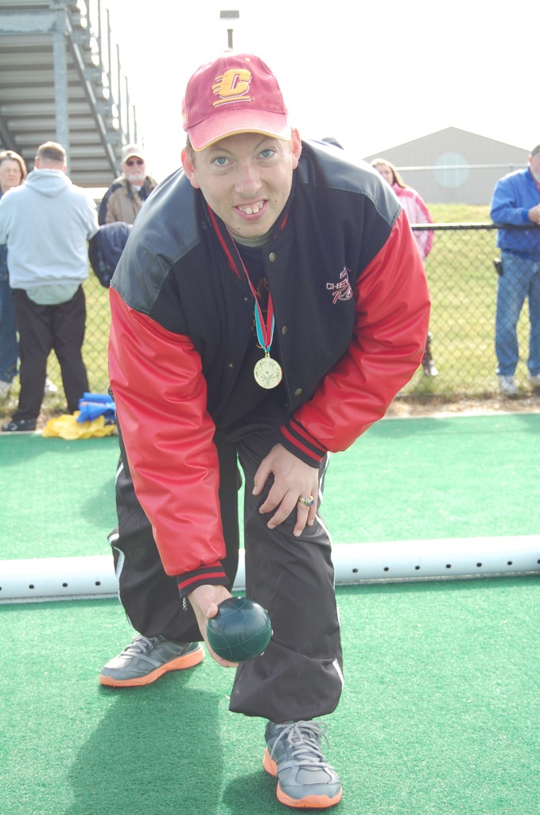
Coaching
No coaching from sidelines (this includes spectators).
In doubles, discussion with any athlete is prohibited.
No coaches on the courts.

Slide 24
How To Get Qualifying Scores
Play 3 short individual games to assess the athlete’s ability…and to determine which Division they should play in. This score will be utilized to set divisions.
Place the pallina on the center of the 30ft line & the player rolls all 8 balls towards it. Measure the closest 3 throws. Record the 3 distances on the Skills Assessment scoresheet in centimeters
Change end… The pallina is placed on the center of the 40ft mark & repeat same process as for the 30 foot.

Slide 25
How To Get Qualifying Scores
Change end… The pallina is placed on the center of the 50ft line & repeat same process as for the 30 foot & 40 foot.
    For modified, the pallina should be placed at the 15, 10, & 5 ft. lines.
Should the pallina be moved from its spot… it is replaced back before the next ball is thrown or any measurements are taken.
Total all 9 scores in centimeters, this is their qualifying score!

Slide 26
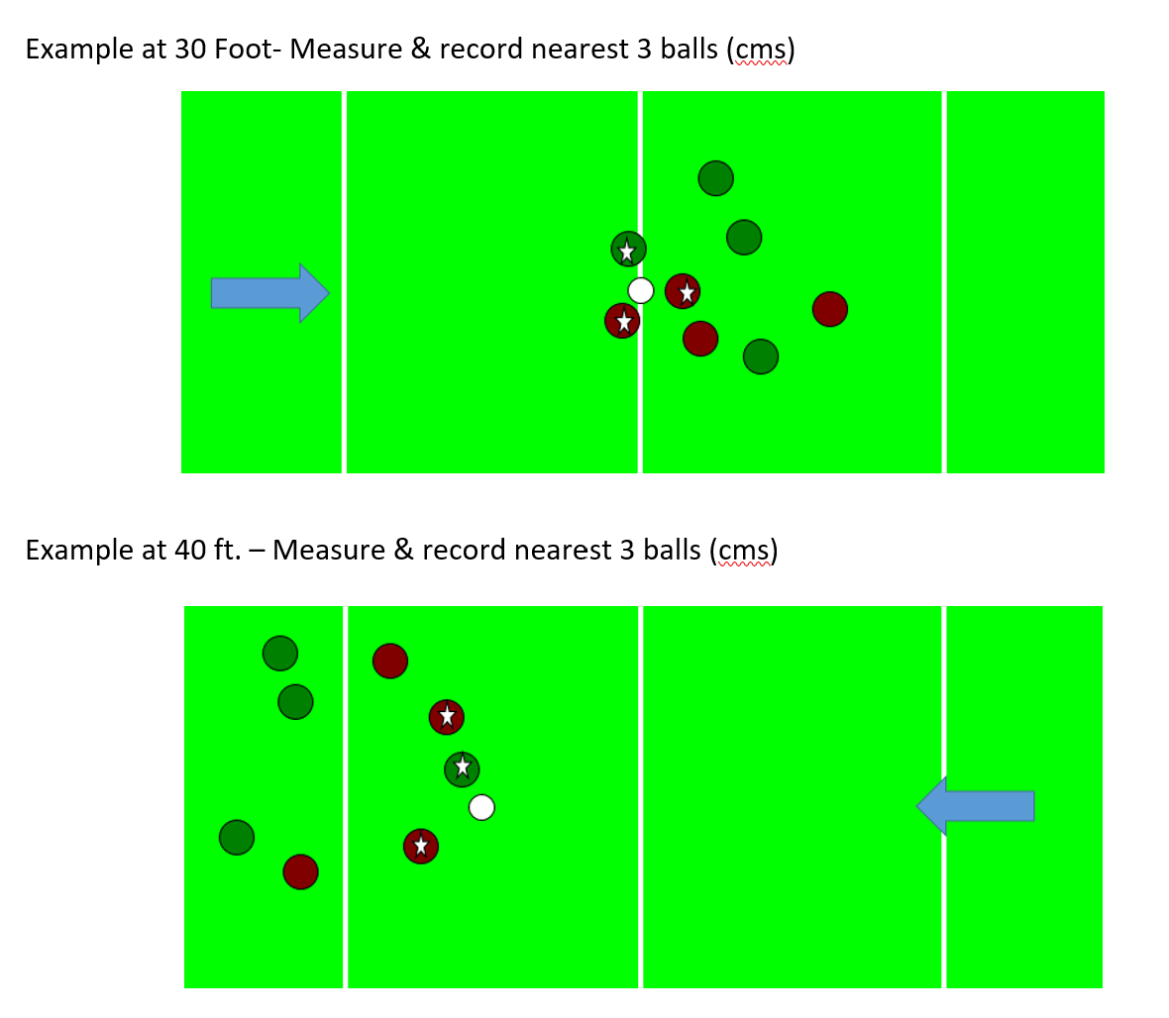
How To Get Qualifying Scores

Slide 27
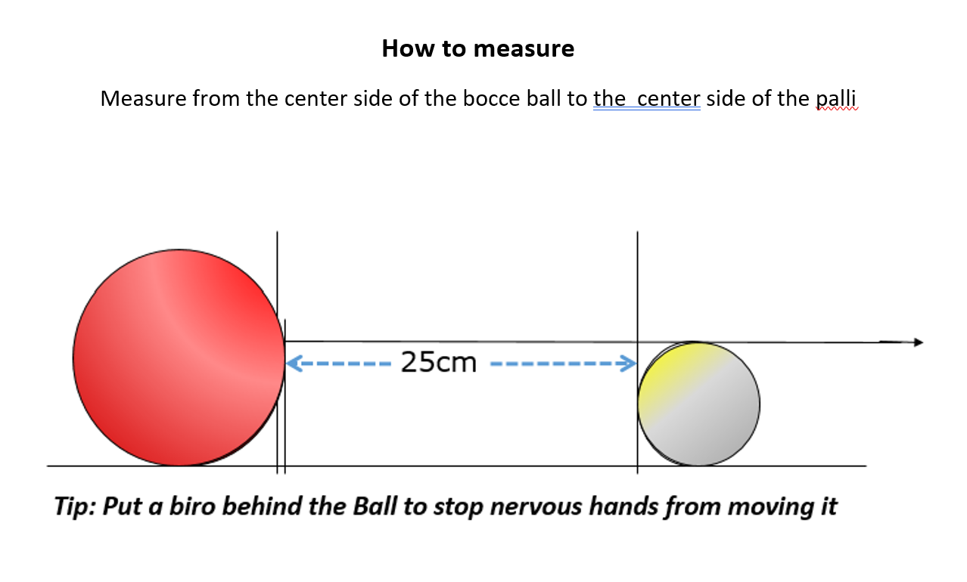
How To Get Qualifying Scores

Slide 28
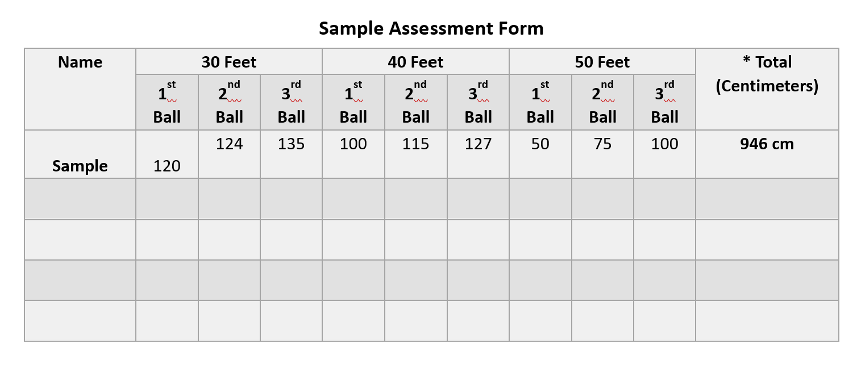
How To Get Qualifying Scores

Slide 29
Terms
Dead Ball: A ball that has been ruled, by the official, as a disqualified ball due to some form of infringement or technicality.
Foul Line: The lines on a court that the player must stay behind before the ball is released, when playing either type of delivery.
Hitting: Also called spocking, popping or shooting. It is a shot usually played to displace other balls around the target ball, rather than playing a slow gentle roll to gain the advantage/ point.

Slide 30
Terms
Pallina: A 1¾ inch ball which is rolled down the court first and becomes the target ball.
Pointing: Also called rolling or lagging. Unlike the hitting shot, this shot is played to get the ball close to the target ball, rather than trying to scatter the balls to displace other balls.
Sideboards: The boards that surround and enclose a court, usually at least 6-12 inches high in the middle, to stop the balls from leaving the court.

