Slide 1
Basketball Official Rules

Slide 2
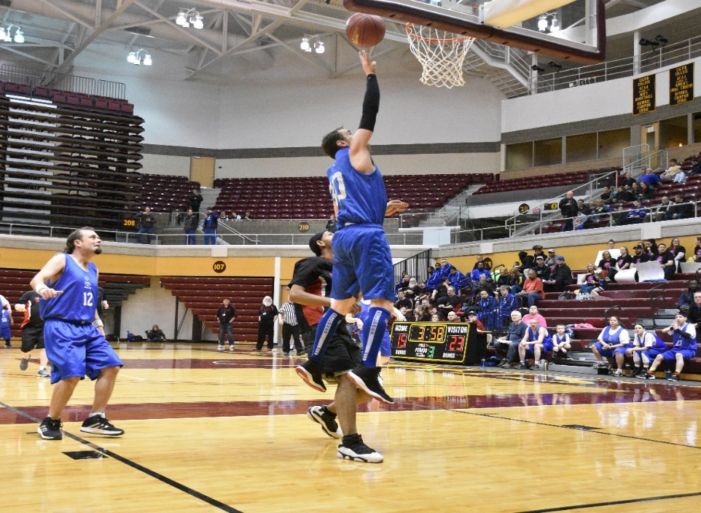
A picture paints a thousand words
“Let me win, but if I cannot win, let me be brave in the attempt.”
“Let me win, but if I cannot win, let me be brave in the attempt.”
Use the Picture and Caption format to create strong compelling slide like this. Don’t’t forget to caption where possible. For best effect crop the image to fill the placeholder.

Slide 3
The Basics
Sport season:
  December – March
Culminating State Events:
  District Basketball (Traditional Male/Co-Ed)
  State Basketball Finals (Unified, Female, Qualifying Male/Co-Ed Teams)

Slide 4
Events Offered
Team Competition
Unified Team Competition
Individual Skills Level 1 & 2
3 on 3 Competition – Contact the State Office for 3 on 3 rules

Slide 5
Uniform Guidelines and Equipment
Uniforms consist of a jersey, shorts, and sport shoes.
  All team members must have identical uniforms in color and design.
Numbers must appear on the front and the back of each athlete's jersey
  Legal Uniform Numbers: 00, 0-5, 10-15, 20-25, 30-35, 40-45, 50-55
  Teams may not have both a 00 and 0 on the roster
  For Unified teams athletes should have even numbers on jerseys and partners should have odd numbers. (Suggestion)
All uniforms must have the SOMI logo.

Slide 6
Uniform Guideline and Equipment
Hats, bandanas, du-rags, jewelry, and denim may not be worn during games or practice. Headbands, wristbands, and arm sleeves are acceptable. Headwear for religious or medical reasons are acceptable but must be on documented with the state office prior to the event.
Traditional basketball shoes should be worn.
Undershirts, if worn, must be white or the color of the jersey. All team members wearing an undershirt must wear the same color.

Slide 7
Uniform Guideline and Equipment
Sweatpants may be worn, but shorts must be worn over the top. Sweatpants must be the same color as the team shorts.
Any athlete entering the court with an illegal uniform will be assessed a technical foul
No demin is allowed on the court

Slide 8
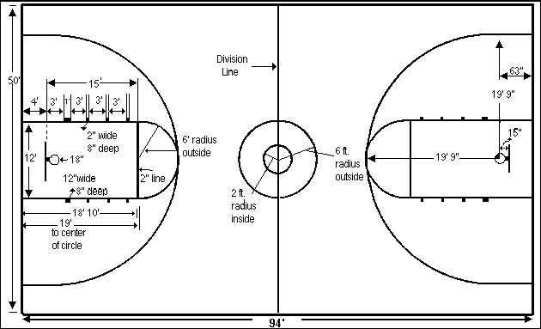
Court
Games will be played on a standard basketball court measuring roughly 94 feet long by 50 feet wide.
The 3-Point line will be use when available.

Slide 9
Equipment
For male, co-ed and Unified competition, ages 12 years and over, a size 7, 29.5 inch, basketball should be used. A smaller size 6, 28.5 inch, basketball should be used for all female competition for athletes 12 years and over. A smaller size 5, 27.5 inch, basketball should be used for competition for all athletes (male and female) under 12 years of age.

Slide 10
General Rules

Slide 11
Roster Size
  Roster Size:
    Minimum of 6 athletes, maximum of 12
    May have 3 alternates
  Unified Rosters:
    The roster shall contain an equal number of traditional athletes and unified partners
    May have up to 4 alternates
          2 Athletes, 2 Unified Partners
    Must always have 3 Athletes and 2 Unified Partners on the court at all times

Slide 12
Timing
  4 – 6 Minute Quarters
  5 Minute Half Time.
  Overtime:
    3 Minute periods until a winner is determined
  Each Team receives 5 Timeouts
    3 – 60 second timeouts; 2 – 30 second timeouts

Slide 13
Timing
  Forfeits
    Teams who arrive 15 minute past their scheduled game time will automatically forfeit their game.
    Game will count as a loss, but they may play their next game for 3rd/4th place.

Slide 14
General Rules
  Ball must be inbounded after each made basket
    5 second inbound rule applies
    10 seconds to cross half court applies
    Over and back rule does apply

Slide 15
Fouls
  5 Individual Fouls will result in a disqualification from the game.
  Technical Fouls will be assessed for any rough or unsportsmanlike play
    Two technical fouls per player or coach will result in an ejection
Team fouls will accumulate throughout each quarter.
  Teams will enter the bonus, or be awarded two free-throws, after their opponents commit their 5th foul of the quarter, and for each foul afterwards.
  Team fouls will be reset after each quarter.
Free Throw lineup starts at the second block

Slide 16
Unified Basketball Rules

Slide 17
Unified Basketball Rules
  Each team must have a certified non-playing head coach.
    Unified Partners are athletes and should not be involved in coaching.
    Assistant Coaches may be on the team roster and play.
  During Unified team competitions all Unified Partners share the same responsibilities and rights on the court as Special Olympics Athletes do. This means they can shoot, score, rebound, block shots, and steal the ball at all levels of competition.

Slide 18
Unified Basketball Rules
  There are Dominant Partner rules in place limiting a Unified Partners ability to take over a game on their own.
    If a Unified Partner is not allowing the entire team to be a part of the game, it is the head coach’s responsibility to remove that player from the game.
    If they do not, the Games Director may step in and remove both the Unified Partner and coach from the game or tournament.

Slide 19
Individual Skill Contest

Slide 20
Individual Skills Contest
The individual Skills Contest is designed for lower ability, or new, athletes who have not yet developed the skills necessary to participate meaningfully in team competitions, and atheltes who use a wheelchair. Athlete may not be assisted by coaches and modifications may be made for athletes who have visual or hearing impairments.
Events Include:
    Target Pass
    Spot Shot
    10 Meter Dribble
    Speed Dribble

Slide 21
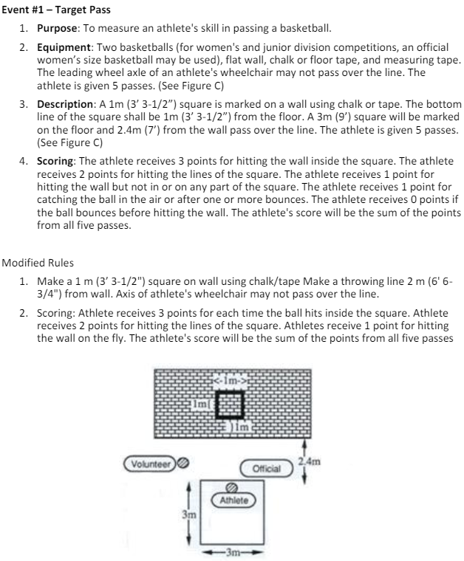
Individual Skills Competition
Target Pass

Slide 22
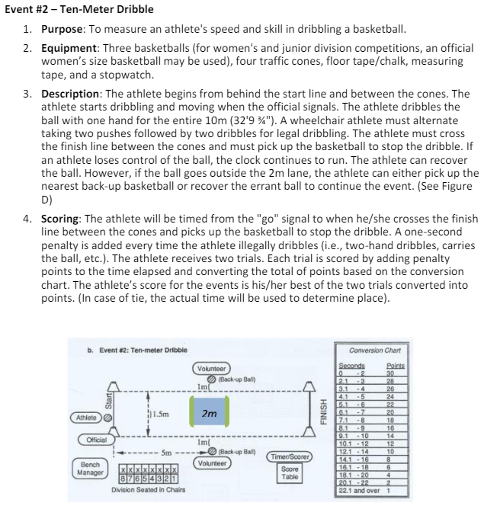
Individual Skills Competition
10 Meter Dribble

Slide 23
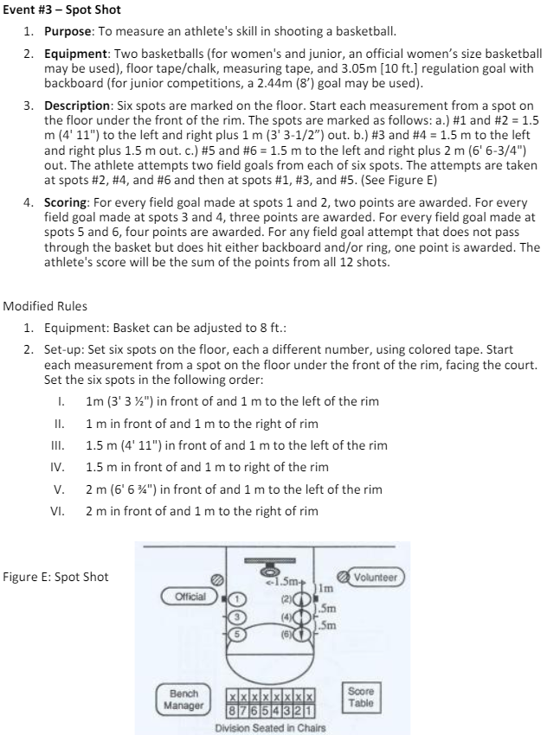
Individual Skills Competition
Spot Shot

Slide 24
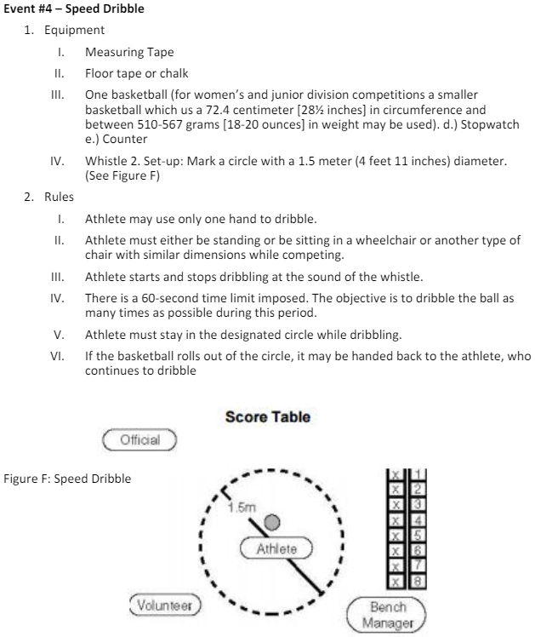
Individual Skills Competition
Speed Dribble

Slide 25
Thank you!

