Slide 1
Basketball Official Rules

Slide 2
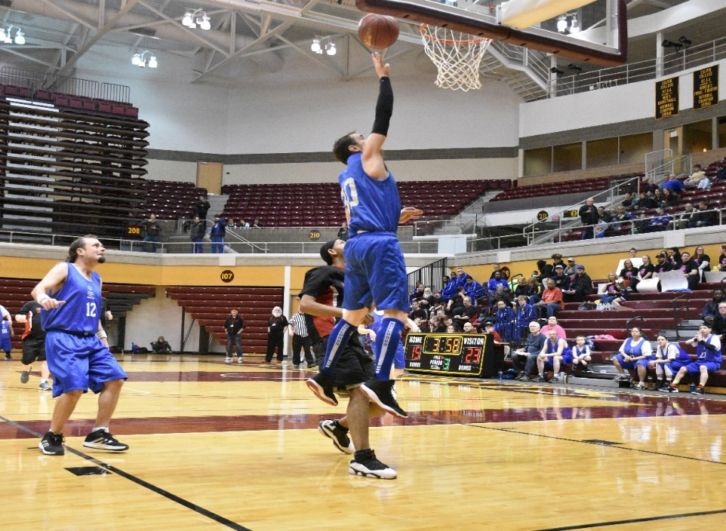
A picture paints a thousand words
“Let me win, but if I cannot win, let me be brave in the attempt.”
“Let me win, but if I cannot win, let me be brave in the attempt.”
Use the Picture and Caption format to create strong compelling slide like this. Don’t’t forget to caption where possible. For best effect crop the image to fill the placeholder.

Slide 3
The Basics
Sport season:
December – March
Culminating State Events:
` District Basketball
State Basketball Finals State
Unified Basketball Finals

Slide 4
Events Offered
Team Competition
Unified Team Competition
Individual Skills Level 1 & 2
3 on 3 Competition – Contact the State Office for 3 on 3 rules

Slide 5
Uniform Guidelines and Equipment
Uniforms consist of a jersey, shorts, and sport shoes.
All team members must have identical uniforms in color and design.
Numbers must appear on the front and the back of each athlete's jersey
For Unified teams athletes should have even numbers on jerseys and partners should have odd numbers.

Slide 6
Uniform Guideline and Equipment Cont.
Hats, bandanas, du-rags, jewelry, and denim may not be worn during games or practice. Headbands, wristbands, and arm sleeves are acceptable. Headwear for religious or medical reasons are acceptable but must be on documented with the state office prior to the event.
Traditional basketball shoes should be worn.

Slide 7
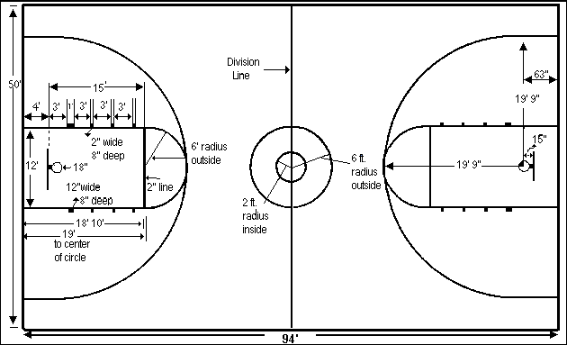
Equipment
For male competition for athletes 12 years and over, a size 7, 29.5 inch, basketball should be used. A smaller size 6, 28.5 inch, basketball should be used for all female competition for athletes 12 years and over. A smaller size 5, 27.5 inch, basketball should be used for competition for all athletes (male and female) under 12 years of age.

Slide 8
General Rules

Slide 9
General Rule Cont.
5 Individual Fouls will result in a disqualification from the game.
7 Team Fouls will result in 1 and 1 bonus (1 Free Throw, if made 2)
10 Team Fouls will result in double bonus (2 Free Throws).

Slide 10
Unified Basketball Rules

Slide 11
Unified Basketball Rules
The roster shall contain an equal number of traditional athletes and unified partners; equal means at least 4 traditional athletes and 3 unified partners.
Unified Partners are athletes and should not be involved in coaching. Assistant Coaches may be on the team roster and play.

Slide 12
Individual Skill Contest

Slide 13
Event 1- Target Pass
A 1m (3’ 3-1/2”) square is marked on a wall using chalk or tape. The bottom line of the square shall be 1m (3’ 3-1/2”) from the floor. A 3m (9’) square will be marked on the floor and 2.4m (7’) from the wall pass over the line. The athlete is given 5 passes.
The athlete receives 3 points for hitting the wall inside the square. The athlete receives 2 points for hitting the lines of the square. The athlete receives 1 point for hitting the wall but not in or on any part of the square. The athlete receives 1 point for catching the ball in the air or after one or more bounces. The athlete receives 0 points if the ball bounces before hitting the wall.

Slide 14
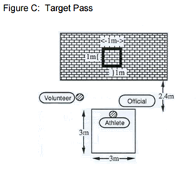
Event 1 Cont.

Slide 15
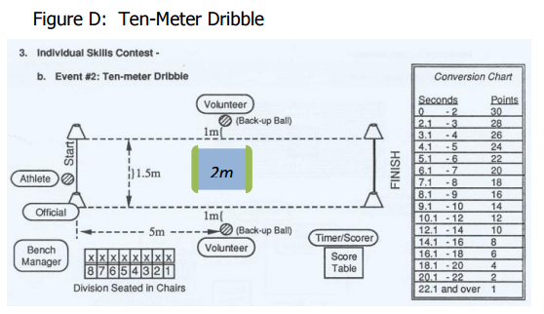
Event 2 – Ten meter Dribble
The athlete begins from behind the start line and between the cones. The athlete starts dribbling and moving when the official signals. The athlete dribbles the ball with one hand for the entire 10m (32'9 ¾").

Slide 16
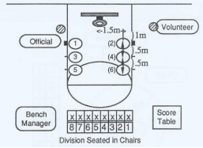
Event 3- Spot Shot
Six spots are marked on the floor. Start each measurement from a spot on the floor under the front of the rim. The athlete attempts two field goals from each of six spots.
For every field goal made at spots 1 and 2, two points are awarded. For every field goal made at spots 3 and 4, three points are awarded. For every field goal made at spots 5 and 6, four points are awarded

Slide 17
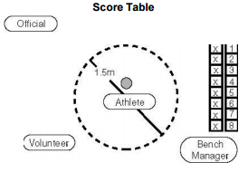
Event 4 – Speed Dribble
There is a 60-second time limit imposed. The objective is to dribble the ball as many times as possible during this period.
Athlete must stay in the designated circle while dribbling.
If the basketball rolls out of the circle, it may be handed back to the athlete, who continues to dribble

Slide 18
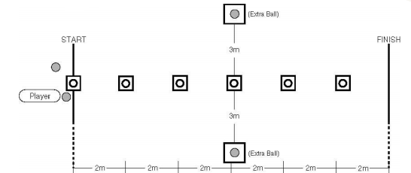
Event 1- 12 Meter Dribble Level 2
A player is instructed to dribble the ball while passing alternately to the right and to the left of six obstacles placed in a line, 2 meters apart, on a 12-meter course.
The player may start to the right or to the left of the first obstacle but must pass each obstacle alternately thereafter.
One point is awarded each time a cone is passed

Slide 19
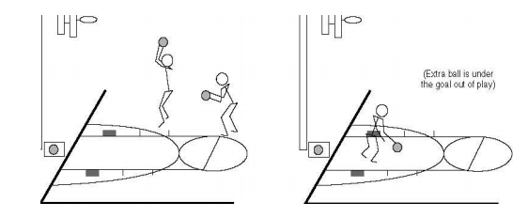
Event 2 – Perimeter Shooting Level 2
A player stands at the juncture of the free-throw line and lane, either to the left or right.
The player dribbles toward the goal and attempts a field goal of his/her choice outside the 2.75 meter arc (9 feet). This attempt must be taken anywhere outside the 2.75 meter arc marked off by a dotted line.
The player then rebounds the basketball and dribbles anywhere outside the arc before attempting another field goal.
The player shall make as many field goals as described above in one-minute

Slide 20
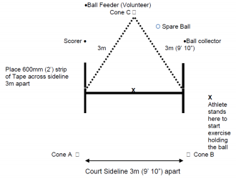
Event 3 – Catch and Pass Level 2
On go, the athlete passes the ball to the feeder and moves quickly to either cone A or B.
The player must catch the ball, then pass it back to the feeder from behind the end line. One or both feet can be grounded but both must be behind the line at the moment of passing the ball back to the feeder.
When athlete has passed the ball, they move quickly to the opposite cone to receive the next pass
The player continues passing, moving along the line and catching the ball for 60 seconds

Slide 21
Team Skills – 5 Person Teams
Each player on the first five-member team attempts to catch the ball and then throw it accurately to the player stationed at the next position.
The player in position #1 throws the ball to the player at position #2. The player at position #2 throws the ball to the player at position #3. This sequential throwing rotation continues until the ball reaches the player at position #5.
Athletes may pass the ball in any manner, but each player must pass in numerical sequence. A bounce pass is allowed provided that there is only one bounce.

Slide 22
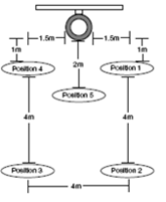
Team Skills – 5 Person Teams Cont.
If the ball is thrown past an athlete, the athlete or official may retrieve the ball. However, the athlete must return to his/her position before throwing the ball to the next player. A correct pass is defined as a ball that is thrown within reach of the receiving player.
When the ball reaches the player in position #5, he/she then attempts a field goal.

Slide 23
Thank you!

