Slide 1
Alpine Skiing

Slide 2
The Basics
Sport season:
December- February
Culminating State Events:
State Winter Games

Slide 3
Events Offered

Slide 4
Recommended Events

Slide 5
Uniform & Equipment

Slide 6
Uniform Guideline and Equipment

Slide 7
Course Layout

Slide 8
Course Layout

Slide 9
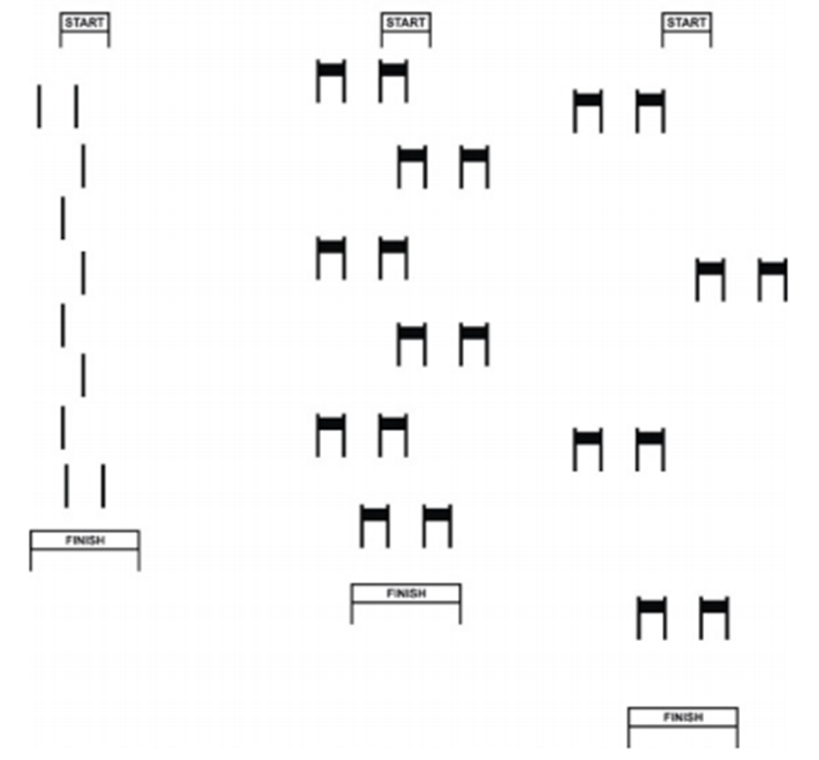
Course Layout Cont.

Slide 10
Course Layout Cont.

Slide 11
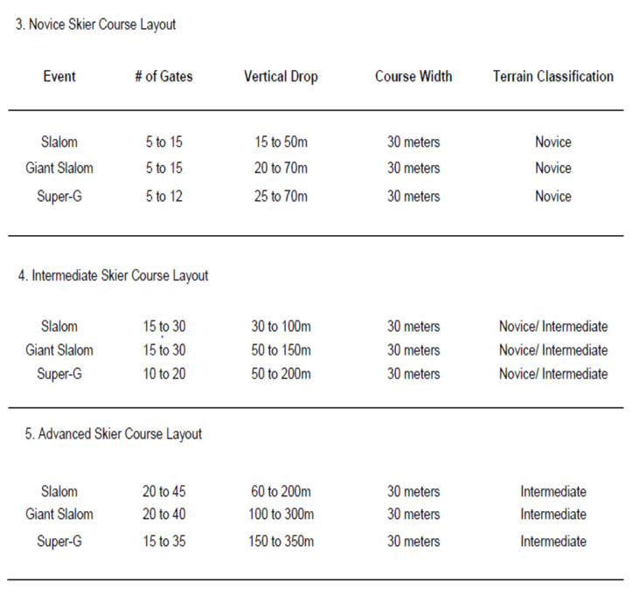
Course Layout Cont.

Slide 12
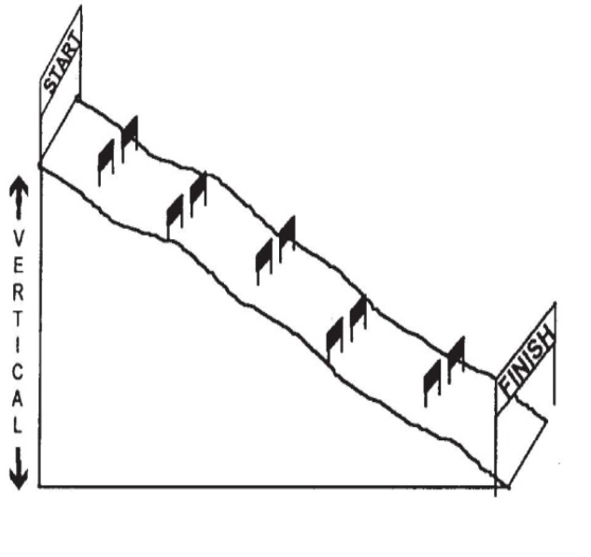
Course Layout Cont.

Slide 13
General Rules

Slide 14
General Rules
1. It is mandatory for all athletes to be on snow regardless of snow conditions prior to attending Winter Games.
2. Each athlete participating at the Games may only compete in one sport. Each athlete may participate in two events within the chosen sport. Special attention should be directed to recommended events for the athlete’s ability level. An athlete can be registered only within one level. For example, an athlete cannot be in Novice Slalom and Intermediate Super-G.
3. All athletes must be accompanied by an Intermediate ski coach for safety reasons. If athletes are found on the hill unsupervised or if they are a safety hazard to others, they will be escorted off the hill.
4. Coaches MAY NOT coach on the hill.

Slide 15
General Rules Cont.
5. A skier must have three (3) pieces of equipment on them when they cross the finish line. Example: Two skies and one pole.
6. Athletes with Down Syndrome who may compete in Alpine Skiing must have an x-ray prior to participation indicating that they don’t have atlantoaxial instability.
7. Start Areas
I. All start areas shall be flat, enabling the skiers to stand in the start in either a relaxed or ready position. Care should be given to provide easy access to this area as well as securing the area from the flow of general public skier traffic.

Slide 16
General Rules Cont.
8. One Minute Rule
I. During competition, if the competitor moves out of the general direction of the line of the course (fall, miss a gate, lose a ski, etc.) he/she shall have 1 minute from the time of the deviation to re-enter the course.
II. A competitor who fails to adhere to this 1-minute time limit, or receives assistance of any kind, shall be disqualified. Disqualification shall be determined on the gate card by the Gate Judge assigned to the gate closest to where the infraction occurred.
III. The Gate Judge is responsible for timing the 1 minute.
9. Start command
I. For all Special Olympics alpine events at each ability level, the start command shall be as follows: "5.4.3.2.1. GO!" The timer begins when the skier’s front boot crosses the start line, or when the electric timing wand is activated.

Slide 17
General Rules Cont.
3. Gate Line
I. The gate line in downhill and giant slalom, where a gate consists of two pairs of poles holding panels between them, is the imaginary shortest line between the two inner poles at ground (snow) level. The gate line in the slalom is the imaginary shortest line between the turning pole and the outside pole at ground (snow) level.
4. Correct Passage
I. A gate has been passed correctly when both the competitors’ ski tips and both feet have passed across the gate line.
II. If a competitor loses a ski without committing a fault (not by straddling a slalom pole), then the tip of the remaining ski and both feet must have passed the gate line.
III. The start and finish lines are the same as a gate line.
IV. In the event that a competitor removes a pole from its vertical position before both the competitors’ ski tips and both feet have passed the gate line, the ski tips and feet must pass the original gate line (marking in the snow).

Slide 18
General Rules Cont.
5. Divisioning
I. All coaches are reminded to review the sections in the Official Special Olympics Winter Sports Rules for clarifications of divisioning.
II. Novice, intermediate and advanced skiers shall have two runs on a modified giant slalom course of their ability level, with the fastest time used to determine their division for competition. If there is time, divisioning time trials may be conducted for each event.
III. In the first run of competition in each division, the fastest time starts first, the slowest last.
IV. If an athlete does not perform at the level they are registered for the games officials have the authority to move the athlete to their correct level.
V. If an athlete performs in an unsafe manner they will be disqualified

Slide 19
Event Modifications

Slide 20
Event Modifications

Slide 21
Unified Alpine Skiing Rules

Slide 22
Unified Alpine Skiing Rules

Slide 23
Thank you!

