Slide 1
Soccer Official Rules

Slide 2
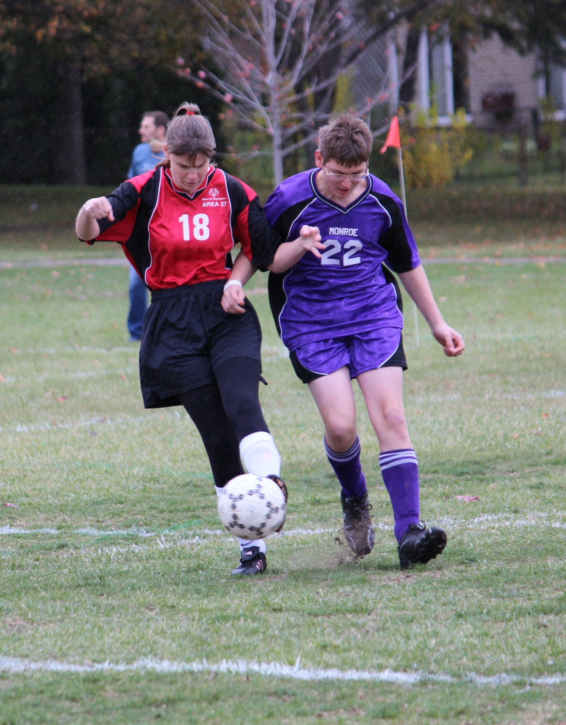
Events Offered
Team Competition
11-A-Side
7-A-Side
5-A-Side
Unified Team Competition
11-A-Side
7-A-Side
5-A-Side
Individual Skills Contest

Slide 3
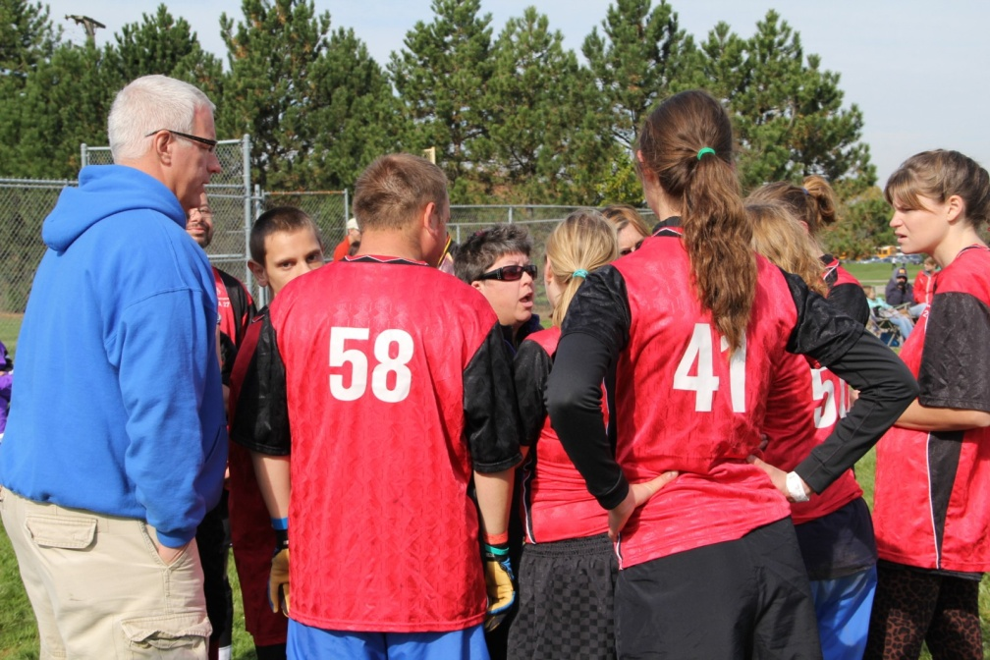
Federation Rules
Federation Internationale de Football Association (FIFA)
FIFA rules are followed except when in conflict with the Official Special Olympics Sports Rules for Football (Soccer)

Slide 4
Rosters
Roster Sizes
5/Side: Minimum of 6 players, maximum of 10
7/Side: Minimum of 8 players, maximum of 14
11/Side: Minimum of 12 players, maximum of 16
Matches must start with 5 players (5/Side), 7 players (7/Side) or 11 players (11/Side). Games may continue with less due to injury or Red Cards.
The next match must be started with the same number of players.

Slide 5
Rosters
Teams may register up to 3 athletes as alternates.
Unified teams may have up to 4 alternates: 2 Athletes and 2 Unified Partners.
Each coach must see to it that all athletes have frequent opportunities to participate.
For Unified Sports their must always be one more Athlete than Unified Partner on the field. Failure to follow this will result in an automatic forfeit.
5/Side: 3 Athletes, 2 Unified Partners
7/Side: 4 Athletes, 3 Unified Partners
11/Side: 6 Athletes, 2 Unified Partners
Either an Athlete or Unified Partner may play goalkeeper.
Unified Teams must have a certified, non-playing head coach.

Slide 6
Uniforms
Uniform consists of jersey, shorts or sweatpants, matching socks with shin guards, and shoes
Jerseys must be numbered on the front and on the back. Teams are encouraged to include a number on the front of the team short at the bottom of the right leg.
No sponsor logos may appear on uniforms.
Goalkeepers must wear colors which distinguish him/her from other players and referees
Shin guards must be completely covered by socks and made of a plastic or hard foam material.
Atheltic shoes or rubber sole cleats may be worn. Metal spikes are not allowed.

Slide 7
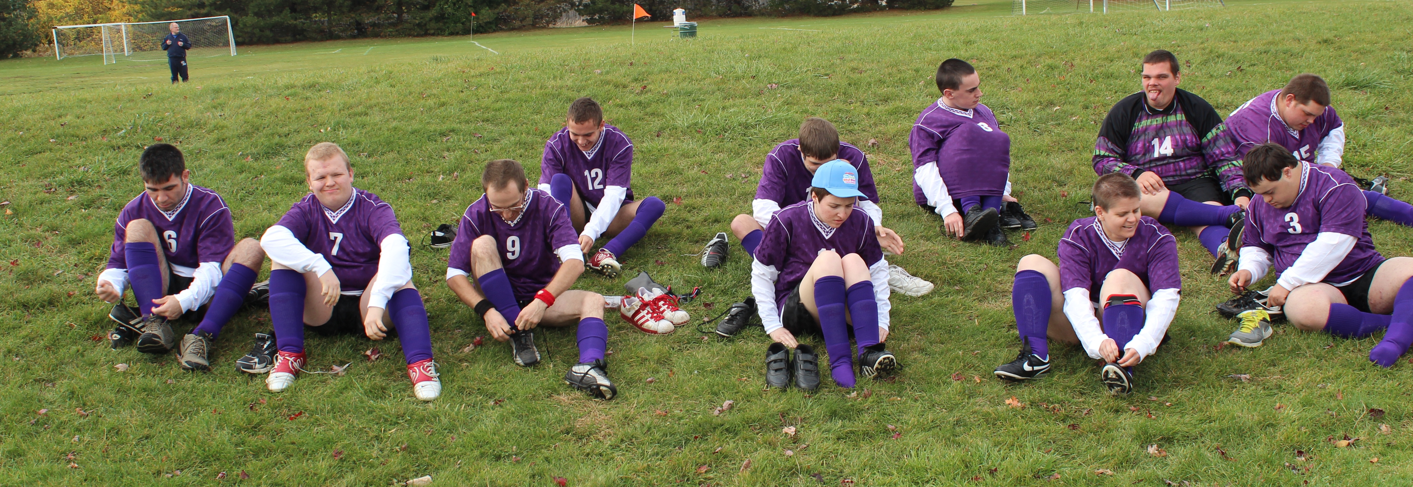
Uniforms
Jewelry is prohibited to be worn during competition as is denim.
All team uniforms must have the Special Olympics Logo adorned somewhere on the jersey.

Slide 8
Field & Equipment
Ball Size:
Juniors: Size 4 Ball
Seniors: Size 5 Ball

Slide 9
Field & Equipment
5/Side Field:
Field Size: Can range from a maximum of 50 meters long by 35 meters wide to a minimum of 40 meters long by 30 meters wide.
Goals Size: 4M x 2M (Roughly 9 ft x 6 ft)
Goal Area: 8M x 12M
Penalty Mark: 7M

Slide 10
Field & Equipment
7/Side Field:
Field Size: Can range from a maximum of 70 meters long by 50 meters wide to a minimum of 50 meters long by 35 meters wide.
Goals Size: 5M x 2M (Roughly 16 ft x 6 ft)
Goal Area: 8M x 20M
Penalty Mark: 7M

Slide 11
Field & Equipment
11/Side Field:
Field Size: Can range from a maximum of 120 meters long by 90 meters wide to a minimum of 90 meters long by 45 meters wide.
Goals Size: 7.32M x 2.44M (Roughly 24 ft x 8 ft)
Goal Area: 16.5M x 40.2M (roughly 44 yd x 18 yd)
Penalty Mark: 11M

Slide 12
5/Side Rules
Match Length:
Two 15-Minute halves
5-Minute halftime
Tie Match: If during tournament play a match is tied at the end of regulation the match will proceed directly to penalty kicks.
No extra time or injury time is added to the end of matches.

Slide 13
5/Side Rules
Any ball off the defense and over the goal line (end line) results in a corner kick for the offense.
Any ball off the offense and over the goal line (end line) results in a goalkeeper throw-in.
While throwing the ball in play the goalkeeper must not leave the goal area.
The throw must leave the goal area and not be touched by another player within this area.
Penalty for this is a re-throw by the goalkeeper.
The throw must bounce, or be touched, before crossing the midfield line.
Penalty for this is a free kick from mid-field awarded to the defense.

Slide 14
5/Side Rules
Goalkeepers may not catch a ball kicked to them by their teammates, they must play this ball with their feet.
All balls over the sideline shall result in a kick-in.
There is no offsides.
Substitute players and coaches are to remain seated in the bench area at all times unless making a substitution.
Coaches are not allowed around the perimeter of the field; Must stay in the coaches' box.
Only one coach may stand and communicate with his/her players

Slide 15
7/Side Rules
Match Length:
Two 17-Minute halves
5-Minute halftime
Tie Match: If during tournament play a match is tied at the end of regulation the match will proceed directly to penalty kicks.
No extra time or injury time is added to the end of matches.

Slide 16
7/Side Rules
Any ball off the defense and over the goal line (end line) results in a corner kick for the offense.
Any ball off the offense and over the goal line (end line) results in a goalkeeper throw-in.
While throwing the ball in play the goalkeeper must not leave the goal area.
The throw must leave the goal area and not be touched by another player within this area.
Penalty for this is a re-throw by the goalkeeper.
The throw must bounce, or be touched, before crossing the midfield line.
Penalty for this is a free kick from mid-field awarded to the defense.

Slide 17
7/Side Rules
Goalkeepers may not catch a ball kicked to them by their teammates, they must play this ball with their feet.
All balls over the sideline shall result in a kick-in.
There is no offsides.
Substitute players and coaches are to remain seated in the bench area at all times unless making a substitution.
Coaches are not allowed around the perimeter of the field; Must stay in the coaches' box.
Only one coach may stand and communicate with his/her players

Slide 18
11/Side Rules
Match Length:
Two 30-Minute halves
10-Minute halftime
Tie Match: If during tournament play a match is tied at the end of regulation the match will proceed to extra time.
Two extra 5-minute periods will be played, with no break between. This will be ‘sudden death’ with the first goal winning the match.
If the match is still tied, the teams will move to penalty kicks.
No injury time is added to the end of matches.

Slide 19
11/Side Rules
Any ball off the defense and over the goal line (end line) results in a corner kick for the offense.
Any ball off the offense and over the goal line (end line) results in a goal kick for the goalkeeper.
Goalkeepers may not catch a ball kicked to them by their teammates, they must play this ball with their feet.
All balls over the sideline shall result in a throw-in.
During a throw in the athlete must throw the ball in according to the rules – over the head with feet not leaving the ground.

Slide 20
11/Side Rules
Substitute players and coaches are to remain seated in the bench area at all times unless making a substitution.
Coaches are not allowed around the perimeter of the field; Must stay in the coaches' box.
Only one coach may stand and communicate with his/her players
Teams are allowed to use all substitutions named on the roster.
Athletes may not re-enter the game after being substituted out.

Slide 21
Penalty Kicks
If a match is tied at the end of regulation play a penalty kicks will be taken.
Five penalty kicks will be taken by each team with the team scoring the most goals declared the winner.
The referee chooses the goal and tosses a coin the winning captain decides the first or second kick.
Five players are selected from each team.
In Unified matches, kicks must be alternated between athletes and Unified Partners, with an athlete taking the first kick.
Kicks are made at the penalty mark.
The kicks are taken alternately by the teams.
The highest score after five penalty kicks is declared the winner.

Slide 22
Penalty Kicks
Only players on the field at the end of regulation may be involved in the initial penalty kick order of 5 players, this includes the goalkeeper.
Goalkeepers may be one of the first 5 players to take a kick for each team.
If the game is still tied after the initial 5 kicks, individual alternate penalty kicks will be taken until one team scores and the other does not, and a winner is declared.
Players may not take a second kick until the all the members of the team have taken their first kick

Slide 23
Yellow/Red Cards
Yellow cards are handed out by the official for fouls and indicate a caution given to a player regarding their conduct, or dangerous plays.
Two yellow cards equal one red card.
Red cards are handed out by the official for fouls. These indicate a serious offence and result in a player being permanently suspended from the game.
Players may not re-enter the game after receiving a red card, or two yellow cards.

Slide 24
Yellow/Red Cards
In 5/Side and 7/Side matches If a player is expelled from the game, they may not re-enter the game. His/her team must play a player down for two minutes.
Keeping check of the two minutes shall be the task of the referee and the timing is up to his sole discretion.
The player who enters the game as a substitute after two minutes may only do so with the consent of the referee and when the ball is out of bounds.
In 11/Side matches if a player is expelled from the game, they may not re-enter the game. His/her team must play a player down for the rest of the game.
Match will re-start on the referee’s whistle after both a yellow and red card.

Slide 25
Types of Kicks
Free Kick
Direct Free Kick: May score a goal from a direct kick.
Indirect Free Kick: Must be touched by an offensive or defensive player before entering the goal.
Penalty Kick
A Direct Free Kick awarded for a foul occurring in the penalty area.

Slide 26
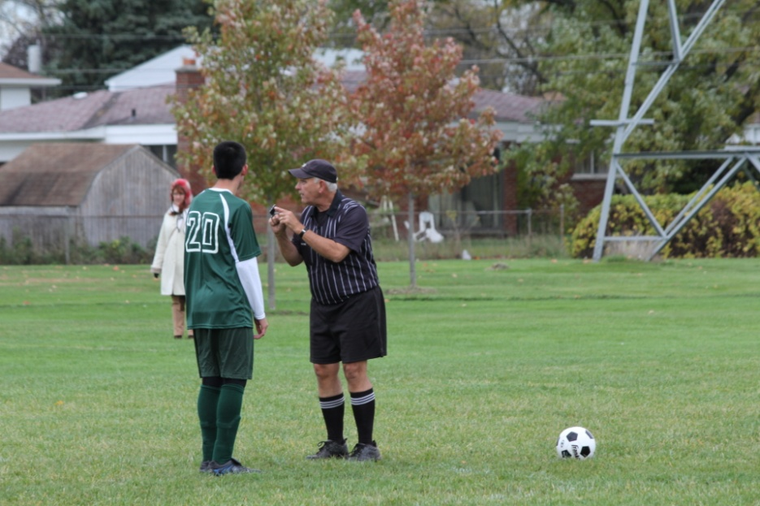
Major Fouls
Fouls result in an indirect free kick, direct free kick or penalty kick
Kicking another person
Tripping
Jumping
Charging
Striking
Holding
Pushing
Directing or stopping the ball using hands or arms

Slide 27
Individual Skills Contest
The individual Skills Contest is designed for lower ability, or new, athletes who have not yet developed the skills necessary to participate meaningfully in team competitions, and atheltes who use a wheelchair. Athlete may not be assisted by coaches and modifications may be made for athletes who have visual or hearing impairments.
Events Include:
Dribbling
Shooting
Run & Kick

Slide 28
Individual Skills Contest Dribbling

Slide 29
Individual Skills Contest Shooting

Slide 30
Individual Skills Contest Run & Kick

Slide 31
Soccer Terms
Control: What a player tries to achieve when the ball comes to him/her
Dribbling: A player who is running with the ball while kicking it
Kickoff: How the game is started
Offside: An infraction of the rules in which an offensive player does not have at least two defensemen between him/her and the goal line when the ball is played forward
Goal Area: The rectangular area in front of each goal from which all goal kicks are taken
Penalty Area: The area marked out in front of the goal within which the goalkeeper can use his/her hands
Screening: A technique where a controlling player keeps his/her body between the ball and a marking opponent
Tackle: To take the ball away from a dribbler using the feet
Trapping: To receive the ball in a controlled manner with any part of the body except hands or arms
Volley: Kicking the ball in or out of midair

